Slide 1
Kentucky’s Remaining Coal Resources
Jerry Weisenfluh

Slide 2
Kentucky’s Coalfields

Slide 3
Stratigraphy of Eastern Kentucky Coal Resources
Limited Extent
Poor Development
Poor Quality
Mixed Surface and Underground
Princess Coals
Diminishing Extent
Maximum Development
Mixed Quality
Mainly Surface, Some Underground
Hazard Coals
Fire Clay
Large Extent
Increasing Development
High Quality
Mainly Underground, Some Surface
Amburgy
Upper Elkhorn 1, 2 & 3
Lower Elkhorn
This Presentation
Clintwood
Glamorgan
Maximum Extent
Minimal Development
High Quality
Underground Access
Hagy
Splash Dam
Not to scale

Slide 4
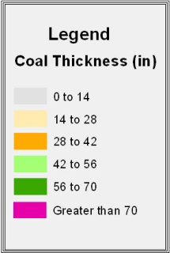
Tabulated Resources

Slide 5
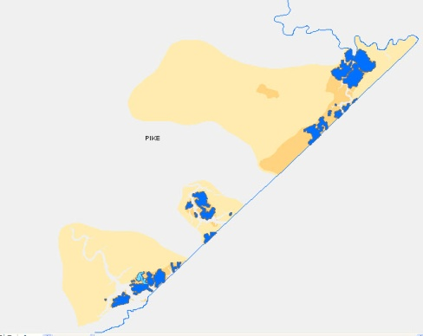
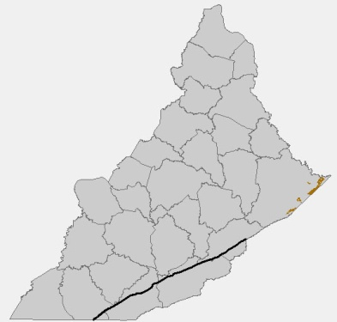
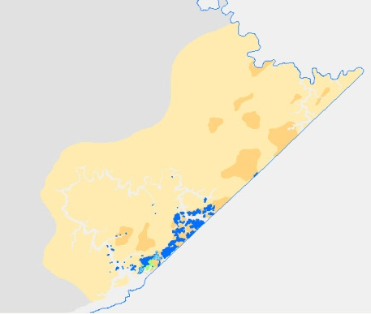
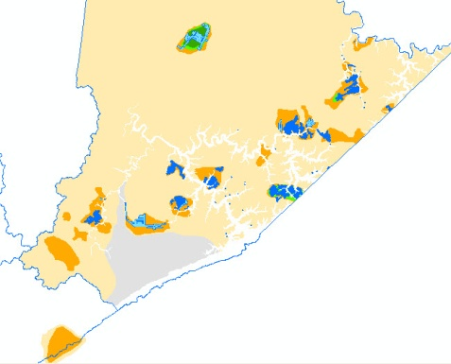
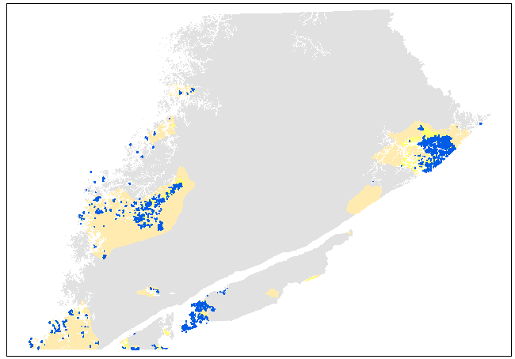
Splash Dam
Hagy
Clintwood
Remaining
39 million short tons
Remaining
79 million short tons
Remaining
141 million short tons
Remaining
275 million short tons
Glamorgan

Slide 6
Stratigraphy of Eastern Kentucky Coal Resources
Limited Extent
Poor Development
Poor Quality
Mixed Surface and Underground
Princess Coals
Diminishing Extent
Maximum Development
Mixed Quality
Mainly Surface, Some Underground
Hazard Coals
Fire Clay
Large Extent
Increasing Development
High Quality
Mainly Underground, Some Surface
Amburgy
Upper Elkhorn 1, 2 & 3
Lower Elkhorn
Clintwood
Glamorgan
Maximum Extent
Minimal Development
High Quality
Underground Access
534 million short tons
Hagy
Splash Dam

Slide 7
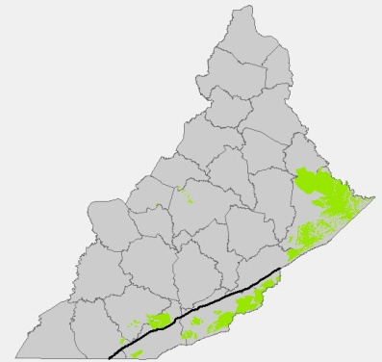
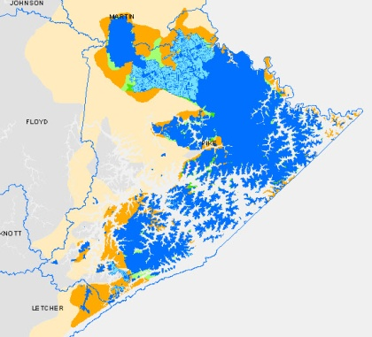
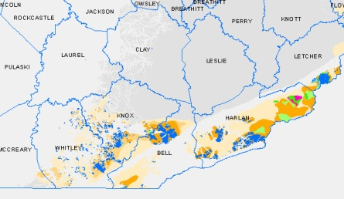
Lower Elkhorn
Upper Cumberland
Imboden/Path Fork
Southwest
Blue Gem
Remaining
1,050 million short tons

Slide 8
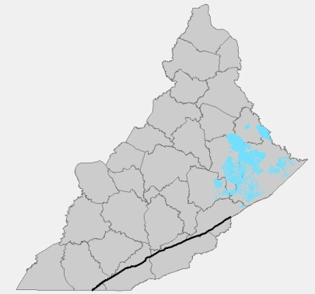
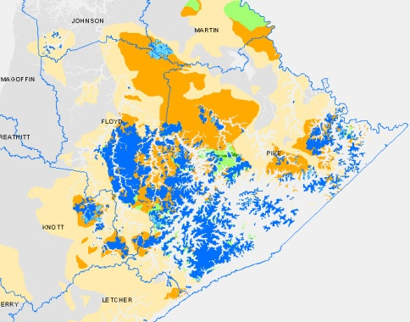
Upper Elkhorn No. 2
Remaining
915 million short tons

Slide 9
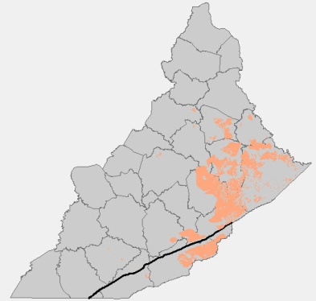
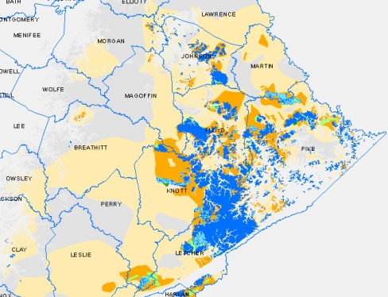
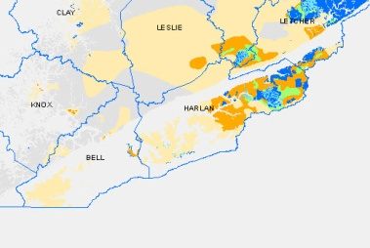
Upper Elkhorn No. 3
Upper Cumberland
Kellioka
Remaining
1,812 million short tons

Slide 10
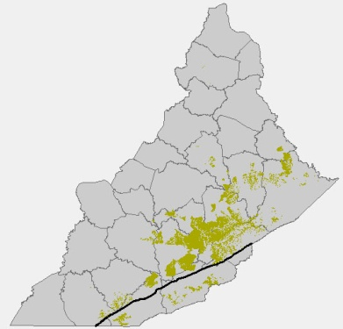
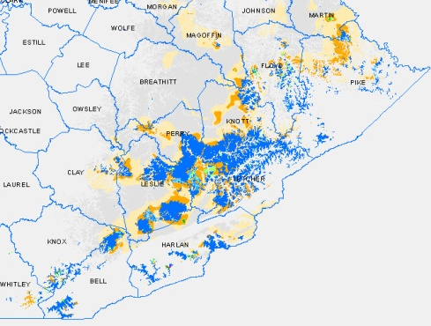
Fire Clay
Remaining
1,057 million short tons

Slide 11
Stratigraphy of Eastern Kentucky Coal Resources
Limited Extent
Poor Development
Poor Quality
Mixed Surface and Underground
Princess Coals
Diminishing Extent
Maximum Development
Mixed Quality
Mainly Surface, Some Underground
Hazard Coals
Fire Clay
Large Extent
Increasing Development
High Quality
Mainly Underground, Some Surface
Amburgy
6.3 billion short tons
Upper Elkhorn 1, 2 & 3
Lower Elkhorn
Clintwood
Glamorgan
Maximum Extent
Minimal Development
High Quality
Underground Access
534 million short tons
Hagy
Splash Dam

Slide 12
EKY Conclusions
At least 7 billion short tons
Lower coals are high quality, but limited in distribution and tonnage
42 in and greater coal largely depleted
Much of remaining coal is below drainage

Slide 13
Western Kentucky Original Coal Resource Distribution
6 principle beds in WKY
3 with significant production

Slide 14
Springfield – Western Kentucky No.9
6.7 billion tons
remaining

Slide 15
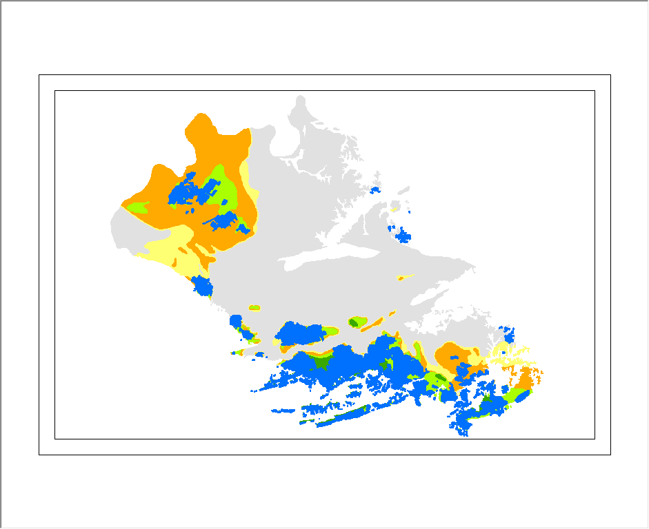
Herrin– Western Kentucky No.11
2.3 billion tons
remaining

Slide 16
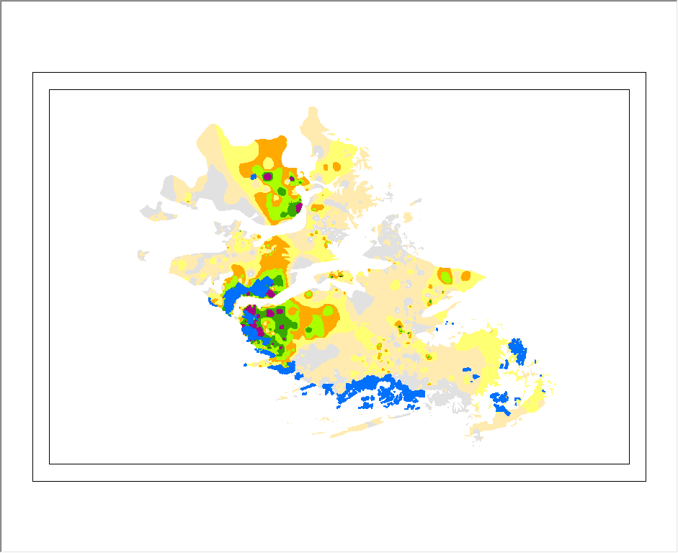
Baker – Western Kentucky No.13
2.5 billion tons
remaining

Slide 17
Summary
At least 7 billion tons of eastern Kentucky coal
Difficult and expensive to mine
Lower demand
Access to metallurgical/specialty markets
At least 11.5 billion tons of western Kentucky coal
Greater demand for lower-quality coal
Mining at greater depths challenging

