Slide 1
Renewable Energy in Kentucky
Kenya Stump
Energy and Environment Cabinet
Kenya.stump@ky.gov

Slide 2
Current State of Renewable energy

Slide 3
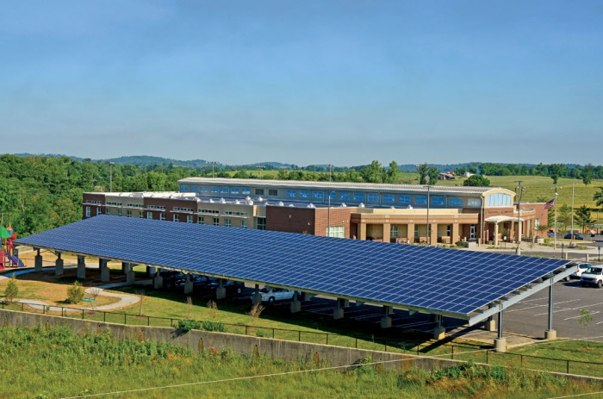
Fast Facts
Around 4% of net electricity generation in Kentucky comes from renewable sources.
Hydroelectricity accounts for almost all of RE generation.
Geothermal, wood, and solar are showing strong growth rates for residential energy demands.
Distributed generation sources have grown to almost 20 MW statewide, including the nation’s first net zero school in Warren County.

Slide 4
Hydroelectric Facilities
Plant Name | Capacity | Status
Barkley Dam | 130 MW | Operational
Kentucky Dam | 184 MW | Operational
Dix Dam | 24 MW | Operational
Ohio Falls | 80 MW | Operational
Wolf Creek | 270 MW | Operational
Mother Ann Lee | 2 MW | Operational
Cannelton | 88 MW | Operational
Meldahl | 105 MW | Operational
Smithland | 76 MW | Under Construction
Weisenberger Mill | 50 kW | Operational

Slide 5
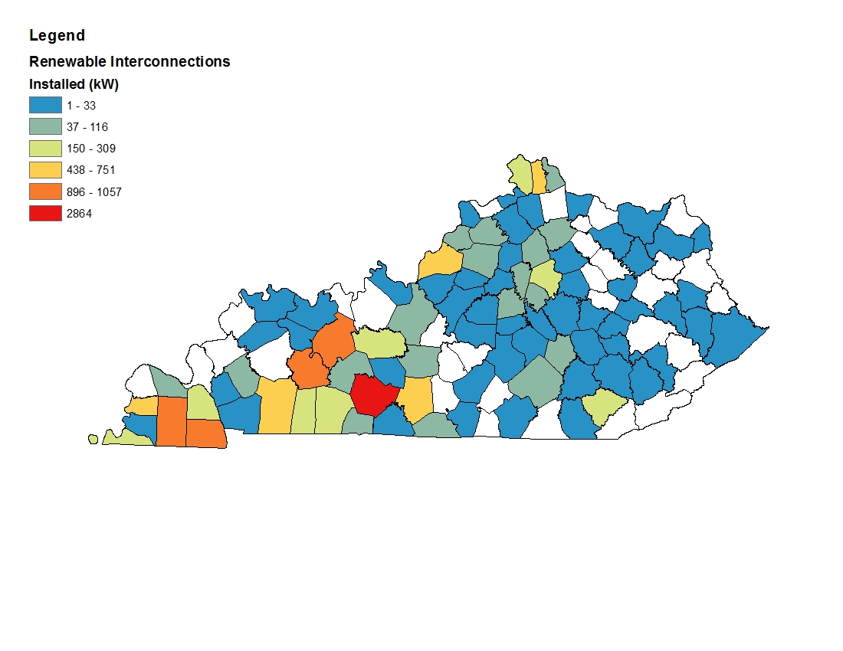
Interconnected (Distributed) Renewable Energy Resources
Notes:
Does not include CHP units except for Purdue

Slide 8
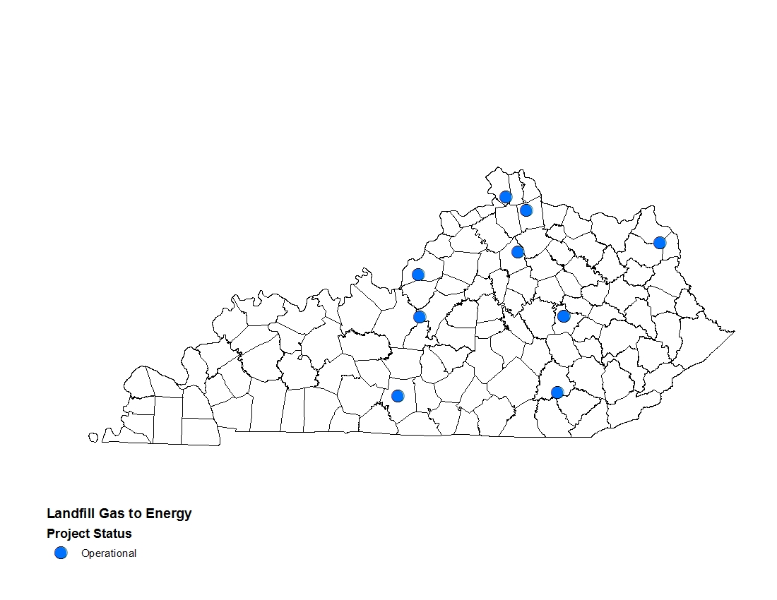
Landfill Gas to Energy Projects

Slide 9
Biomass\Biogas Examples
Anaerobic Digestion
Mac Farms (Campbellsville, KY)
Purdue (Cromwell, KY)
Biomass
Young Manufacturing (Beaver Dam, KY)
Cox Interior (Campbellsville, KY)
Domtar (Hawesville, KY)

Slide 10
Renewable energy potential

Slide 11
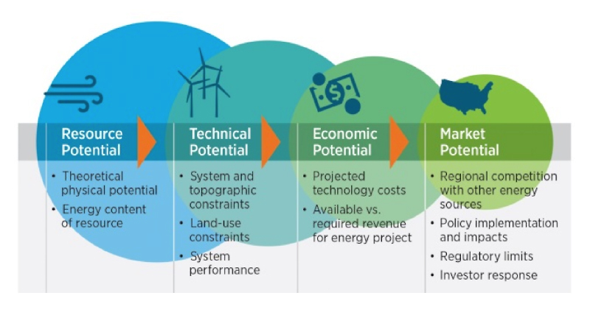
What Kind of Potential?
http://www.nrel.gov/gis/re_econ_potential.html

Slide 12
Resource Potential

Slide 13
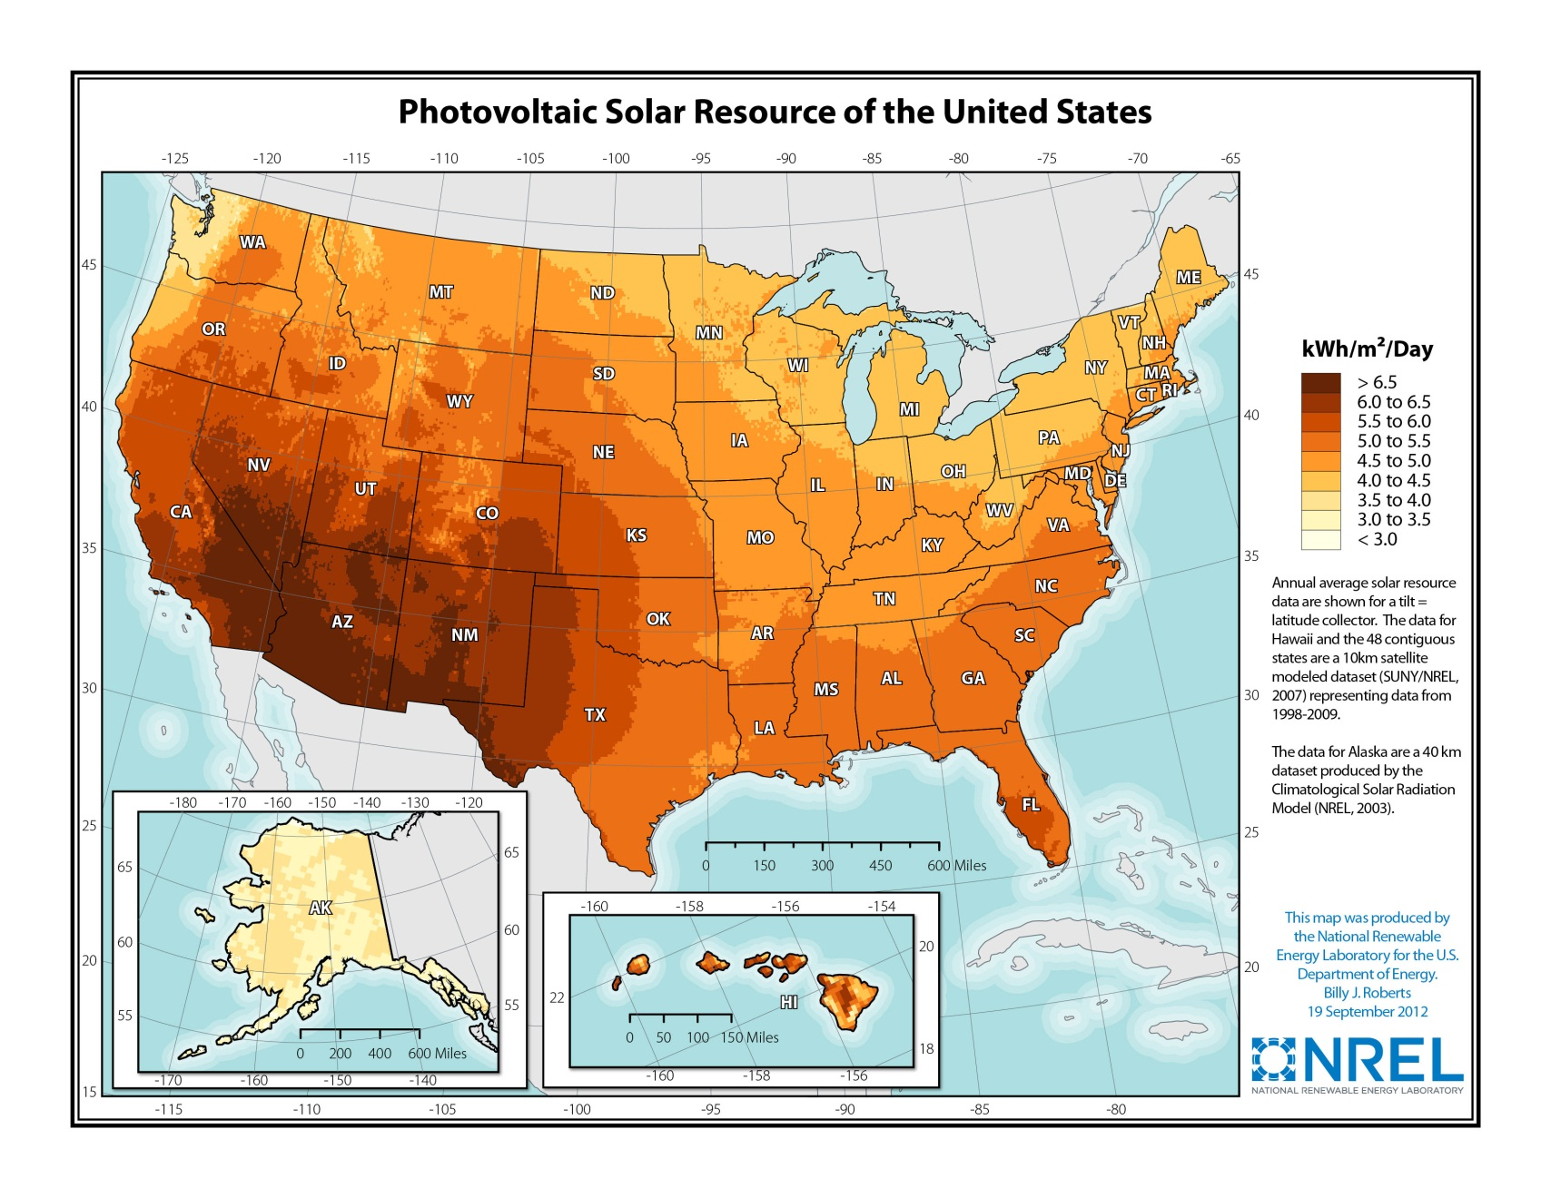

Slide 14
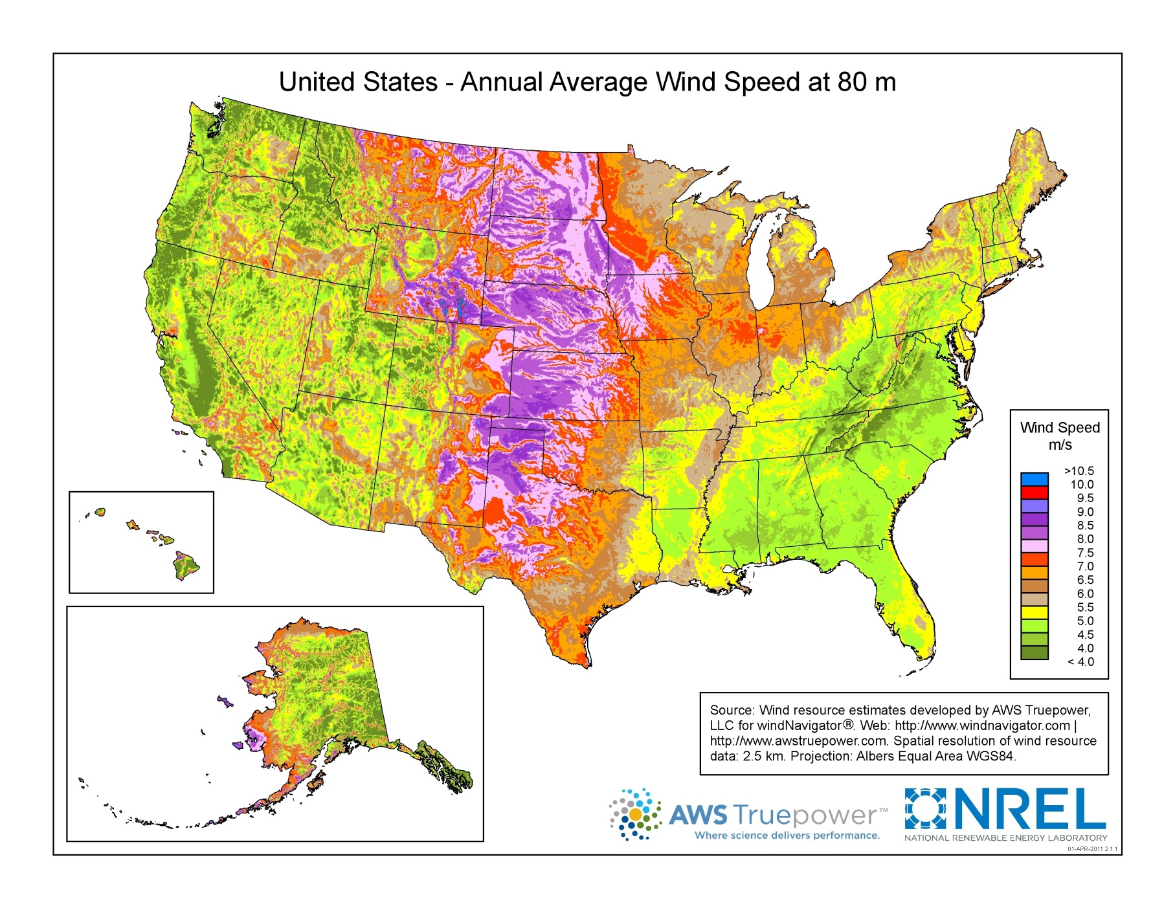

Slide 15
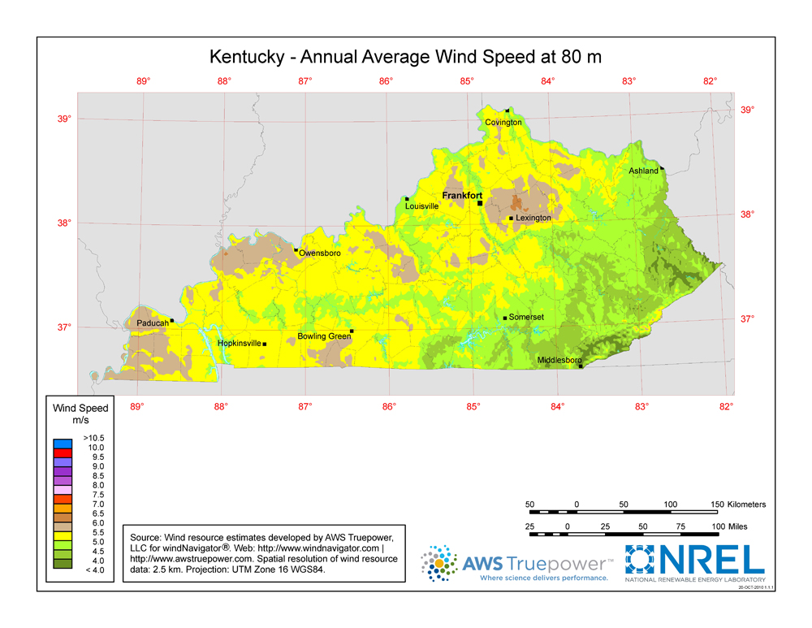

Slide 16
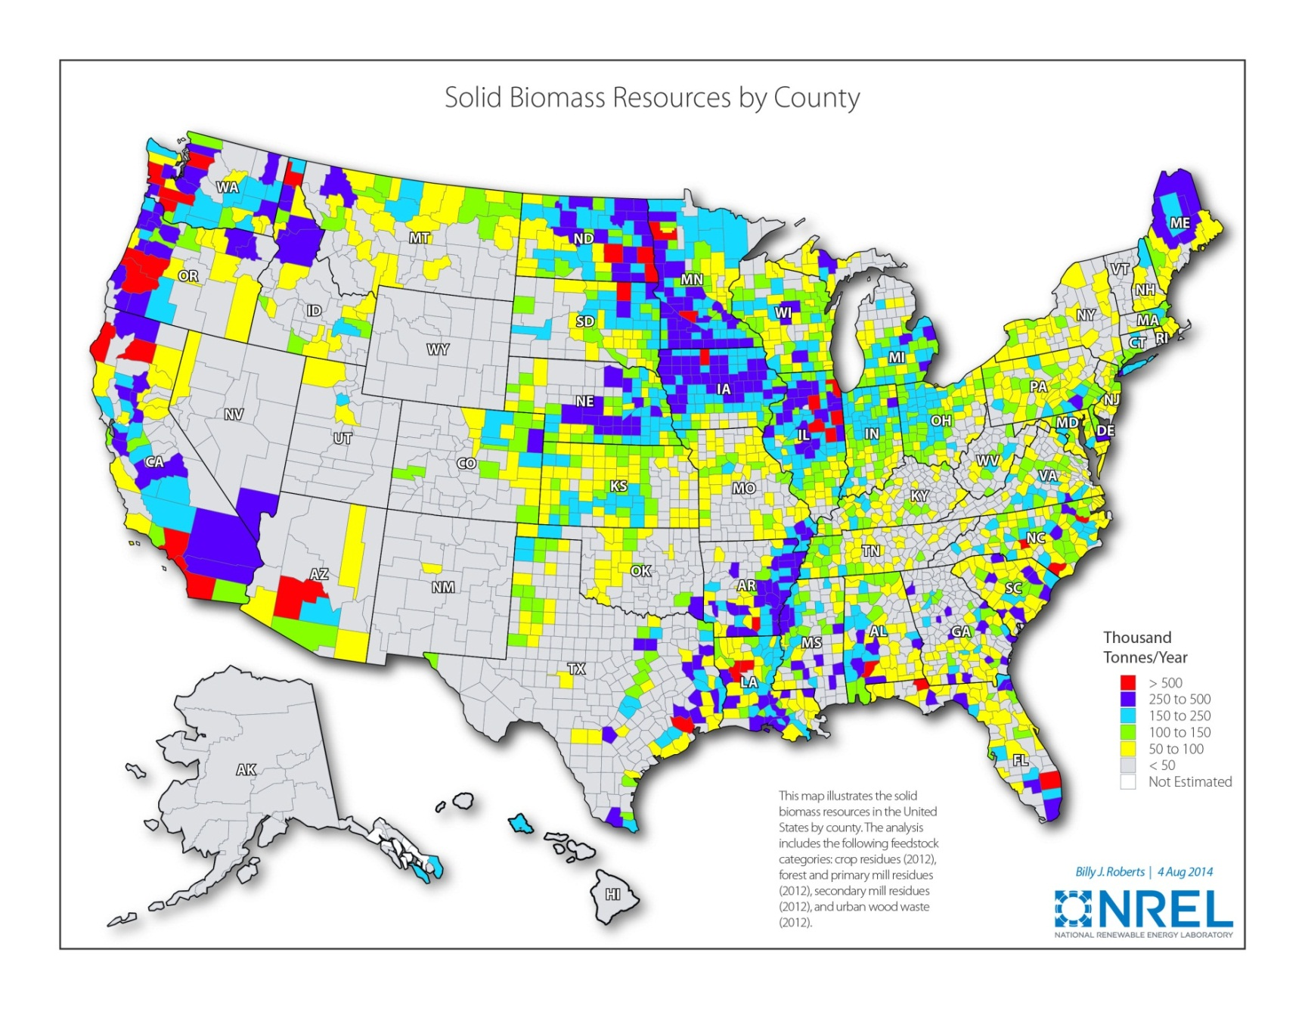

Slide 17
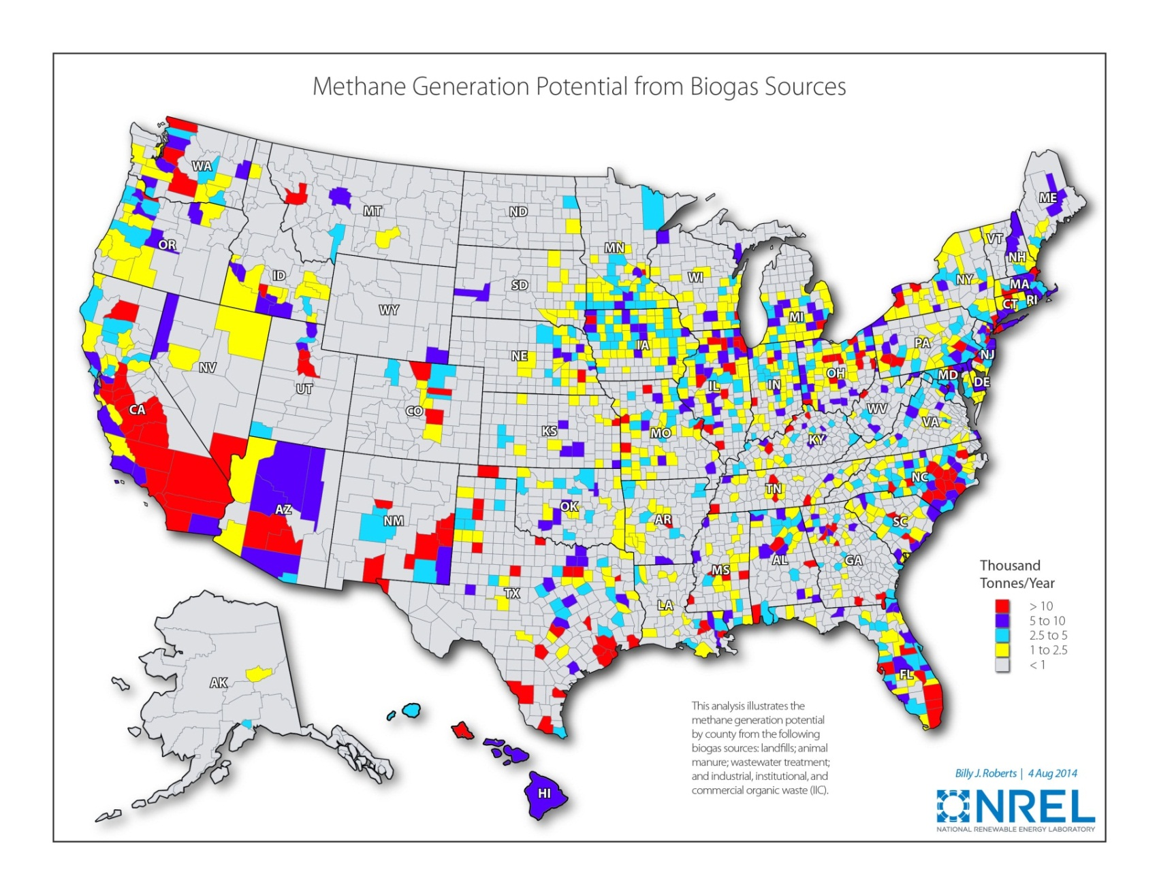

Slide 18
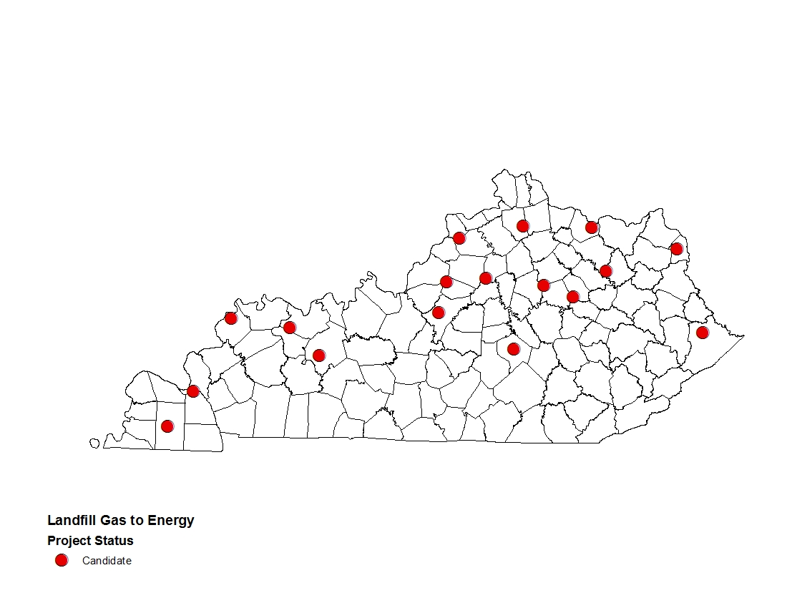
Landfill Gas to Energy Potential

Slide 19
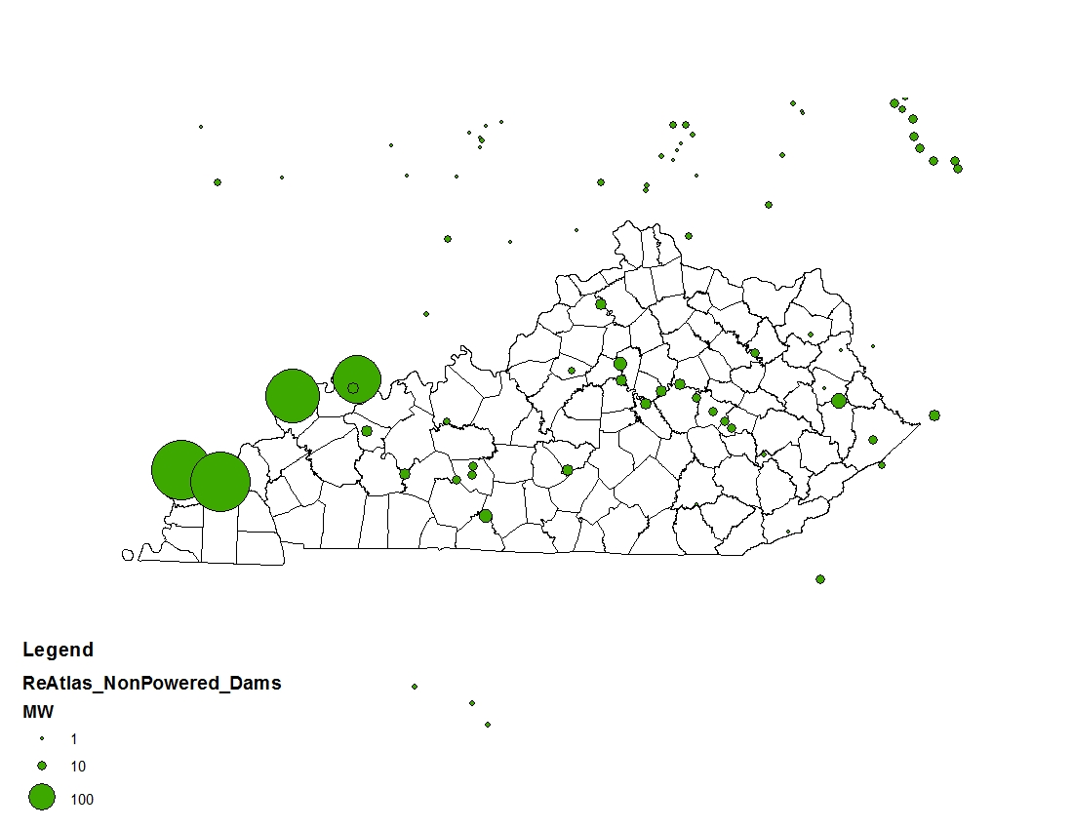
Non-Powered Dams
http://www1.eere.energy.gov/water/pdfs/npd_report.pdf

Slide 20
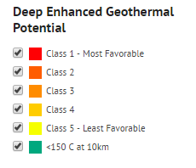
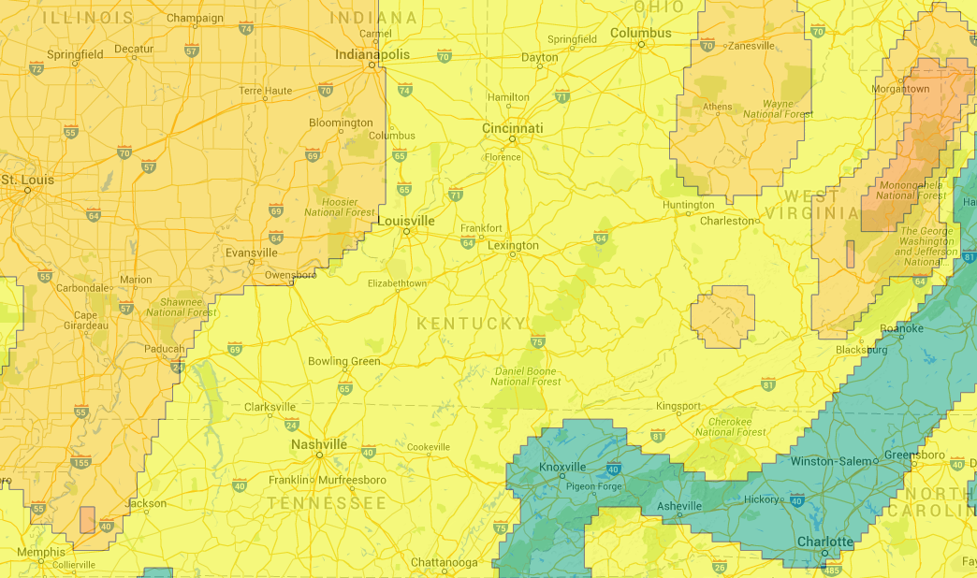
Enhanced Geothermal Potential

Slide 21
Technical Potential

Slide 22
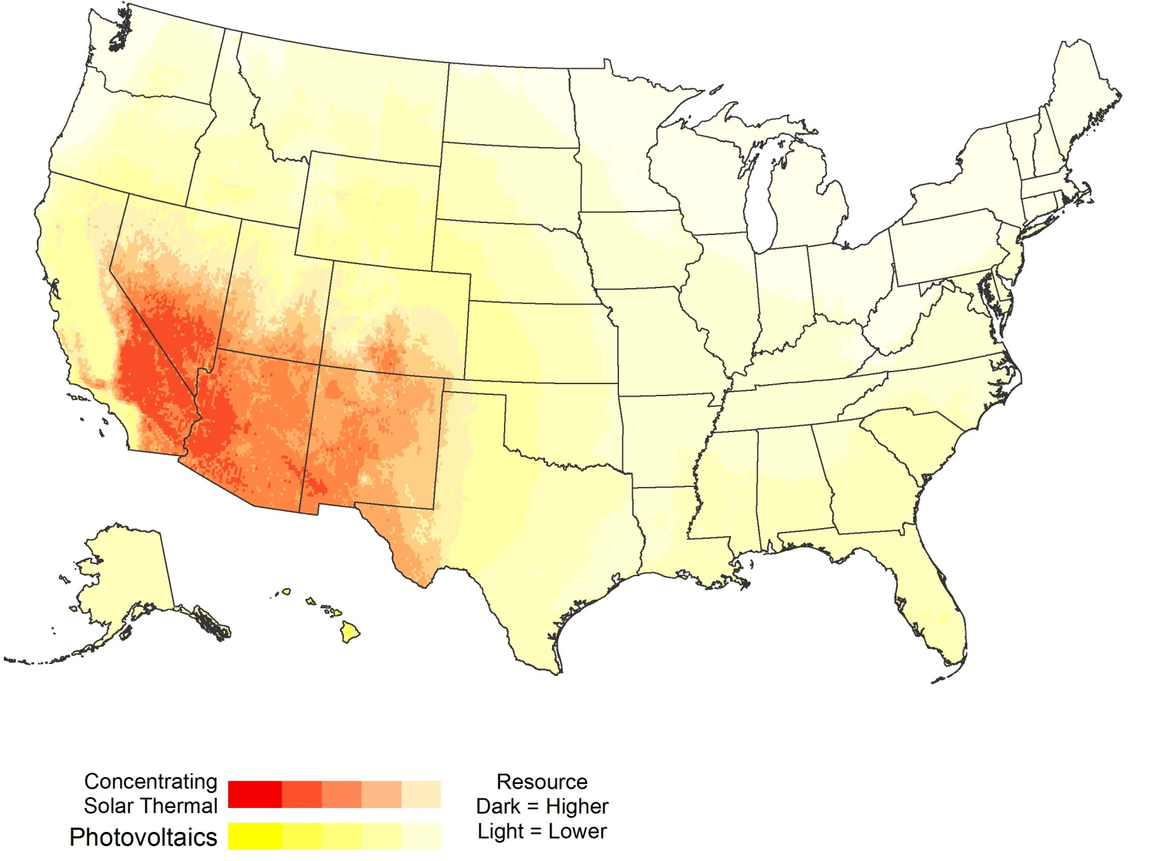
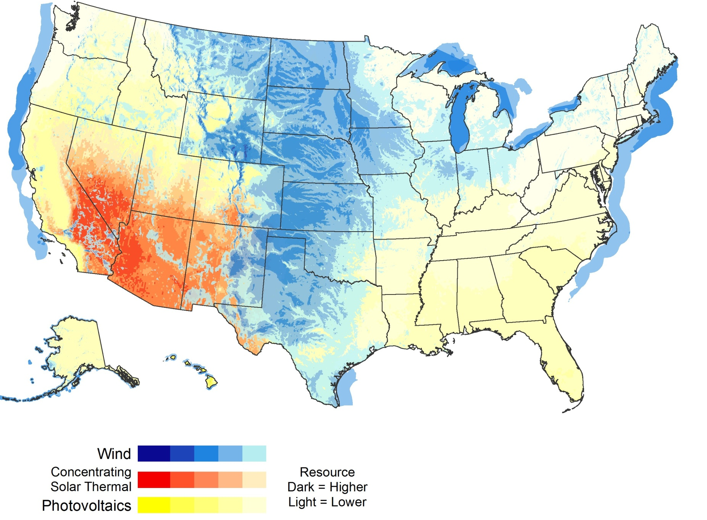
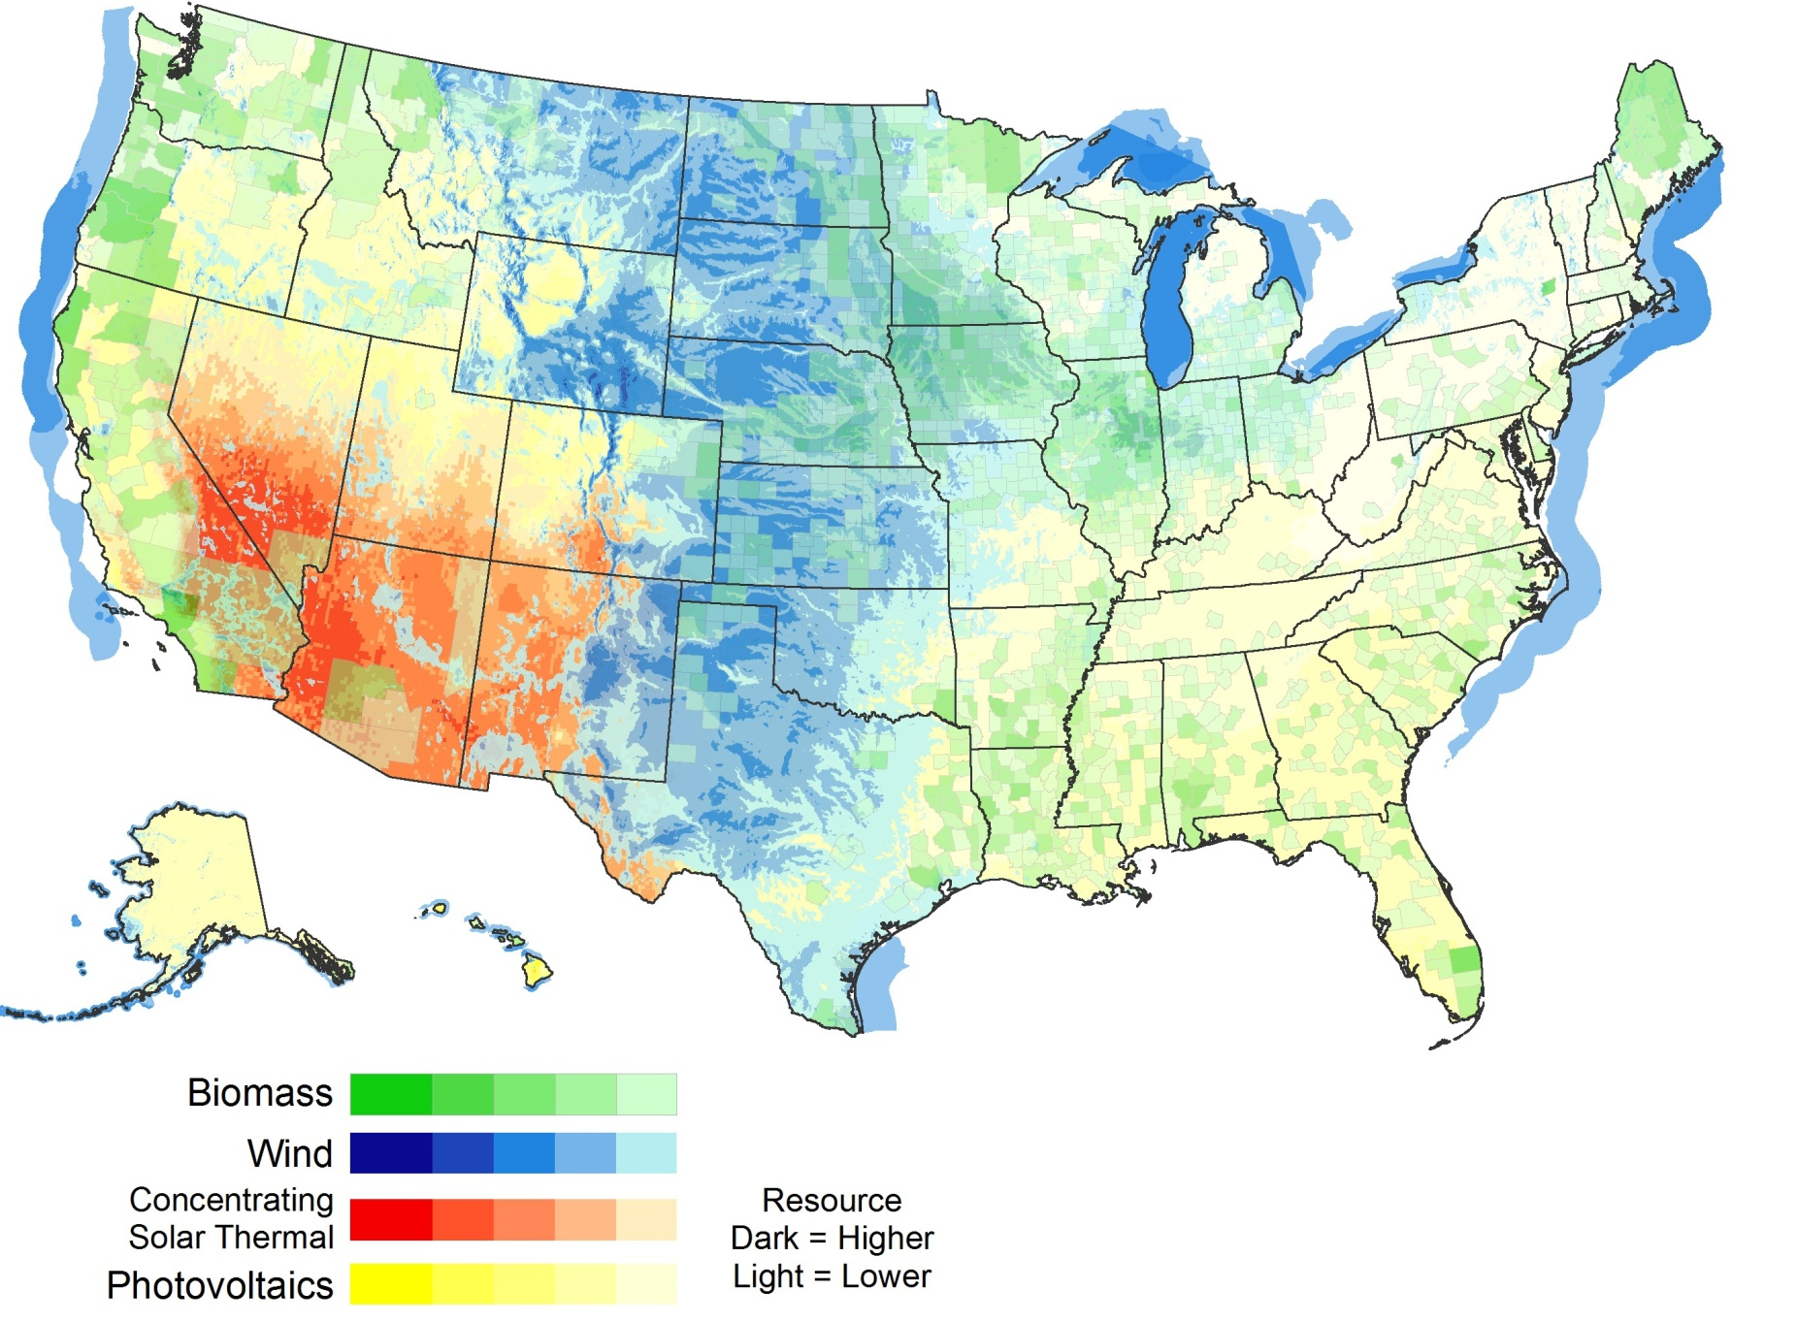
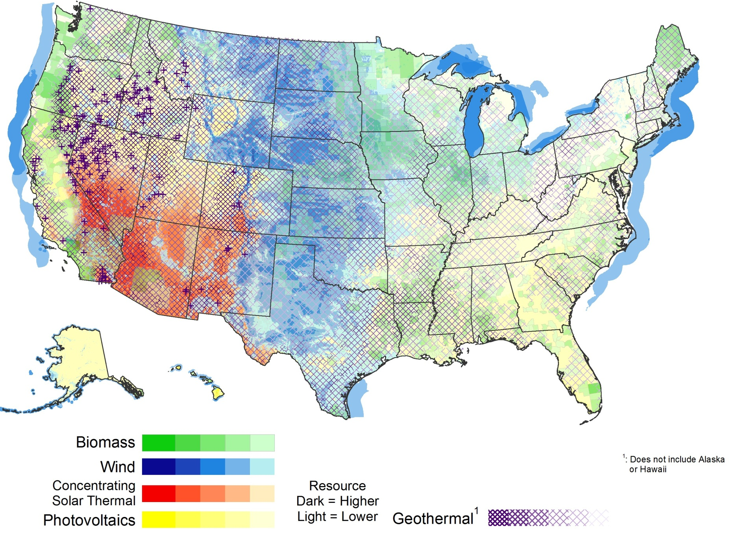
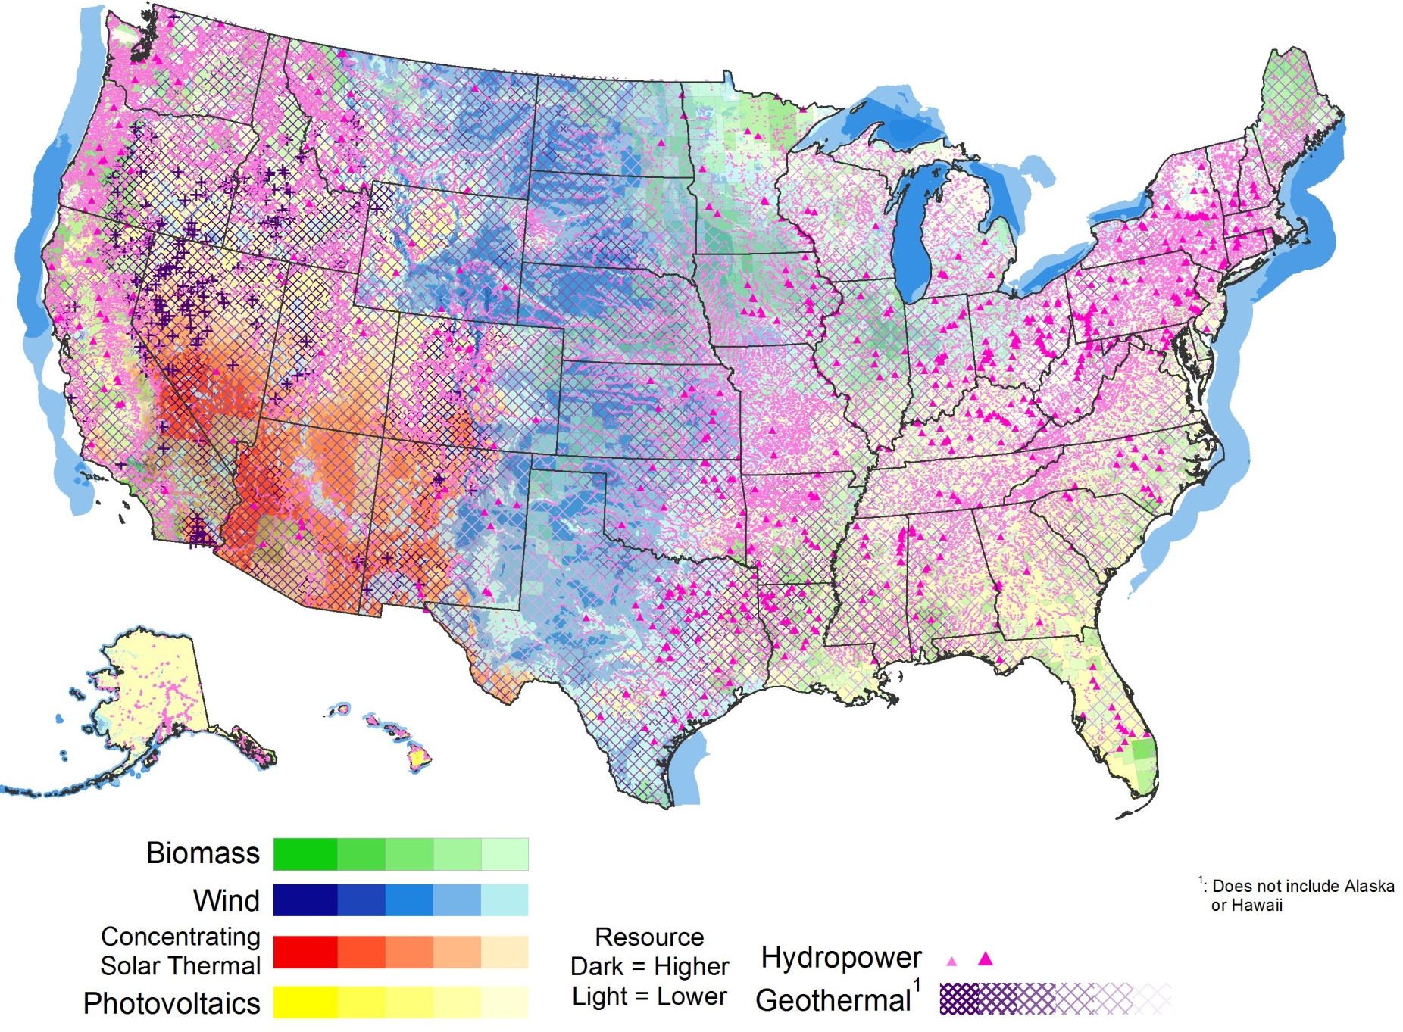
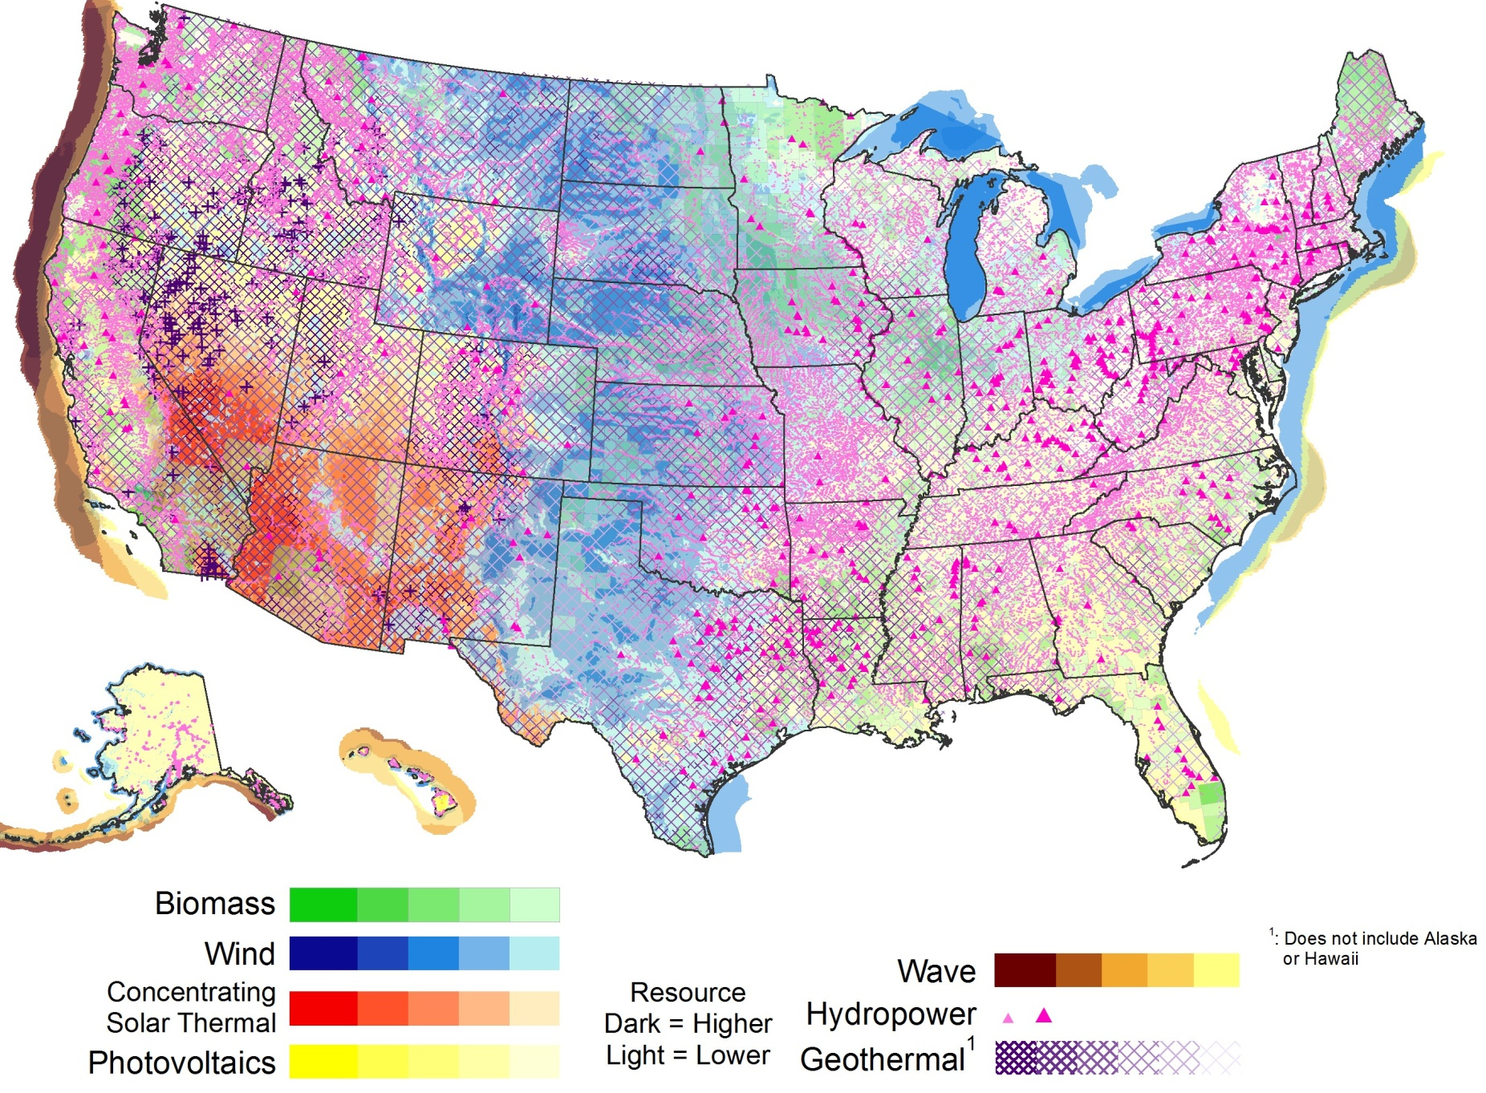
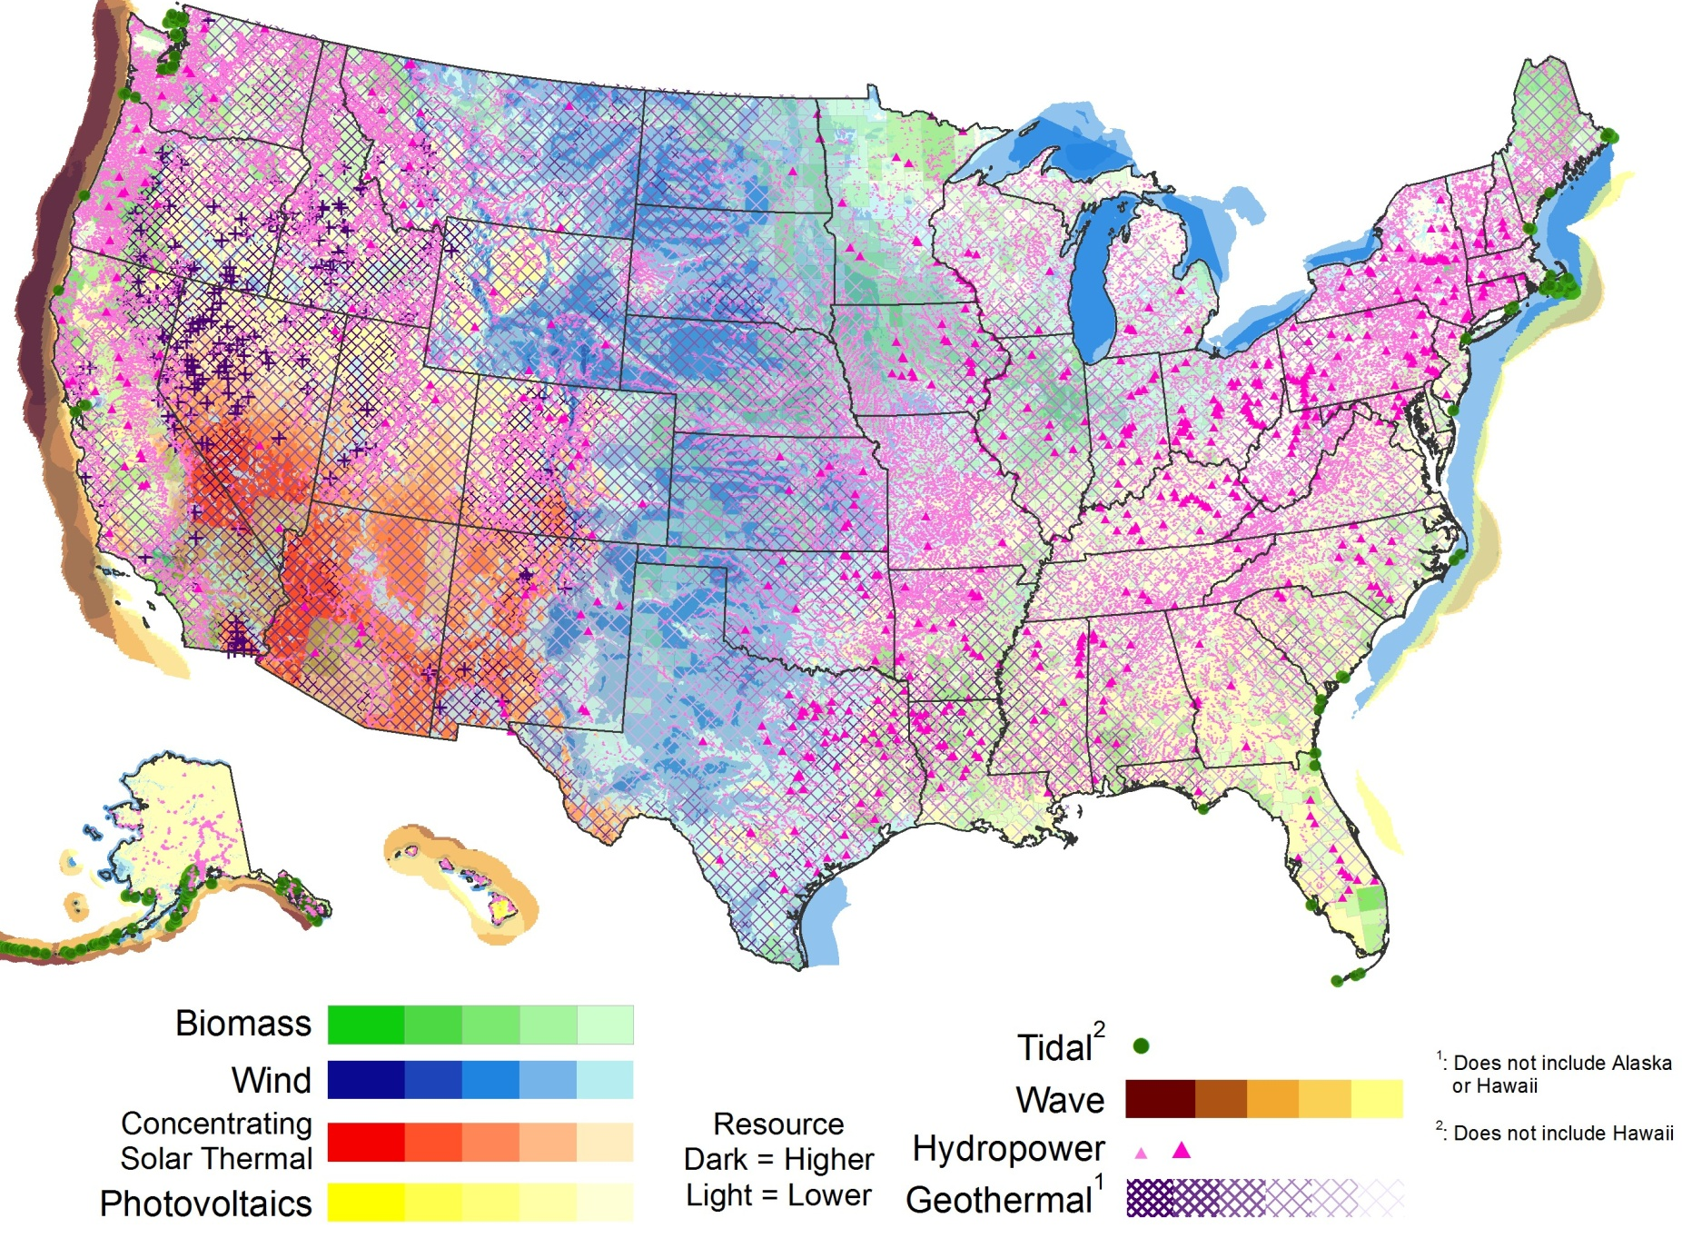
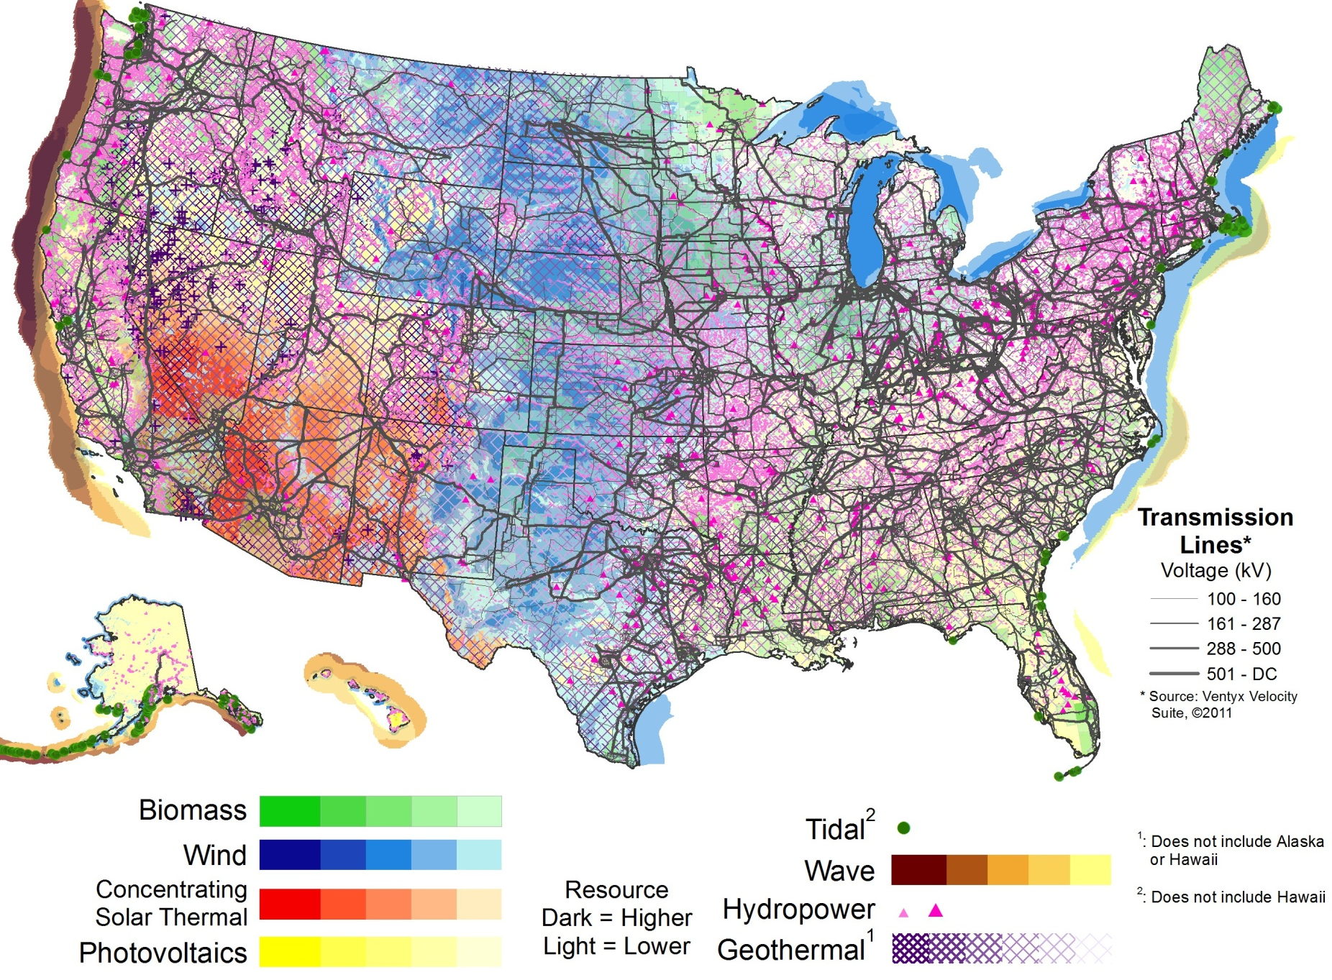
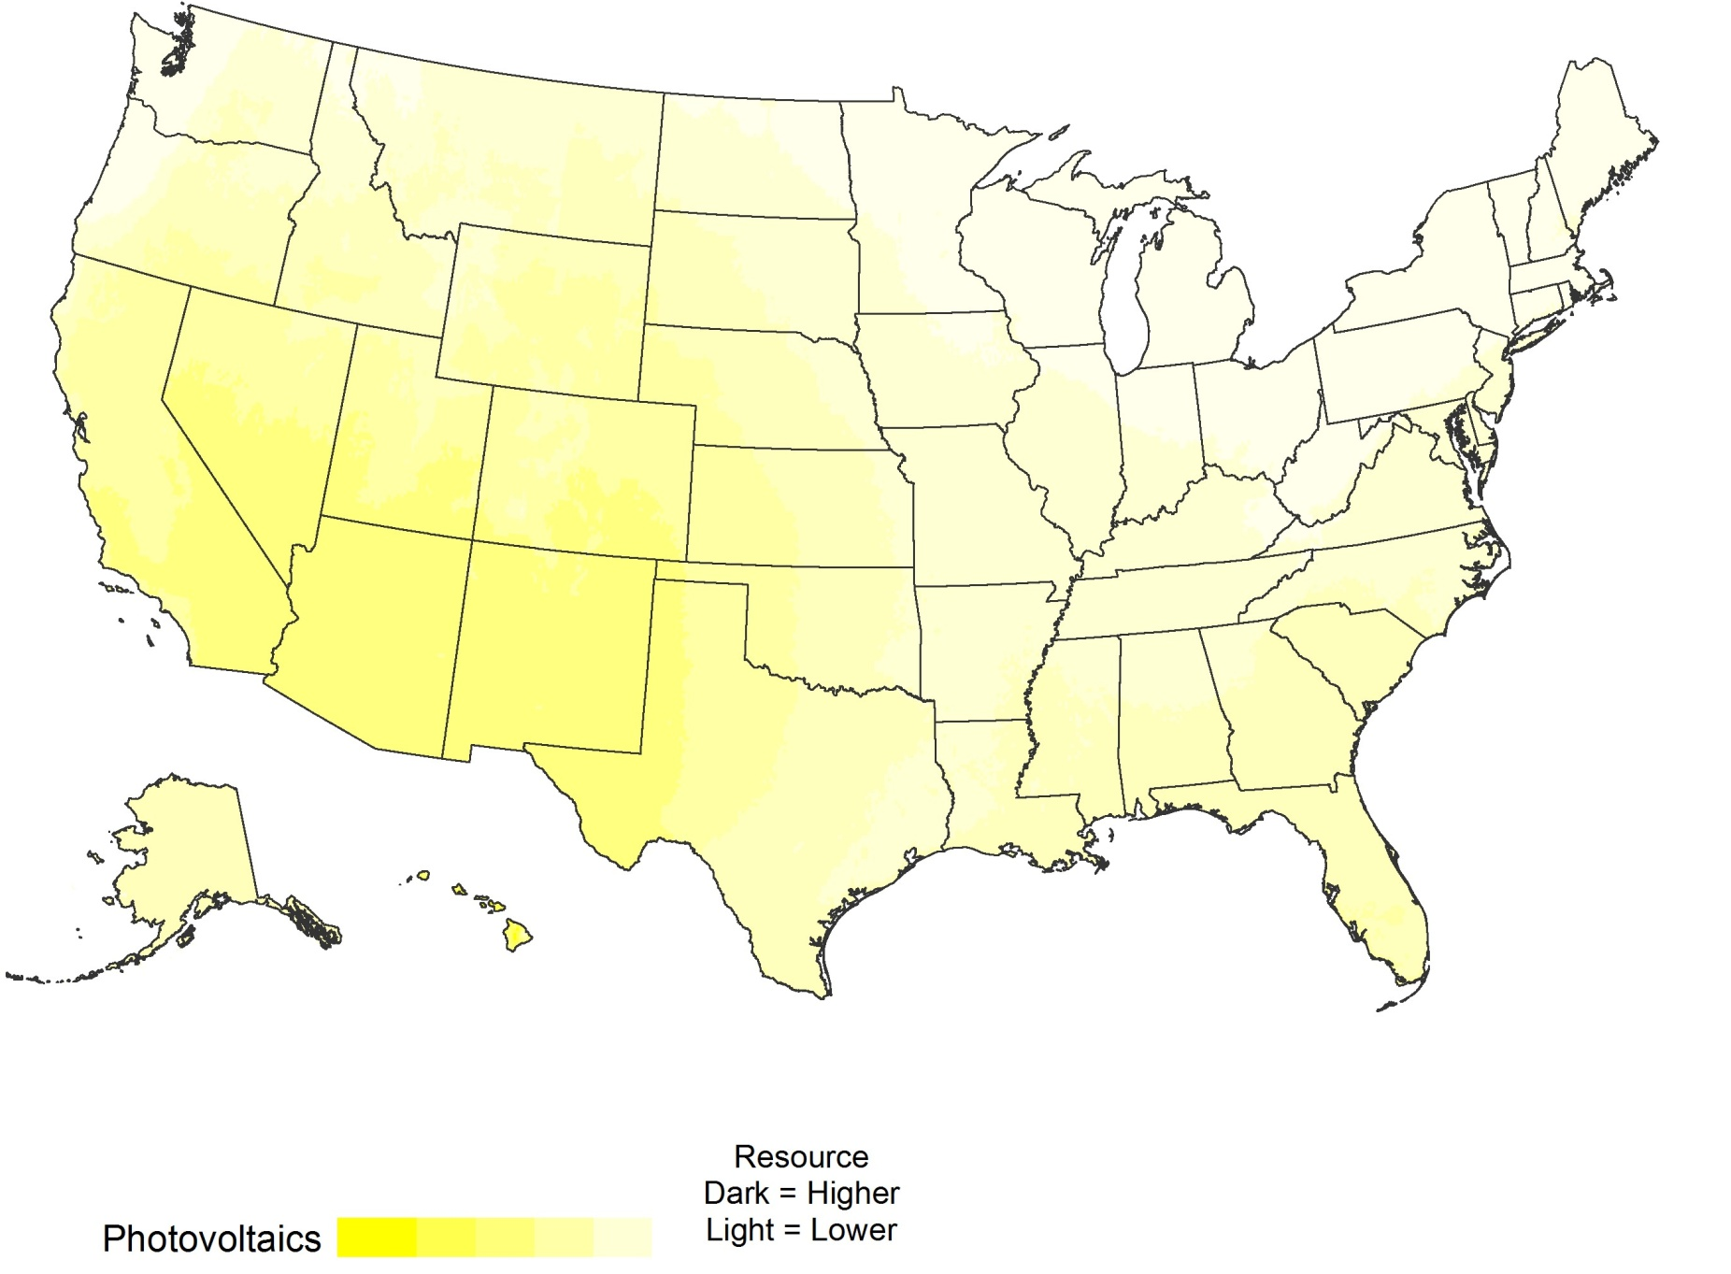
U.S. Renewable Resources
Resource | Solar PV/CSP) | Wind | Geothermal | Water Power | Biopower
Theoretical Potential | 155,000 GW (PV) 38,000GW (CSP) | 11,000 GW (onshore) 4,200 GW (offshore to 50 nm) | 38 GW (conventional) 4,000 GW (EGS) | 68 GW | 62 GW
Technical potential
sources and
assumptions are
listed in the slide
notes.
Notes:
1) Technical potential estimates for solar, wind, geothermal, hydropower, and biopower were extracted from NREL’s report U.S. Renewable Energy Technical Potentials: A GIS-Based Analysis (2012). However, the hydropower potential was augmented as noted below in (5).
2) Solar: Estimates of potentials for both PV and CSP are assumed to be unconstrained by grid limitations such as lack of storage or transmission capacity. For PV, the solar resource potential is separated into utility scale PV in urban and rural areas, and rooftop PV potential.
Utility scale PV in urban areas was restricted to large urban open spaces with slope <= 3% and a minimum of 18,000 m² (large enough to support ~1 MW of PV). Installed capacity for utility scale PV assumes an installation density of 48 MW/km².
Utility scale PV in rural areas was restricted by excluding federal protected lands, water features and wetlands, and allowing installations only where land surface slopes are <= 3%. Resulting areas must be >= 1 km² to be included in the technical potential calculation. Installed capacity for utility scale PV assumes an installation density of 48 MW/km².
Rooftop PV potentials were estimated by Denholm and Margolis (2008, “Supply Curves for rooftop Solar PV-Generated electricity for the United States”) using commercial and residential building estimates of rooftop availability % for buildings in different climates, and assumes an installation density of 100 W/m² for flat roofs and 135 W/m² for other roofs.
The CSP potential calculations use the same land filters used for utility scale PV in rural areas, but is also restricted based on direct normal solar insolation values to areas with an average annual value of 5.0 kWh/m²/day. Installed capacity for CSP assumes an installation density of 32.8 MW/km², for a trough system with six hours of storage and a solar multiple of 2.
3) Wind: Onshore wind potential at 80 m ht above surface was modified from the analysis conducted by NREL and AWST (http://www.windpoweringamerica.gov/windmaps/resource_potential.asp), limiting resource areas to those with annual gross capacity factor of 30% or more for typical utility scale wind turbines. Urban areas, protected lands, and onshore water features are excluded, and land availability is reduced in non-ridgecrest forest areas. Offshore wind potential was estimated using 90 m height annual average wind speed data as described in Assessment of Offshore Wind Energy Resources for the United States (Schwartz et. al, 2010), with exclusions to eliminate marine sanctuaries, shipping lanes, and within 50 nautical miles of the U.S. coastline. Installation density for both onshore and offshore wind is estimated assuming 5 MW/km2.
4) Geothermal: Hydrothermal potential (identified and undiscovered) is taken from the USGS reports “Assessment of Moderate- and High-Temperature Geothermal Resources of the United States” (2008, Williams et al.) and “Quantifying the Undiscovered Geothermal Resources of the United States” (2009, Williams et al.). Enhanced Geothermal Systems (EGS) potential was derived from an analysis of temperature at depths ranging from 3 km to 10km, produced by Southern Methodist University Laboratory. High temperature areas are most favorable for early development using Enhanced Geothermal System (EGS) technology, while low temperature areas are possible resources in future. Individual areas identified by a dark + symbol indicate high temperature anomalies where identified conventional hydrothermal resources are located.
5) Long-term hydroelectric potential is drawn from a GIS-based study by INL: Feasibility Assessment of the Water Energy Resources of the United States for New Low Power and Small Hydro Classes of Hydroelectric Plants, January 2006. Non-powered dams from the National Hydropower Asset Assessment Program are also shown, and the estimated 8 GW of potential added to the 60 GW of estimated potential from the INL report.
6) Biopower potential estimated based on available residue data from the NREL report Geographic Perspective on the Current Biomass Resource Availability in the United States (Milbrandt, 2004), with some data updates in 2008. The potential calculation assumes 1.1 MWh/bone dry tonne, higher heating values of 8,500 BTU/lb, and a conversion efficiency of 20% for solid residues; 4.7 MWh/tonne of CH₄, higher heating value of 34,250 BTU/lb, and 30% conversion efficiency for gaseous residues.

Slide 23
Economic Potential

Slide 24
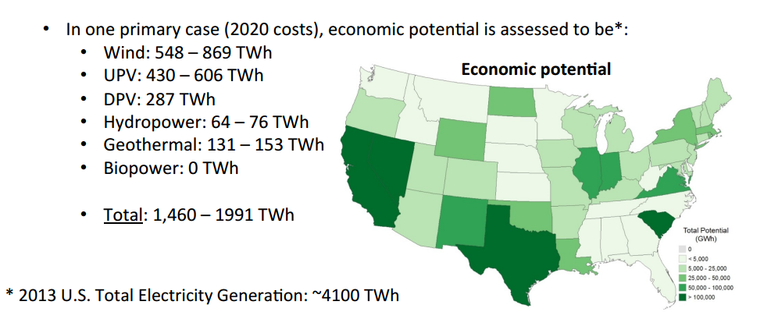
NREL Estimates
http://www.nrel.gov/gis/re_econ_potential.html

Slide 25
Opportunities & Challenges

Slide 26
Drivers for RE Development
Public Image\Customer Expectations
Corporate Sustainability Goals
Energy Security or Independence
Economic Reasons
Hedge against rising energy costs.

Slide 27
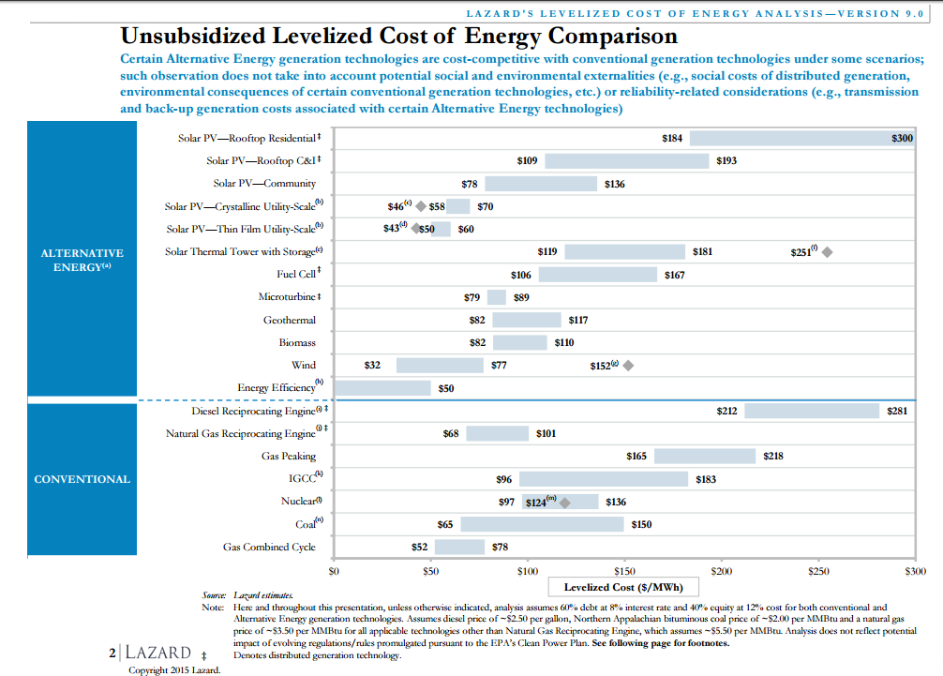

Slide 28
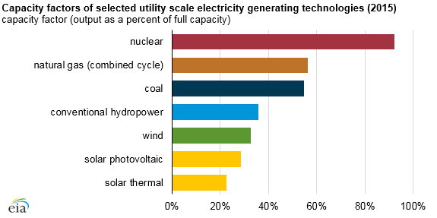
https://www.eia.gov/todayinenergy/detail.cfm?id=25432

Slide 29
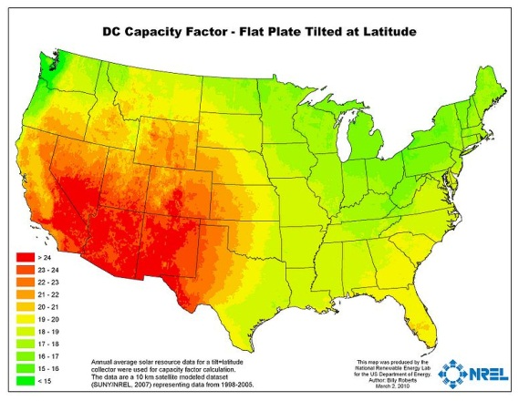

Slide 30
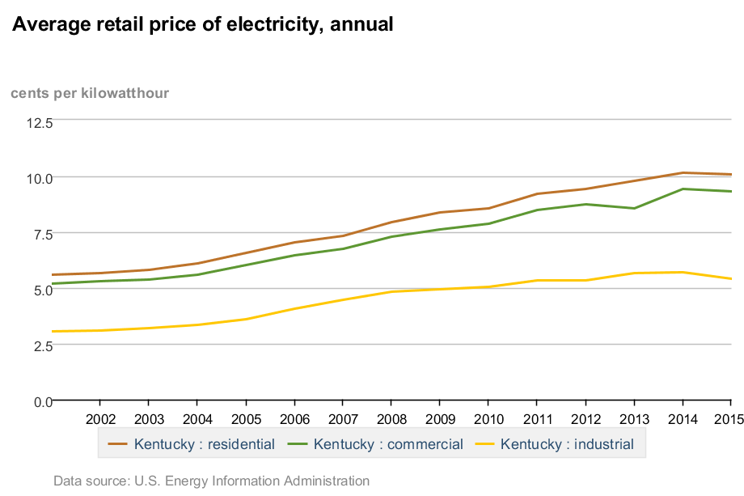

Slide 33
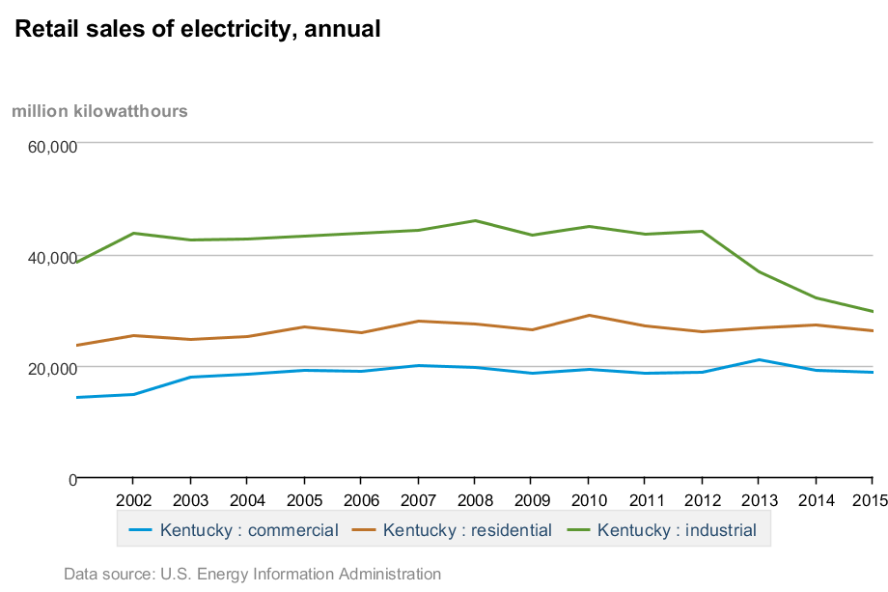
NREL Technical Potential Study
Kentucky | RE Potential (GWh) | Actual 2015 Kentucky Net Generation, All Sources (GWh)
Urban Utility-scale PV | 26,515
Rural Utility-scale PV | 1,823,977
EGS Geothermal | 484,659
Onshore Wind | 147
Rooftop PV | 12,312
Biopower-Solid | 7,048
Biopower-Gaseous | 1,274
Hydropower | 4,255
 | 2,360,187 | 83,232
http://www.nrel.gov/gis/re_potential.html

Slide 34
Potential vs. Reality
Kentucky | New Technical Potential GWh | New Economic Potential GWh | 2015 Kentucky Net Generation, All Sources (GWh)
Urban Utility-scale PV | 26,515 | With flat or declining electricity demand, how will any new generation sources be utilized?
Rural Utility-scale PV | 1,823,977
EGS Geothermal | 484,659
Onshore Wind | 147
Rooftop PV | 12,312
Biopower-Solid | 7,048
Biopower-Gaseous | 1,274
Hydropower | 4,255
 | 2,360,187 | 5,000-25,000 | 83,232

Slide 35
Contact
Kenya Stump
502-564-7192
Kenya.stump@ky.gov

