Slide 1
Regional modeling of Class II wastewater injection wells, Appalachian Basin
Tom Sparks, Energy and Minerals Section
Kentucky Geological Survey Annual Seminar
May 13, 2016
KGS Well Sample and Core Library

Slide 2
Outline of presentation
Class II brine disposal and injection wells (definition, types, purposes)
EPA Region 4 (UIC Program, FOIA requests, access to data, primacy issues)
Map service of disposal and injection wells in Kentucky (online database, statewide numbers, locations)
Brine disposal framework project – Battelle
Forthcoming: Newly released injection volumes (March 2016), currently under evaluation

Slide 3
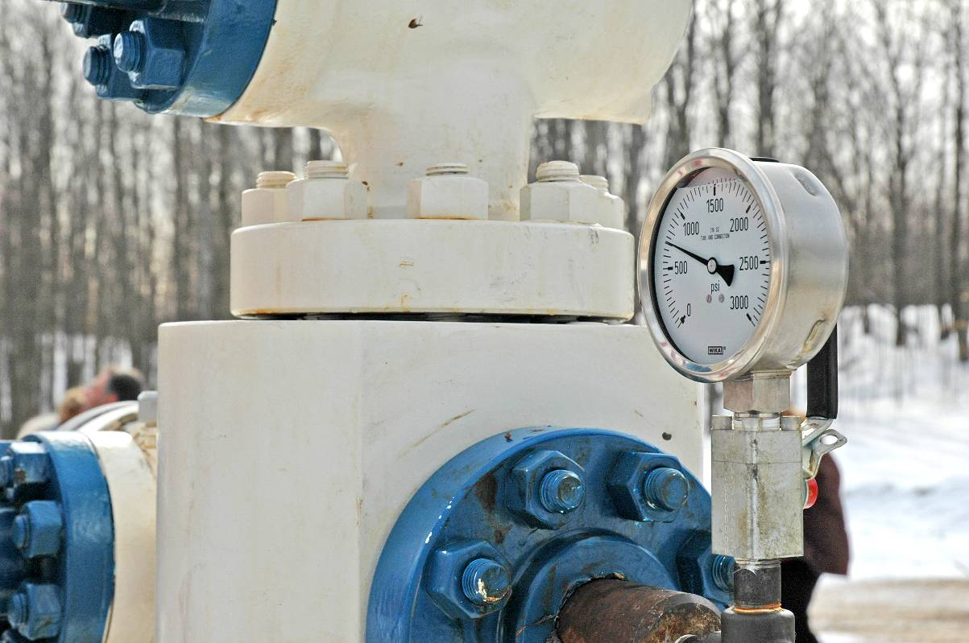
Motivation for study
Develop baseline data for identifying and tracking brine disposal in Kentucky by location and geologic context
Distinguish between saltwater disposal (SWD) and enhanced recovery injection (ERI) wells
Disposal causes a mass balance addition to reservoir
Enhanced injection is overall mass balance neutral
Distinction between disposal and injection wells important for analyzing potential for induced seismicity (next talk)
Notes:
Develop database of brine disposal in Kentucky,

Slide 4
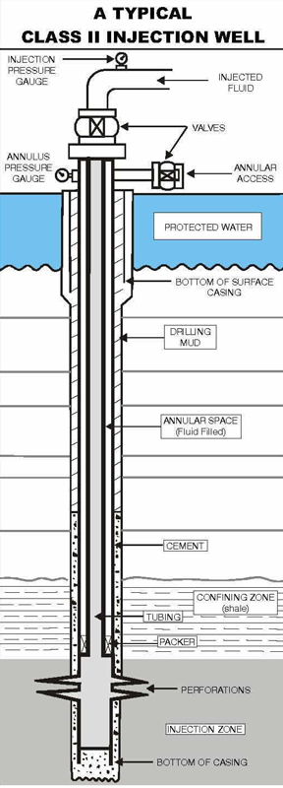
What are Class II injection wells?
Inject fluids associated with oil and gas production into underground porous formations – wastewater, brines (salt water), steam, CO₂, flowback fluids (frack fluids)
Protect underground sources of drinking water (USDW)
Two types of Class II wells:
Type D for permanent disposal for brines (SWD)
Type R for injection into existing reservoir for increased recovery of hydrocarbons (80%)
2 billion gallons brine injected every day in US
180,000 Class II wells in US (3,000 in KY)
Service wells (SWD, ERI, EOR, SRI, TRI, GI, waterflood)
Source: Injection Partners LP
http://www.injectionpartners.com
Notes:
2 billion gallons brine injected every day in US = 48 million barrels (MMBBL) (EPA, 2016), Service wells (SWD, ERI, EOR, SRI, TRI, GI), Drill as new well or utilize existing well borehole

Slide 5
U.S. Environmental Protection Agency (USEPA), Region 4, Atlanta, GA
Primary enforcement authority for Underground Injection Control (UIC) Program, permitting & regulation
Primacy for Kentucky’s Class I-VI wells
Data, documents, detailed information available through Freedom of Information Act (FOIA) web site
Kentucky applied for primacy of Class II wells, Nov. 10, 2015, application currently USEPA Washington, approval expected later this year

Slide 6
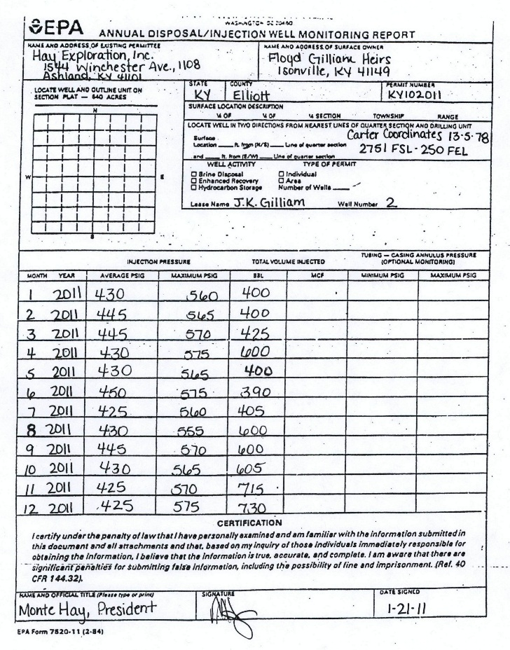
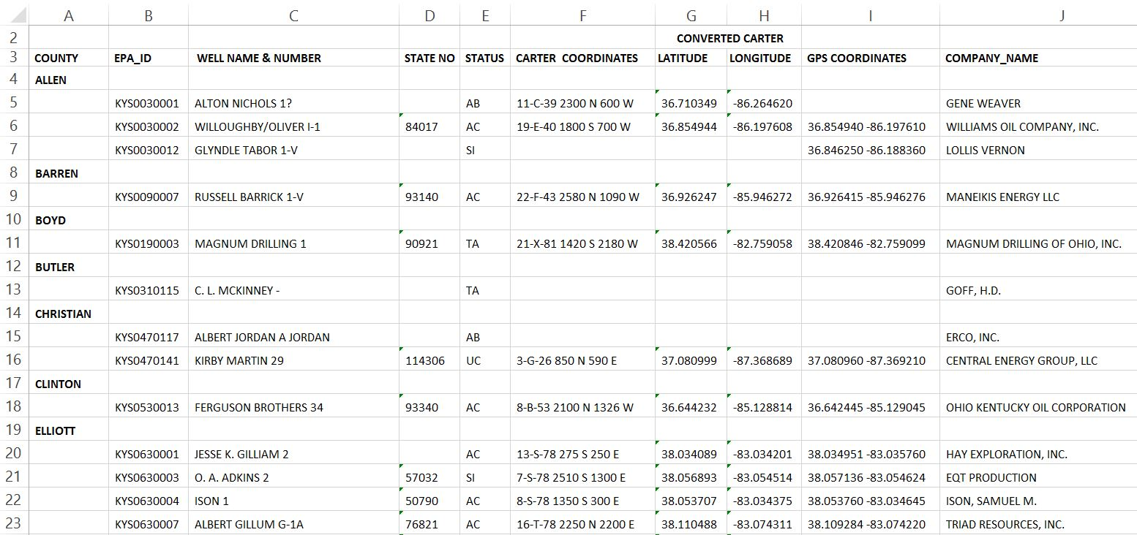
EPA Forms and Data
Administrative & Operations Data
Review, approve locations, issue UIC permits
Form 7520-11 (Well Monitoring Report) used by operators for reporting pressure & volume
Periodic laboratory analysis (pH, TDS, s.g.)
FOIA document (what they distribute)
Database spreadsheet or PDF document
EPA-ID, company, well name & no., status, lat-lon, intervals, formation

Slide 7
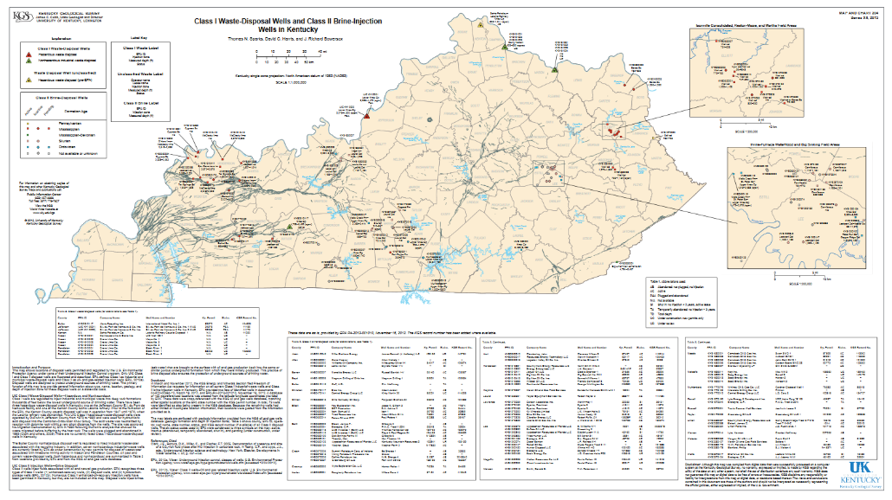
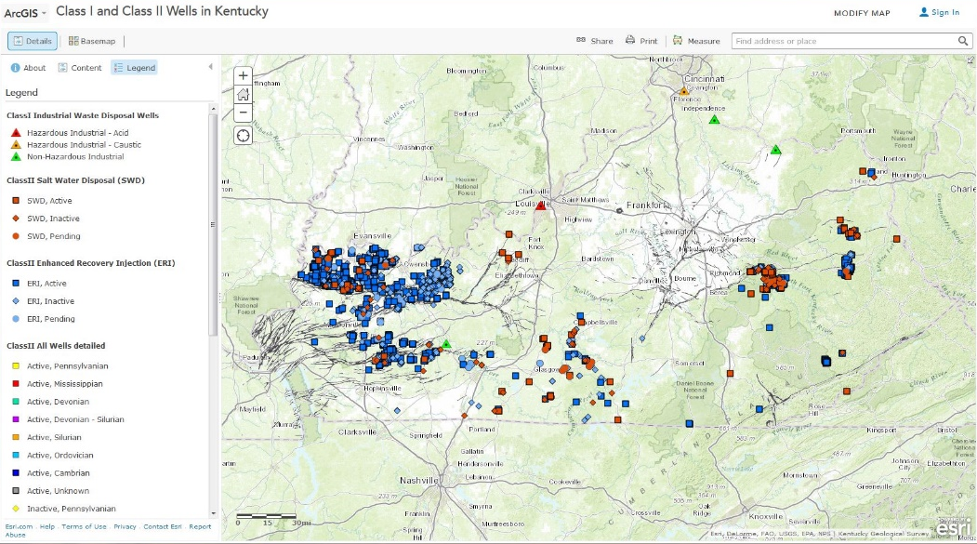
KGS map products from FOIA documents
March 2013: published ‘Class I waste-disposal wells and Class II brine-injection wells in Kentucky,’ KGS Map and Chart 204, ser. 12
December 2014: online map service, updated inclusion of 2,900 ERI wells: http://goo.gl/xQZ2QD
Available on KGS Online Maps Home
Sparks, Harris, and Bowersox, 2013; KGS Map and Chart 204, ser. 12
http://kgs.uky.edu/kgsweb/olops/pub/kgs/MC204_12.pdf
ArcGIS Map service of EPA permitted Class I industrial waste-disposal wells, Class II brine-disposal (SWD) and enhanced-recovery injection (ERI) wells

Slide 8
Map service of disposal and injection wells
Layers:
11 Class I wells
152 Class II SWD wells
2,939 Class II ERI wells
Faults
O&G Fields
Berea Ss
Penn-Miss. Ss & Ls (Illinois Basin)
Corn.,
Knox Gp
Weir sd
Big Lime
Ft. Payne-Knox Gp

Slide 9
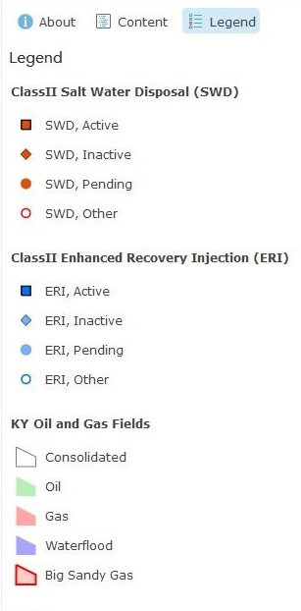
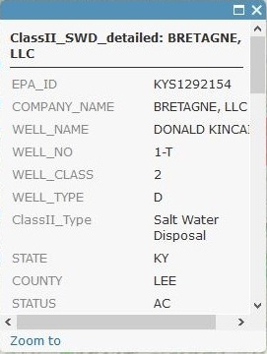
Map service of disposal and injection wells
Big Sinking waterflood, LCKP, BGSX (344CORN)
Service includes:
Legends
Tables
Popups
Metadata
Links to KGS DB

Slide 10
Brine Disposal Framework – Battelle, KGS, others
Development of Subsurface Brine Disposal Framework in the Northern Appalachian Basin
Increased demands for disposal wells due to recent rise in shale-gas activity & production
Manager: Research Partnership to Secure Energy for America (RPSEA), Unconventional Resources
Subcontractor: Battelle Memorial Institute
State Surveys of Kentucky, Ohio, West Virginia, Pennsylvania
Tom Sparks, Marty Parris, KGS
2-year project (Apr 2013 – Oct 2015)
Notes:
Increased demands for disposal wells due to recent rise in shale-gas activity & production
Research Partnership to Secure Energy for America (RPSEA), Unconventional Resources Program

Slide 11
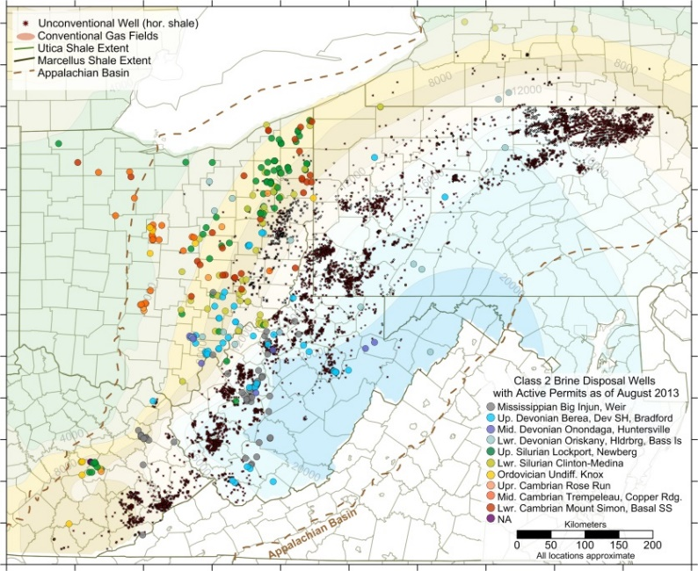
Brine Disposal – objectives
PA
OH
Develop an assessment of brine disposal
in the Northern Appalachian Basin region
based on information from state agencies
and disposal and production companies
Develop a geologic framework of injection zones, performance parameters, operational issues, and operational data.
Complete reservoir evaluations through simulations for injectivity, pressure buildup, geomechanical constraints
Evaluate disposal based on demand, storage capacity, and costs
Guidance to developers, producers, agencies, and stakeholders
KY
WV
Notes:
Develop a systematic assessment of brine disposal wells in the Northern Appalachian Basin based on information from state agencies and disposal and production companies.
Develop a geologic framework with regard to injection zones (regional and local extent), reservoir performance parameters, operational issues, and operational data.
Complete local reservoir simulations for injectivity, pressure buildup, geomechanical constraints of stress magnitude and orientation.
Evaluate aspects of disposal based on possible demand, storage capacity, and well costs.
Provide guidance for developers, oil & gas producers, regulatory agencies, and public stakeholders.

Slide 12
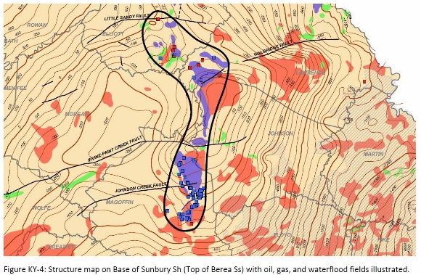
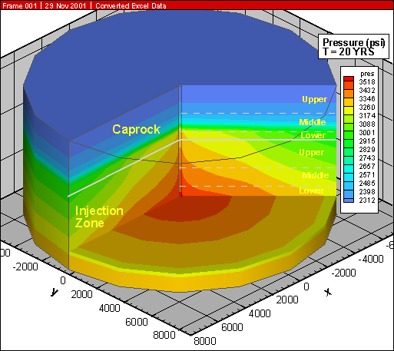
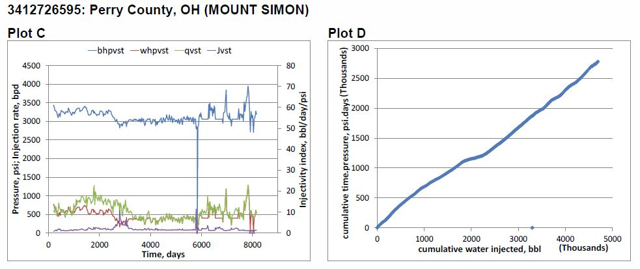
Brine Disposal Framework – major tasks
Data collection and review – compile data, 5-year injection history (2008–2012), laboratory and injectivity analysis
Perform geomechanical testing of 9 selected key formations
Geocellular model development – shallow to deep zones (4)
Local-scale injection simulations of selected wells in model
Source-Sink analysis – compare field prod. vs. injection vol.
Development of products for operators (reports, tables, etc.)

Slide 13
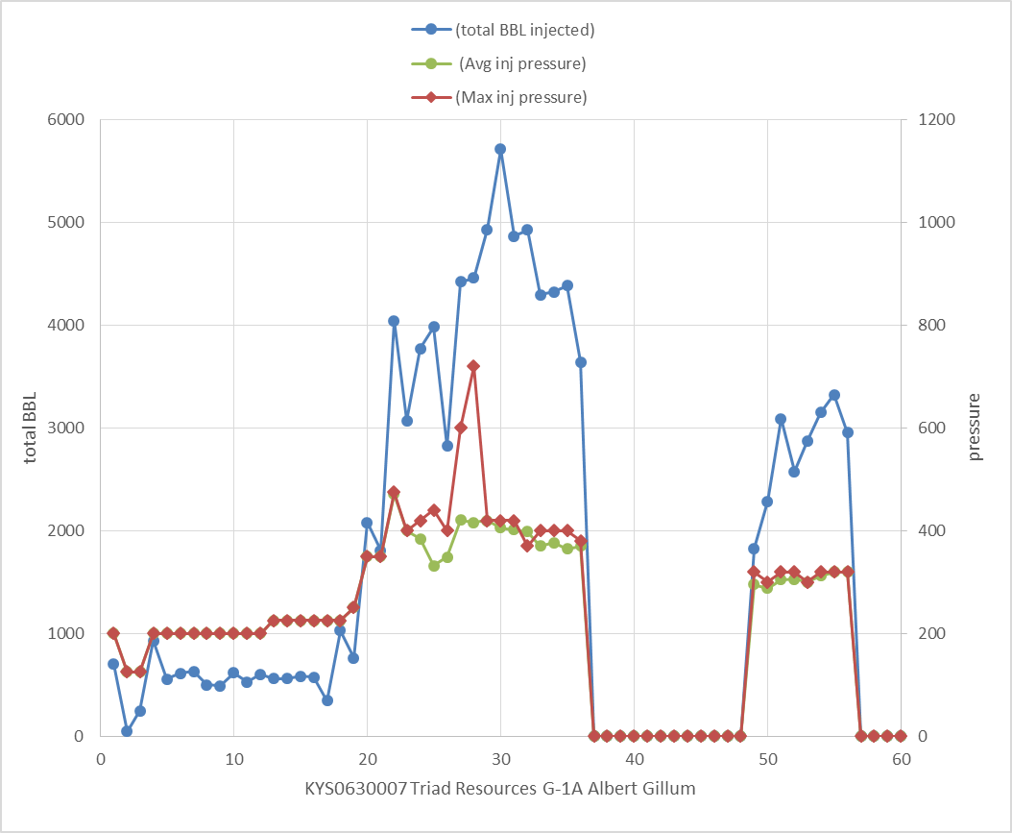
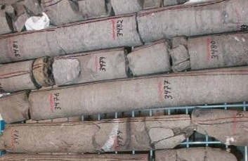
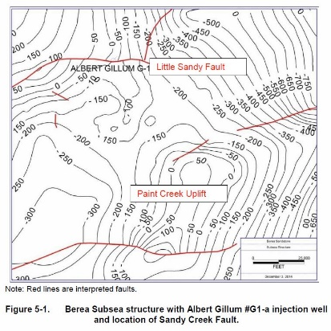
Brine Disposal Framework – KGS contribution
Supplied three whole-core samples for rock mechanics (compressive, acoustic, and tensile strength testing) from KGS No. 1 Hanson Aggregates, Carter County, KY
Rose Run Sandstone @ 3,313’
Copper Ridge Formation @ 3,790’
Mount Simon Sandstone @ 4,686’
Compiled lists of Class II brine disposal wells with administration data, and operational injection data (pressures, volumes) for all active SWD in EKY
30 active brine injection wells in KY Northern Appalachian Basin
Operational monthly volumes complied for 21 wells
Battelle ran various geocellular models and injection simulations through injection formations as provided by each state survey
Kentucky case study – Weir sands, Isonville Fld, Elliott Co.
Created map and cross-section through area for model
Notes:
Other states provided whole core samples from the Big Injun, Clinton, Trempealeau, Newburg, Oriskany, and Medina. Four simulations were completed for major injection intervals in the region: Mississippian Weir Sandstone, Silurian Lockport-‘Newburg’ zone, Silurian ‘Clinton-Medina,’ and Cambro-Ordovician Knox-Basal sandstone interval.

Slide 14
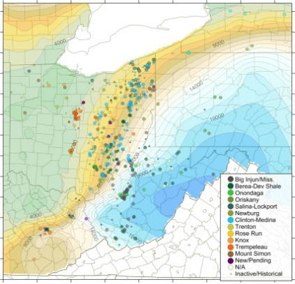
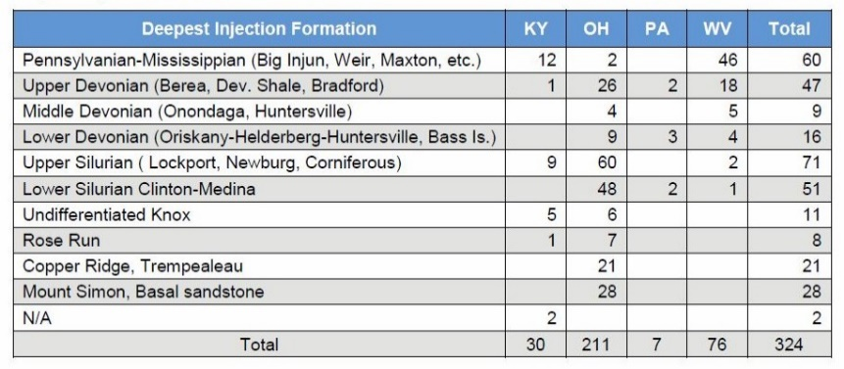
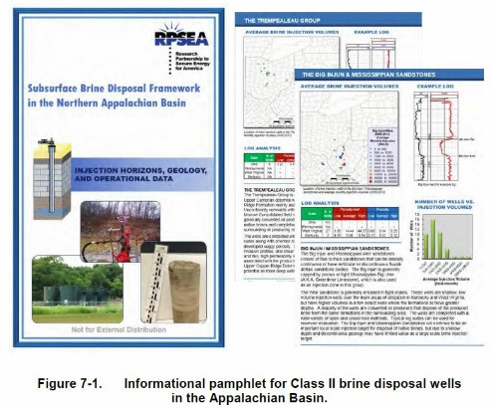
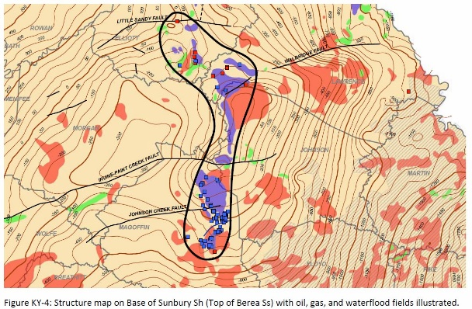
Brine Disposal Framework – Final Report
http://www.rpsea.org/projects/11122-73/
324 SWD wells with active permits Aug. 2013, OH (211), WV (76), eastern KY (30), PA (7)
Monthly operational data (volumes, pressure) compiled from 200 SWD wells for 2008–2012
Injection increased from 9.2 MMBBL in 2008 to 17.6 MMBBL by 2012, mostly to shale gas activity, est. 20 MMBBL in 2013
Brine injected into a variety of 10 porous zones (shallow Pennsylvanian Weir to deep Cambrian Mt. Simon, Basal sandstones)
Suggest 9,984 barrels brine disposed per BCF gas
Long-term demand for brine disposal for Marcellus-Utica may be 706–2,290 MMBBL
“Depleted oil-gas reservoirs and deep saline formations offer very large capacity for brine disposal.” (p. 381)
Notes:
Monthly operational data (injection volumes, wellhead pressure, etc.) compiled from over 200 Class II brine disposal (SWD) wells for 2008-2012.

Slide 15
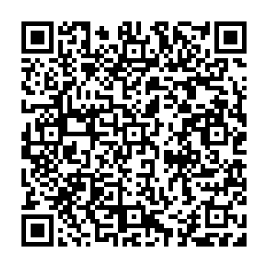
Thank you! See You in Lexington ES-AAPG 2016
Sept. 25-27, 2016
www.esaapgmtg.org
Scan QR code to save the date

