Slide 1
Assessing baseline groundwater chemistry for the Berea sandstone and Rogersville shale play area, eastern Kentucky
Kentucky Geological Survey, University of Kentucky
GSI Environmental Inc., Austin, TX

Slide 2
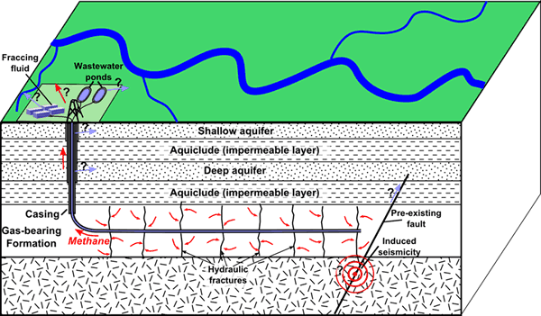
Possible Contamination Pathways of Hydraulic Fracturing to Groundwater Aquifers
(http://www.geosociety.org/criticalissues/hydraulicFracturing/waterQuality.asp)

Slide 3
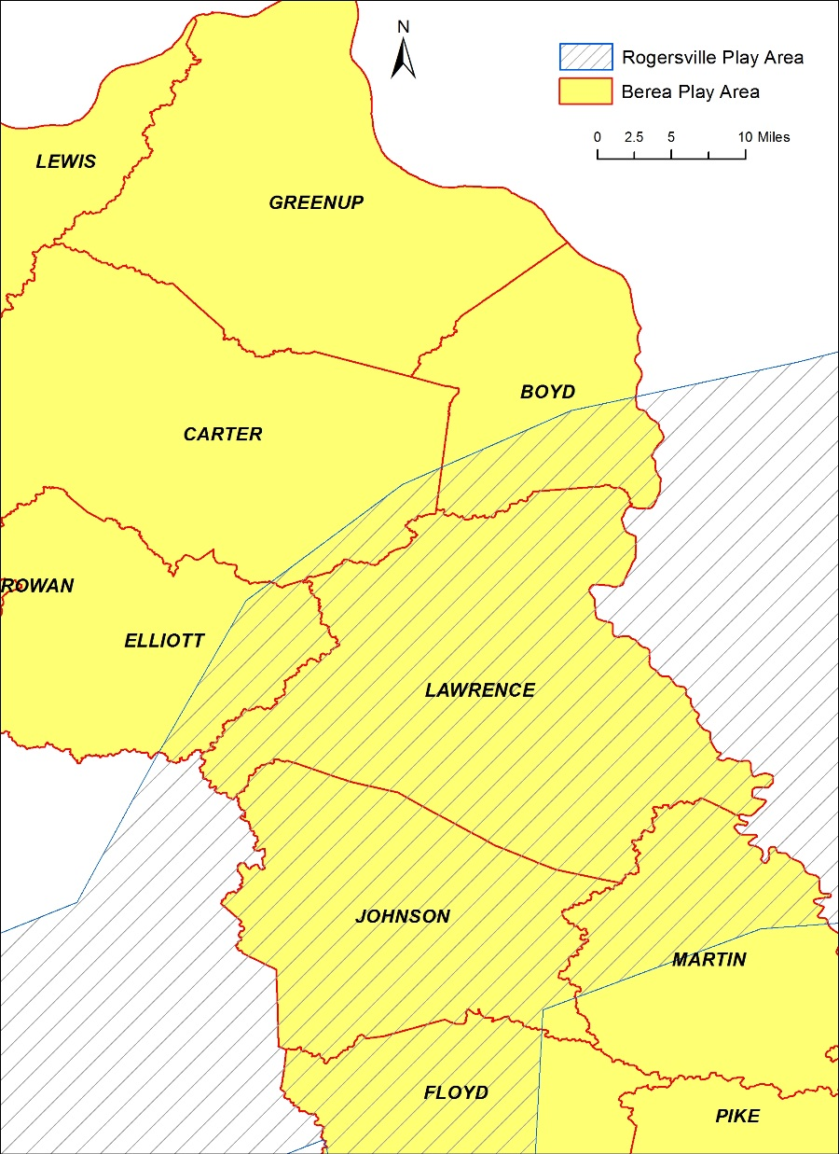
Berea Sandstone
Since 2010 active oil play in Elliott, Carter, Greenup, Lawrence, Johnson, and Boyd Counties.
Volume of fluid and sand small compared to other plays.
Horizontal drilling and hydraulic fracturing at shallow depth (most less than 2,000 ft).
Horizontal Drilling Activities in Eastern Kentucky
Rogersville Shale
5,000 to 10,000 ft deep
Up to 1,100 ft thick in Kentucky, but not all is organic rich.
Very early stage of development
Opportunity to gather baseline groundwater data prior to any large-scale development

Slide 4
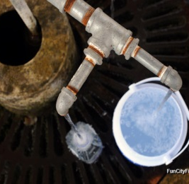
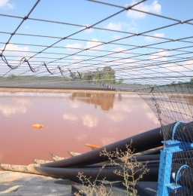
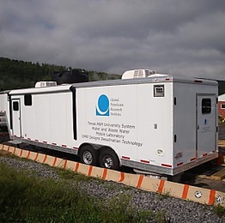
Advanced Analytical Methods RPSEA 11122-45
3-Year project in 2 phases (currently in Phase II)
$3.5M from DOE/RPSEA, $900k in cost share
RESEARCH FOCUS ON THREE KEY ENVIRONMENTAL ISSUES:
Baseline Sampling and Stray Gas Investigation
Advanced Analytics for Air Emissions
Produced Water Characterization

Slide 5
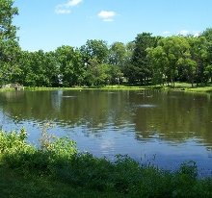
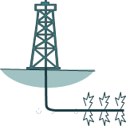
Baseline Sampling Protocol What’s the Goal?
Baseline Sampling of Water Sources
Surface Water
Water Wells
Springs/Seeps
Implications
&
Case Study
1
Regulations
&
Guidance
5
Develop a practical protocol for improved sample collection methods and data interpretation for pre-drill and post-drill sampling programs
2
4
Information Resources
Data Analysis
&
Management
Sample Collection
&
Analyses
3

Slide 6
Baseline Sampling Protocol What’s the Goal?
Baseline Sampling of Water Sources
Surface Water
Water Wells
Springs/Seeps
Implications
&
Case Study
1
Regulations
&
Guidance
5
Develop a practical protocol for improved sample collection methods and data interpretation for pre-drill and post-drill sampling programs
2
4
Information Resources
Data Analysis
&
Management
Sample Collection
&
Analyses
3

Slide 7
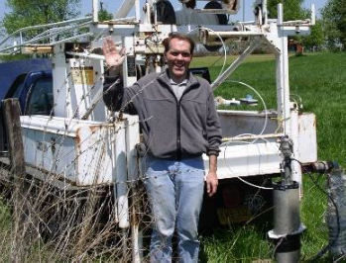
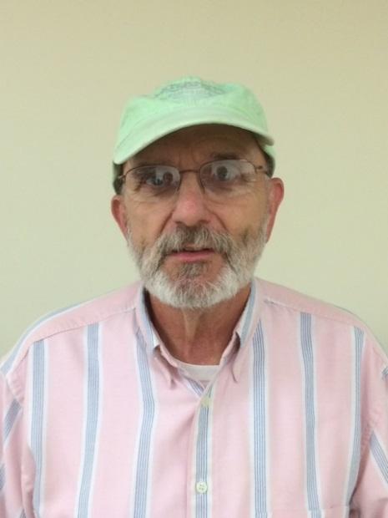
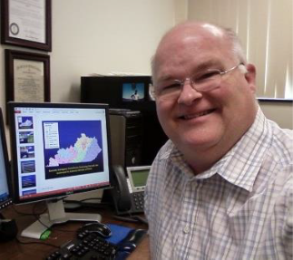
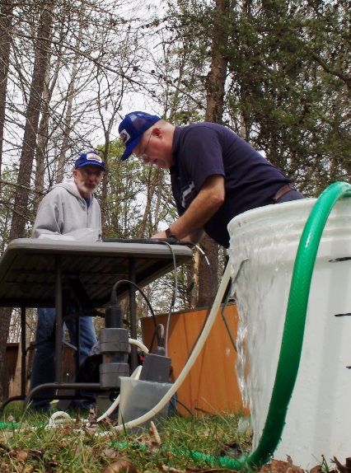
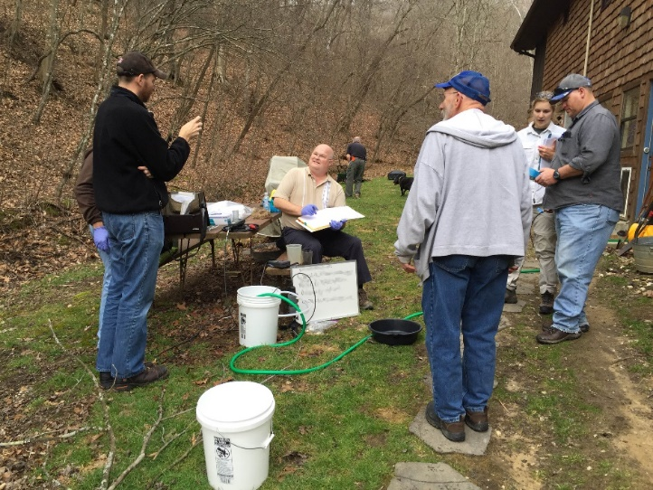
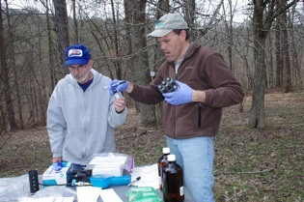
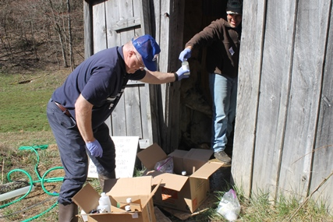
The Field Team
Bart Davidson
Steve Webb
Richard Smath
Some Photos by Mike Lynch

Slide 8
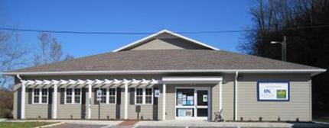
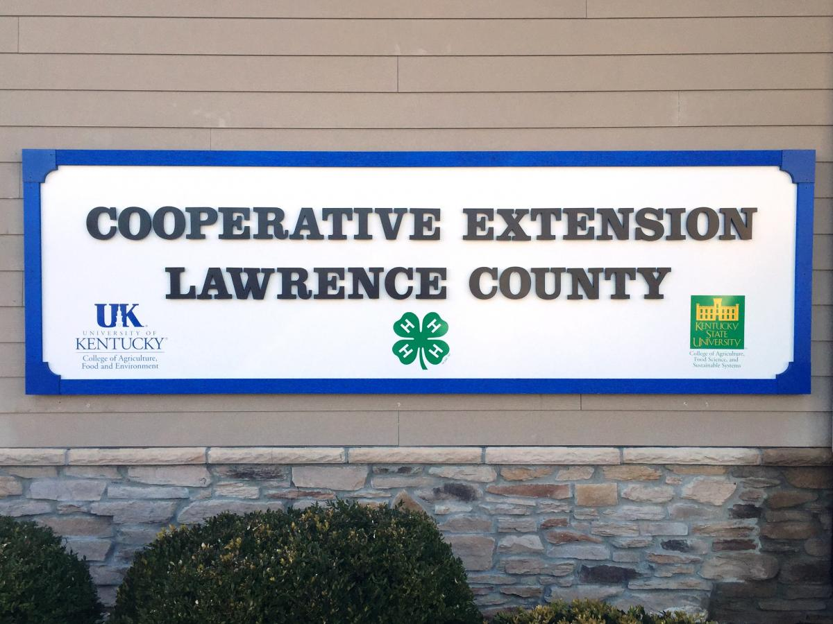
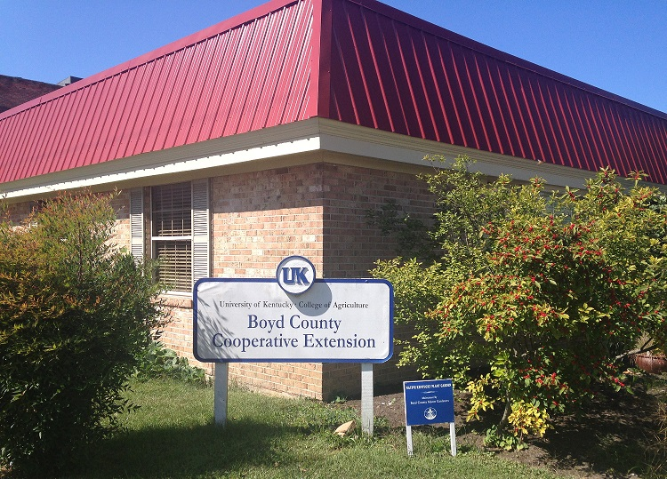
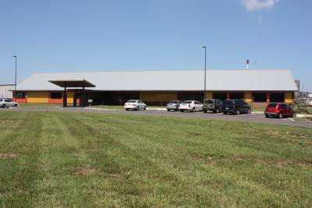
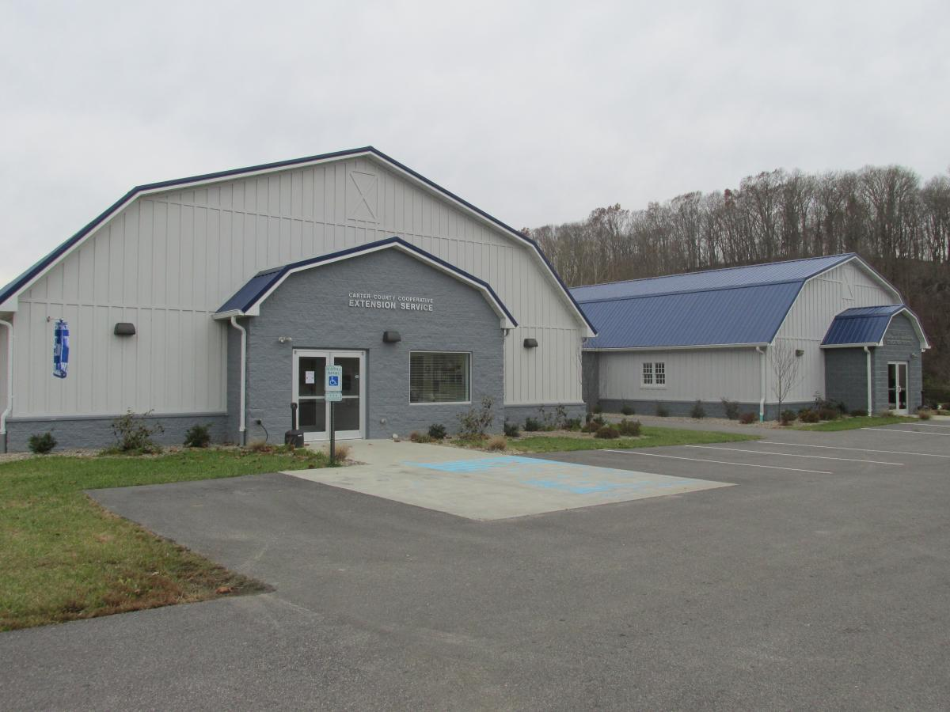
Locating Water Wells
With help from UK Agricultural Cooperative Extension Office, contact well owners and to get permission to sample
https://extension.ca.uky.edu/county

Slide 9
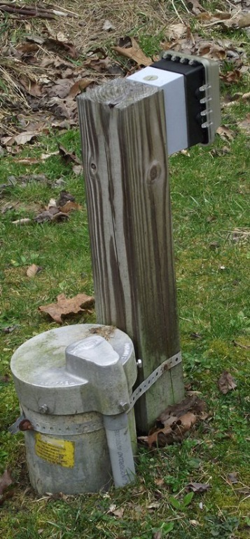
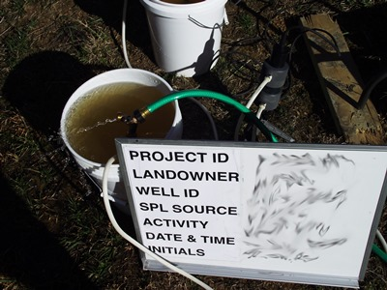
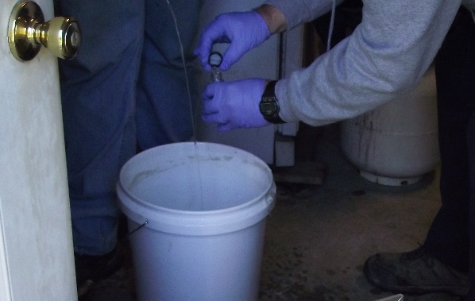
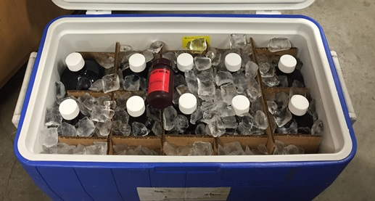
Field Sample
Collect well information
Purge
51 wells sampled in March-April
Collect water samples
Deliver water samples

Slide 10
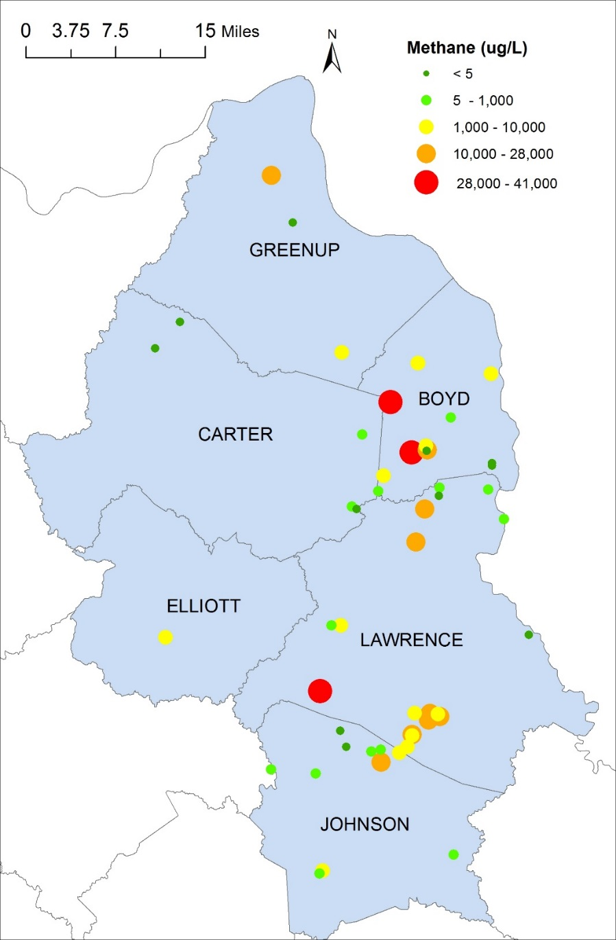
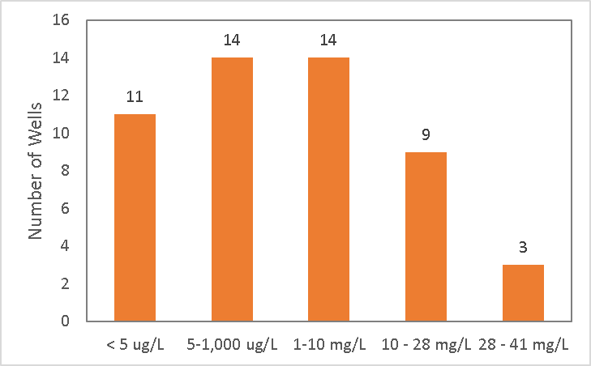
Preliminary Analysis: Dissolved Methane
40 wells have detectable methane (MDL: 5 µg/L).
26 wells have methane >= 1 mg/L.
12 wells have methane >= 10 mg/L.

Slide 11
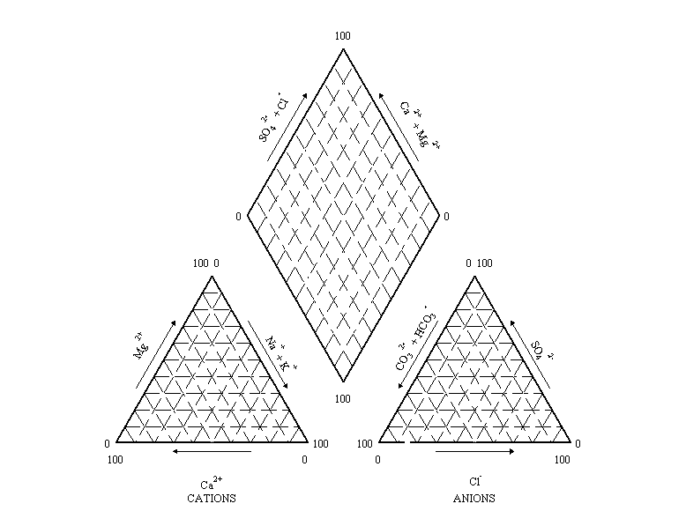
Preliminary Analysis: Water Chemistry
Ca-SO₄ Waters – gypsum groundwater and mine drainage
Ca-HCO₃ Waters – shallow, fresh groundwater
Na-Cl Waters – deep ancient groundwater
51 wells sampled.
Na-HCO₃ Waters – deep groundwater

Slide 12
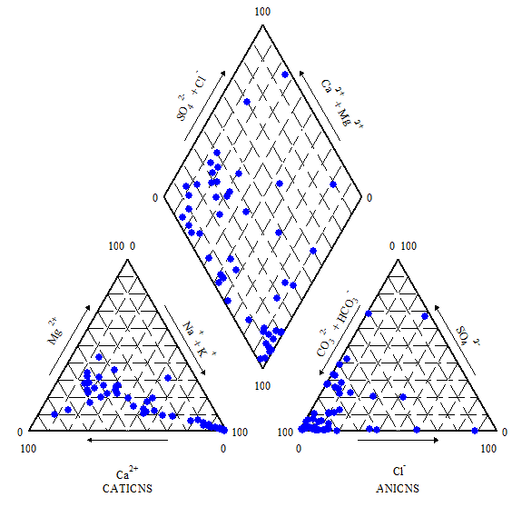
Preliminary Analysis: Water Chemistry
Total 51 wells sampled
Ca-SO₄ Waters – gypsum groundwater and mine drainage
Na-Cl Waters – deep ancient groundwater
Ca-HCO₃ Waters – shallow, fresh groundwater
51 wells sampled.
Na-HCO₃ Waters – deep groundwater

Slide 13
Preliminary Analysis: Methane vs Water Chemistry
Total 51 wells sampled
Ca-SO₄ Waters – 2 wells, 0 with CH₄ > 1 mg/L
Ca-HCO₃ Waters – 18 wells, 4 with CH₄ > 1 mg/L
Na-Cl Waters –2 wells, 2 with CH₄ > 1 mg/L
Other waters – 11 wells, 6 with CH₄ > 1 mg/L
51 wells sampled.
Na-HCO₃ Waters – 18 wells, 14 with CH₄ > 1 mg/L

Slide 14
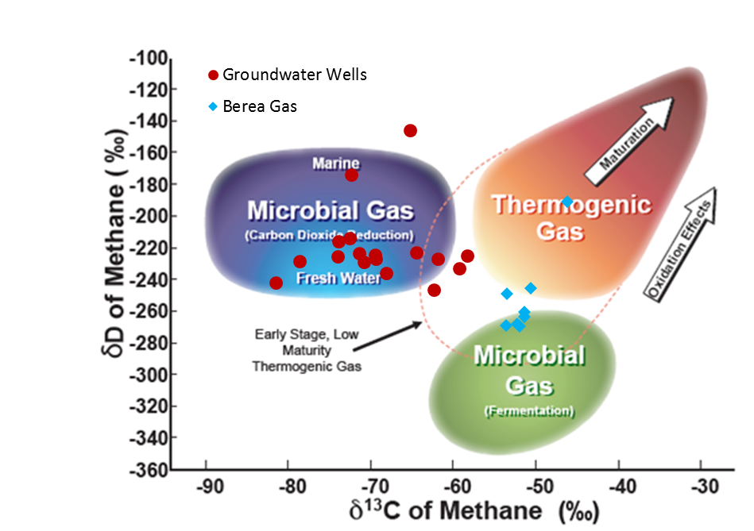
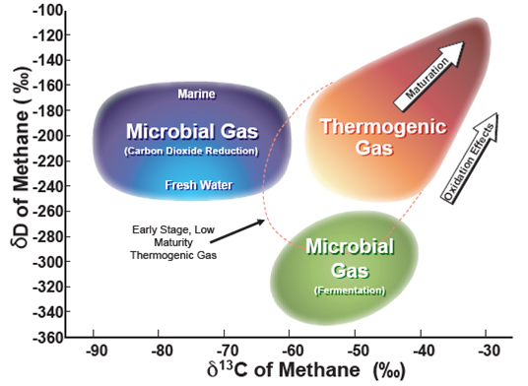
Preliminary Analysis: Methane Isotope
Groundwater Wells
Mississippian-Devonian Gas
(Image source: Isotech)
The image is based on whiticar (1999)

Slide 15
Acknowledgements
The project is funded by the Research Partnership to Secure Energy for America (RPSEA), in collaboration with the Environmentally Friendly Drilling Systems consortium.
We thank UK Agricultural Cooperative Extension Office for assistance in contacting well owners.
Special thanks to Tom Williams at the Environmentally Friendly Drilling Systems consortium for his relentless efforts to make this project happen.

