Slide 1
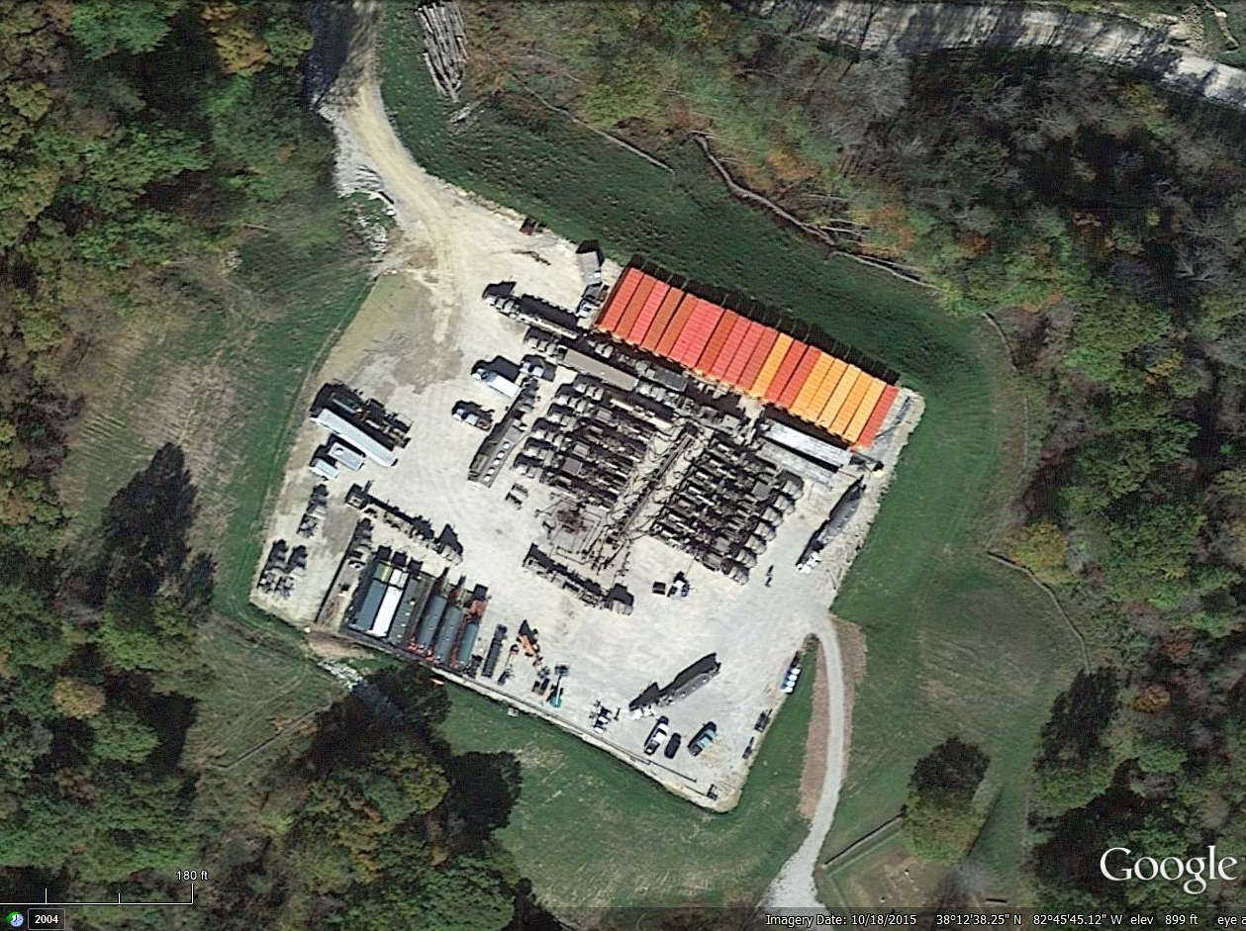
Unconventional Oil and Gas Plays: Berea Sandstone and Rogersville Shale
Dave Harris
Energy and Minerals
Section
May 13, 2016

Slide 2
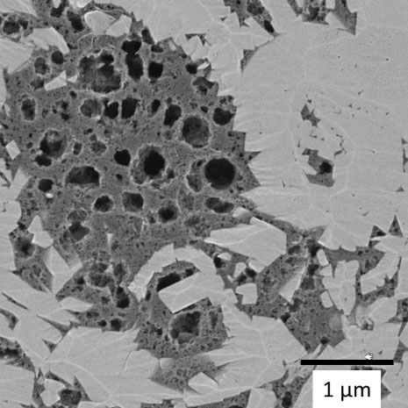
What’s an Unconventional Reservoir?
Low-permeability rock or heavy oil (shale, tight ss, coal)
Source rock = reservoir
Special technology required to produce hydrocarbons at economic rates
Not new: production in Kentucky for decades
Nano-scale porosity in shale,
(courtesy of FEI)

Slide 3
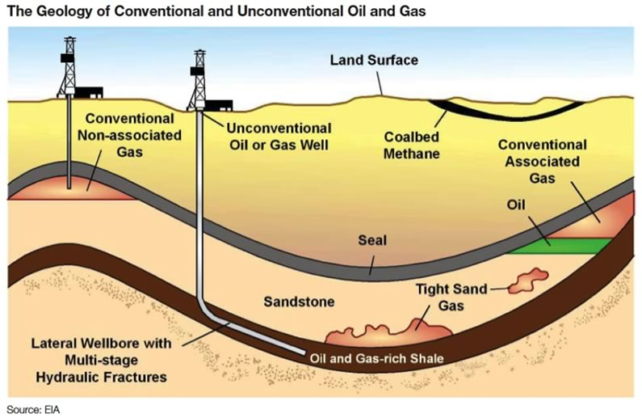
Unconventional Revolution
Large reserves
High pressure
Lower risk

Slide 4
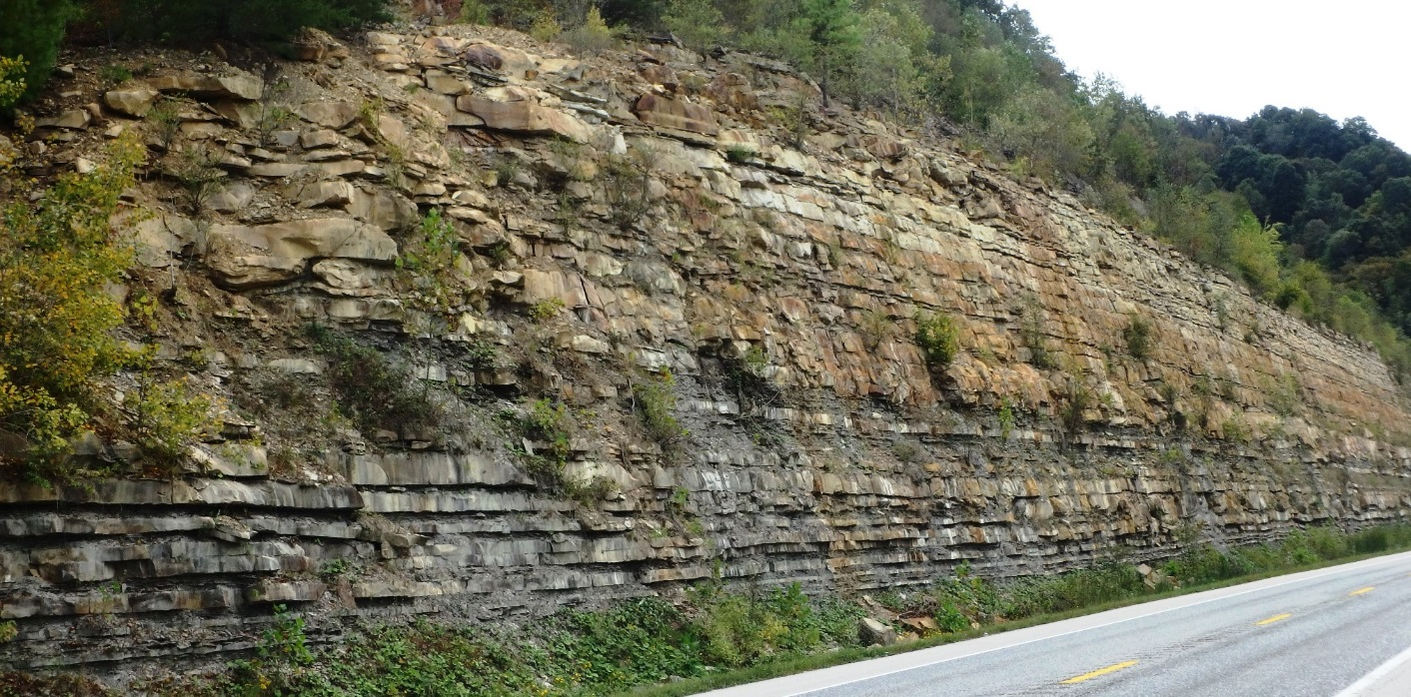
New Unconventional Plays
Upper Devonian Berea Sandstone
Greenup, Lawrence Counties, northeastern Ky.
Active horizontal oil play since 2011
Low-volume hydraulic fracture stimulations
Very shallow depth (700-1,600 ft)
Berea Sandstone
Outcrop, Lewis County
(photo: Steve Greb)

Slide 5
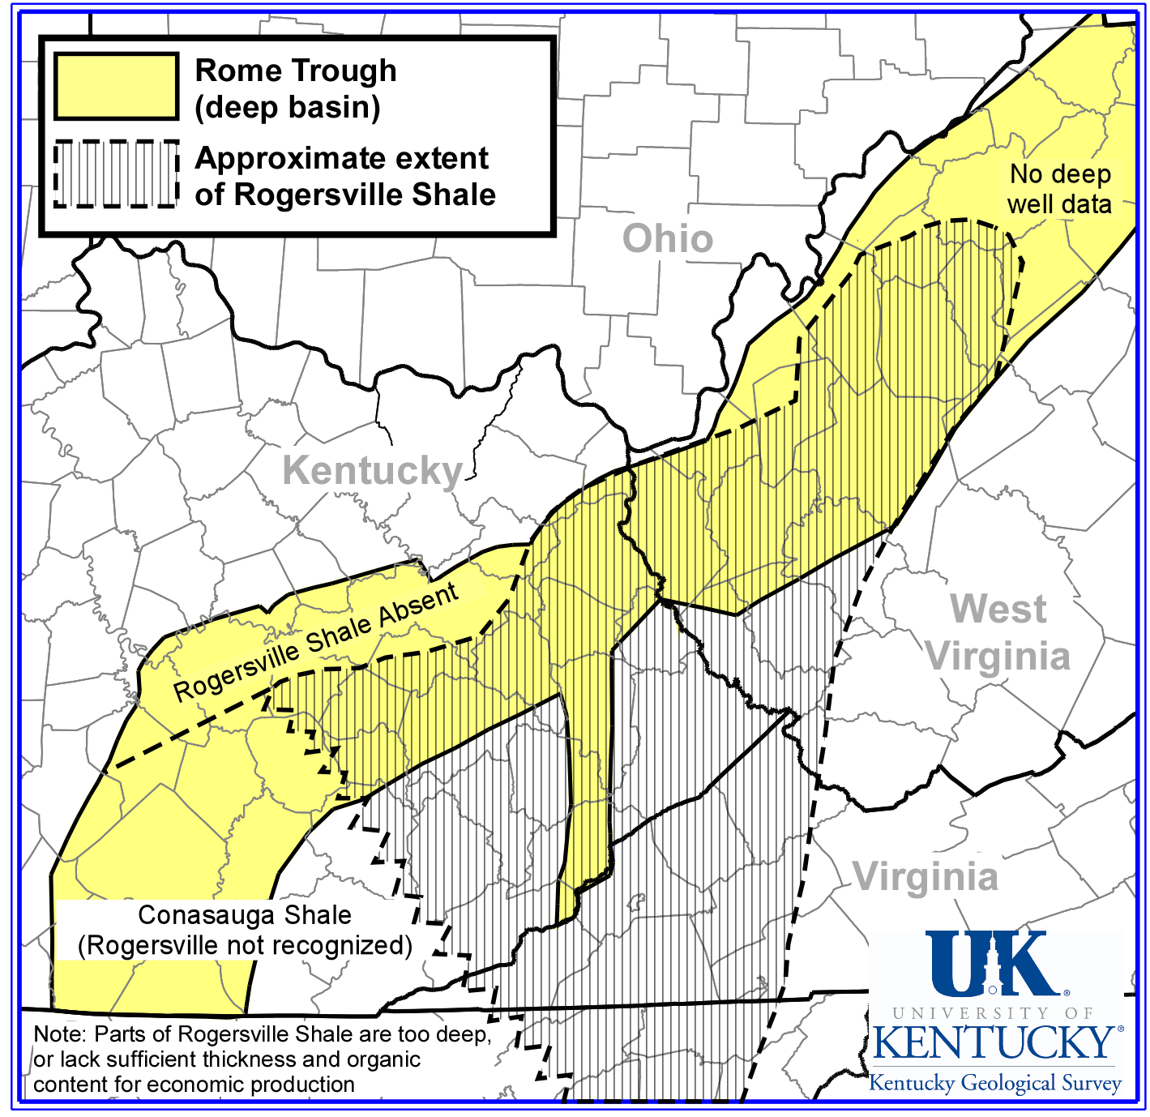
Cambrian Rogersville Shale
Deep Rome Trough
Lawrence and Johnson Counties, eastern Ky.
Early appraisal phase (most data confidential), gas and oil
9,000 to 14,000 ft deep
High-volume hydraulic fracture stimulation

Slide 6
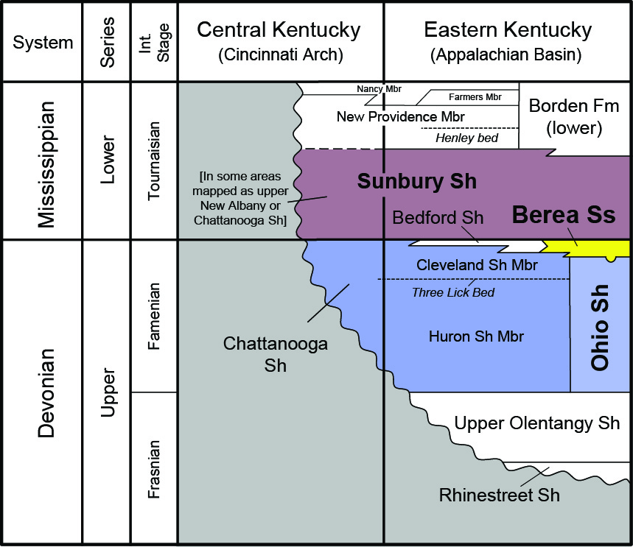
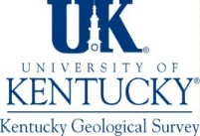
Berea Sandstone
Upper Devonian marine shelf siltstone/ very fine sandstone
Avg. porosity (~13%) and permeability (2.2 md)
Encased by Sunbury and Ohio Sh, both organic-rich shales

Slide 7
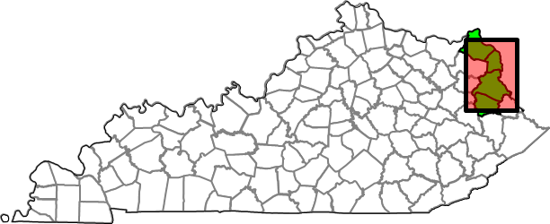
Horizontal Oil Play in the Berea Sandstone
New oil play in older producing area (horizontal infill)
“Tight sand”- very fine sandstone to siltstone; low permeability
Key technology: horizontal drilling with hydraulic fracturing (ave. 252,000 gal fluid)
Shallow depth: 700–1,600 ft
Production rates of 20-200 barrels/day reported

Slide 8
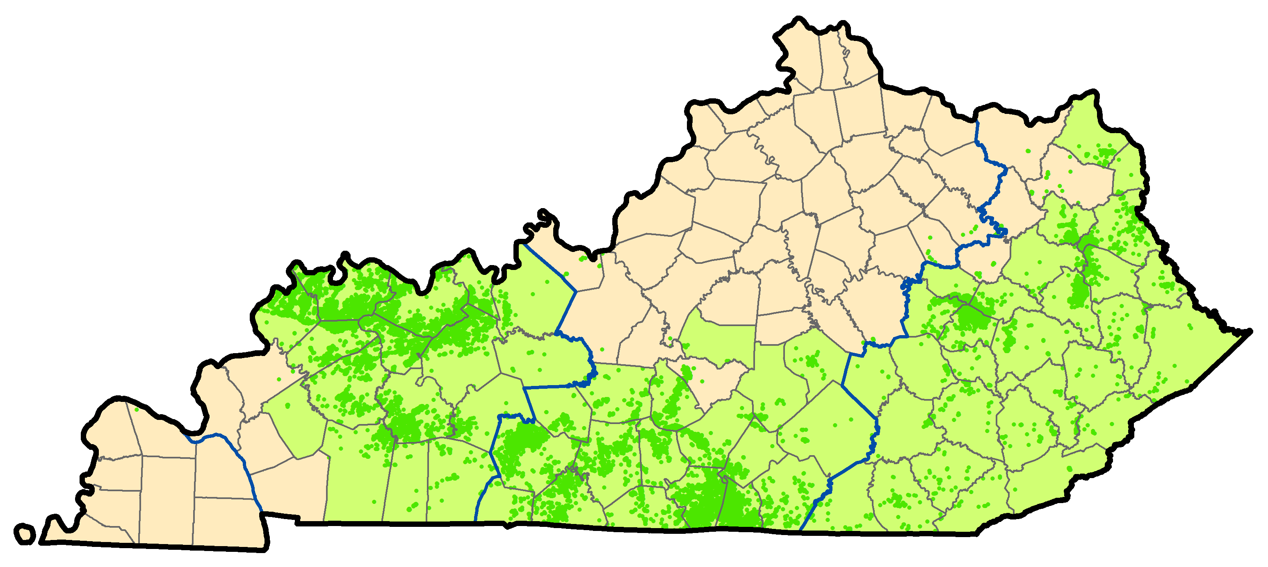
2015 Oil Production: 2.8 MMbo
(2014 – 75% increase over 2011)
58 %
34.2 %
8.3 %
63 Kentucky counties
Slide credit: Brandon Nuttall
Notes:
Horizontal oil wells drilled in northeast Kentucky beginning in 2011 pushed annual production to more than 4 million barrels in 2014, the highest production since 1994. In 2015, production fell 30% to 2.8 million barrels. Eastern Kentucky produces 58% of the statewide total oil.

Slide 9
Cambrian Rogersville Shale (Conasauga Group)
KGS identified hydrocarbon source potential in 2002 Rome Trough Consortium study
Source for Elliott County, Ky. Homer Field gas and oil
2-4.8% total organic carbon in parts; thermally mature
5,000 to 10,000 ft deep in E. Ky.
Up to 1,100 ft thick, but limited to deeper parts of Rome Trough (and not all is organic-rich)

Slide 10
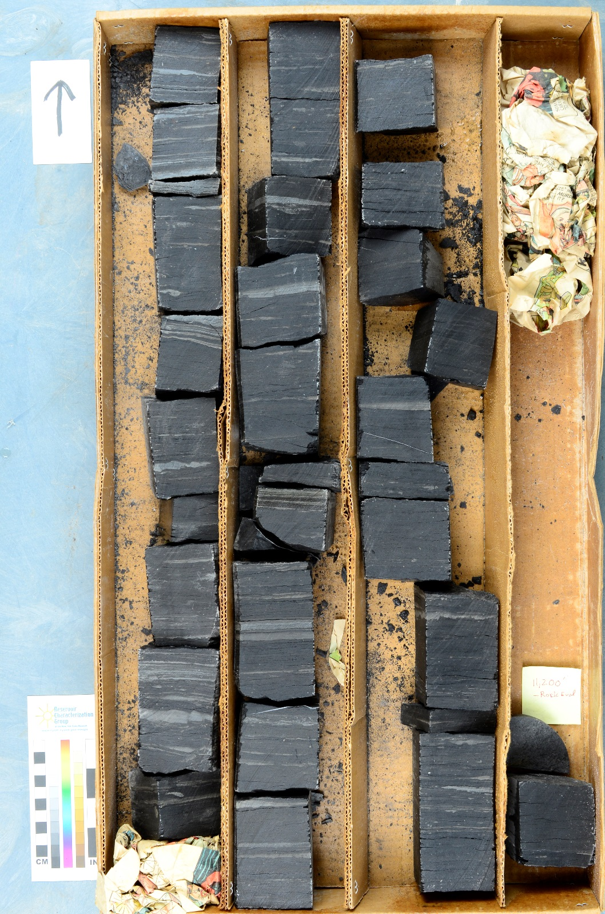
Rogersville Shale Wayne Co., W. Va. 11,191-11,200’

Slide 11
Cabot 50 Amherst Industries
Hard Rock Expl 1 Young, GD
Chesapeake LAW1 Stephens, J
Bruin Expl 1 Young, S
Chesapeake LAW1 Northup Est
Bruin Expl 1 Walbridge
Horiz. Tech Energy 572360 EQT
Play concept proven, economics are not

Slide 12
Impacts
Significant increase in state oil production from Berea; too early for Rogersville
New regulations for unconventional wells:
High-volume horizontal fracs: >80,000 gal per stage or 320,000 gal total
For deep HVHF: notify surface owners before frac, and surface water/groundwater testing required
FracFocus disclosure required for HVHF within 90 days
KGS research to support prudent development

Slide 13
KGS Research Response
Industry-funded Berea Consortium just completed 21-month multidisciplinary study
Two new research programs to collect baseline data:
Microseismic: Seth Carpenter, Hazards Section
Groundwater quality: Junfeng Zhu, Water Section
Pre-development baseline data will allow recognition of natural vs. man-made events
Goal: avoid induced seismicity and other energy development-related issues

