Slide 1
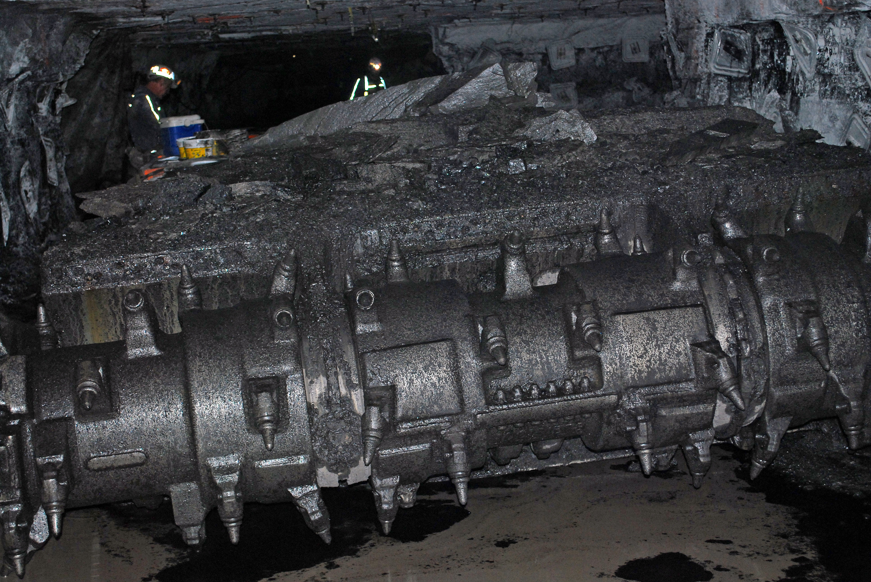

Kentucky Coal and Coal Combustion By-Products as Potential Sources of Rare Earth Elements
Cortland Eble
Kentucky Geological Survey
University of Kentucky
Kentucky Geological Survey Annual Meeting - 13 May, 2016

Slide 2
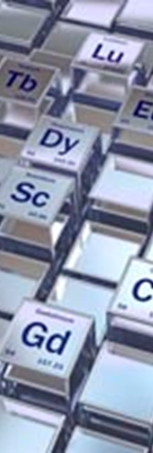
Pilot-scale Testing of an Integrated Circuit for the Extraction of Rare Earth Minerals and Elements From Coal and Coal Byproducts Using Advanced Separation Technologies
U.S. DOE/NETL Funded Project:
Area of Interest 2: Phase I
DOE ID: DE-FE0027035
NETL Project Officer: Charles Miller
Project Management:
University of Kentucky
Department of Mining Engineering
230 Mining & Mineral Resources Bldg.
Lexington, Kentucky 40506-0107
Principal Investigator: Rick Honaker
Award Amount - $1,320,000

Slide 3
Project Objectives
Develop, design and demonstrate a pilot-scale processing system for the efficient, low-cost and environmentally benign recovery of high-value rare earth elements (REE’s) from coal and coal byproducts.
  Integrate both physical and chemical separation processes
  Pilot-scale circuit will have a dry solids feed rate of ¼ - ton/hr (0.23 tonne/hr) and will be capable of producing 5 - 7 pounds (2.3 – 3.2 kg) per hour of combined concentrates with purity levels of at least 2 % (20,000 ppm) total REE’s by weight.
  Technical and economic feasibility of the proposed system will be fully evaluated with respect to separation performance, throughput capacity, capital and operating costs, and environmental acceptability.

Slide 4
University of Kentucky Personnel
Rick Honaker | Professor and Chair, Department of Mining Engineering 70 Refereed Journal Publications, 30 Refereed Conference Articles and 90 Others $10 million in Research as Principal Investigator
John (Jack) Groppo | Professor, Department of Mining Engineering Six U.S. Patents, 29 Refereed Journal Articles and 200 Other Publications Process Engineering & Surface Chemistry
James (Jim) Hower | Principal Research Scientist, Center for Applied Energy Research (CAER) > 330 Technical Articles World-Renowned Coal Geologist
Cortland Eble | Coal Geologist, Kentucky Geological Survey 25 years of Experience Participated in numerous studies quantifying and updating coal reserves, assessing coal quality and marketability.

Slide 5
What are Rare Earth Elements?

Slide 6
Rare Earth Element Abundances
The term rare earth elements (REE’s) is a historical misnomer; persistence of the term reflects unfamiliarity, rather than true rarity.
Several REE’s have crustal concentrations similar to chromium, nickel, copper, zinc, molybdenum, tin, tungsten, and lead.
REE’s with even atomic numbers are more abundant than ones with odd numbers.

Slide 7
Rare Earth Element Resources
1949 - a carbonatite intrusion with elevated contents of light REE’s, was discovered at Mountain Pass, in the upper Mojave Desert, California.
1960’s – Mountain Pass (owned and operated by Molycorp, Inc.) becomes a major source of REE’s. Early development was supported largely by the sudden demand for Eu created by the commercialization of, and demand for, color television sets.
1965 - mid-1980’s - Mountain Pass becomes a dominant source of REE’s, and the United States is largely self-sufficient in REE requirements. PC’s and cell phones do not exist (yet!).
1985 – 2000 – discovery of deposits, and production of REE’s, in China increases dramatically. Production from Mountain Pass declines due to environmental, regulatory and economic pressures.

Slide 8
Rare Earth Element Resources
2000 – Present - nearly all REE’s used in the United States are imported either directly from China, or from countries that imported their plant feed materials from China.

Slide 9
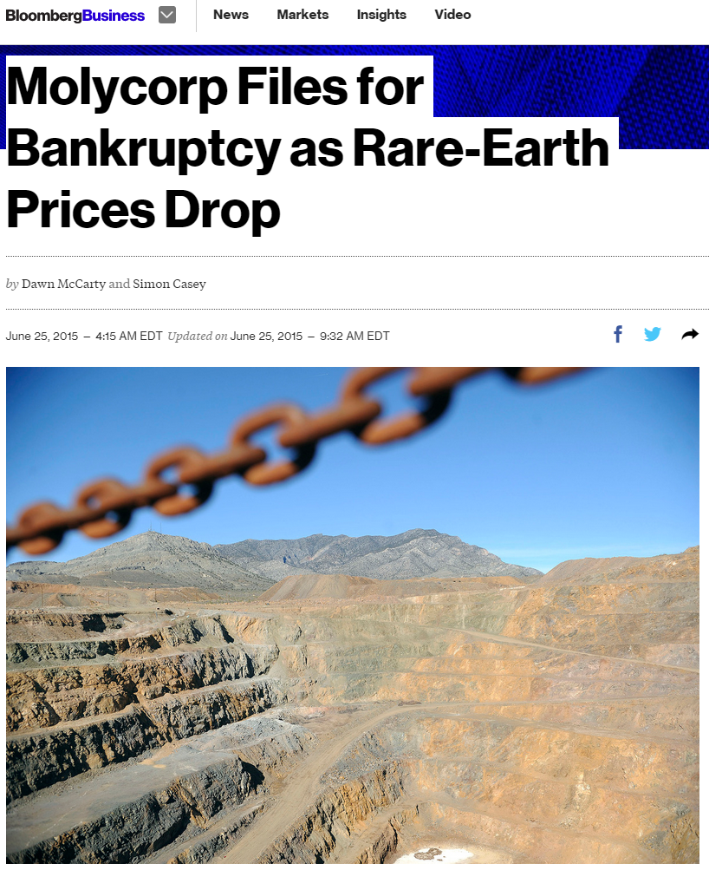
Volatile REE Prices

Slide 10
REE Applications
Magnets - Small, lightweight, high-strength REE magnets have allowed miniaturization of numerous electrical and electronic components Many recent technological innovations (e.g., portable disk drives, DVD drives, cell phones), would not be possible without REE magnets.
Refrigeration - Magnetic refrigeration is considerably more efficient than gas-compression refrigeration. In addition, they do not require refrigerants that are flammable or toxic, deplete the Earth’s ozone layer, or contribute to global warming.
Europium (Eu) - color cathode-ray tubes and liquid-crystal displays used in color televisions and computer monitors.
Erbium (Er) - Fiber-optic telecommunication cables can transmit signals over long distances with greater bandwidths, because they incorporate periodically spaced lengths of erbium-enhanced fiber that function as laser amplifiers.

Slide 11
KGS REE Research
July – October, 2014 - With USDOE funding, stimulated and secured by U.S. Congressman Hal Rodgers (representing Kentucky’s 5th District), 150 coal samples were assembled from existing collections, and sent to LTI, a USDOE contractor, for trace element analysis. Samples were chosen to best represent the Central Appalachian and Illinois Basins. Additional samples were obtained from Alabama, Mississippi and Texas to cover the southern Appalachians and Gulf Coast.
Approximately 1,300 samples were also collected from active mines, preparation plants, and coal-fired power plants. These samples were analyzed for REE content by the KGS in 2.5 months!!
November, 2014 – January, 2015 – A final report is assembled by LTI, forwarded to the USDOE, and presented to a congressional subcommittee.
March, 2016 – Research and testing continues with USDOE funding.

Slide 12
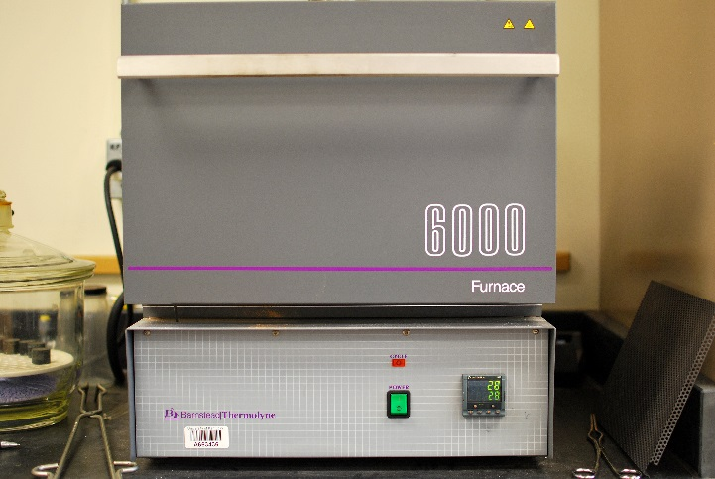
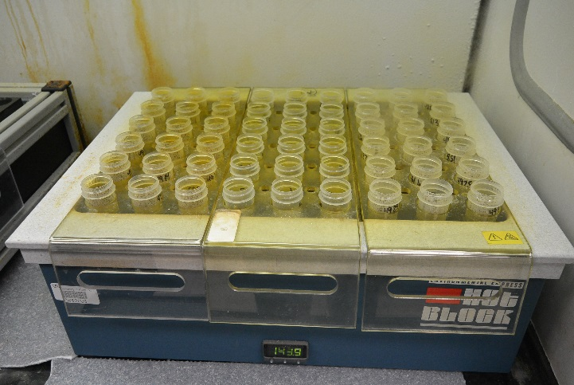
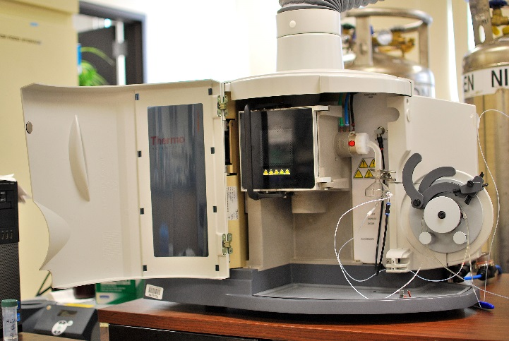
KGS REE Research
Sample Collection
(mines, prep and power plants)
Sample Preparation
(reduce material to -325 mesh)
Sample Ashing
(500⁰ C for 5 to 6 hours)
Sample Digestion
(HF/HCL/HNO₃ for 10 to 12 hours)
Sample Analysis
(5 to 10 minutes, via ICAP)
ICAP = Inductively-coupled argon plasma
optical emission spectroscopy

Slide 13
Total
REE + Y
(ppm)
295.9
976.6
1100.4
292.0
1018.3
263.7
Coal average = 1031.8 ppm
Rock average = 283.9 ppm

Slide 14
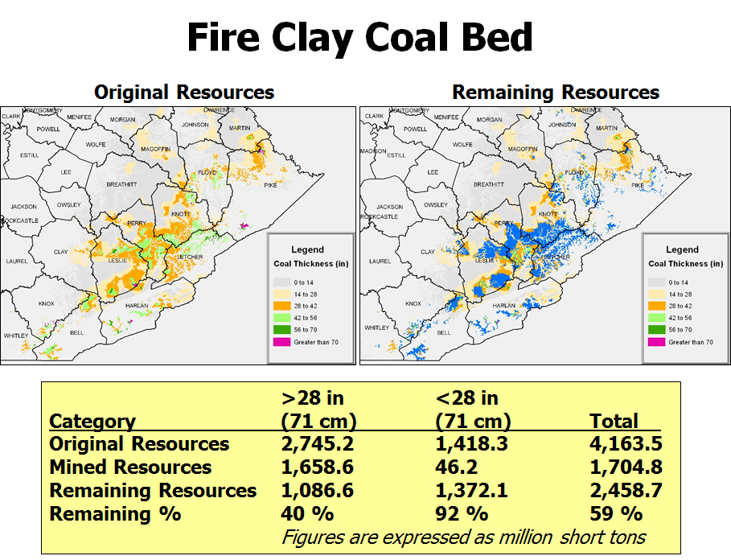
blue = mined-out

Slide 15
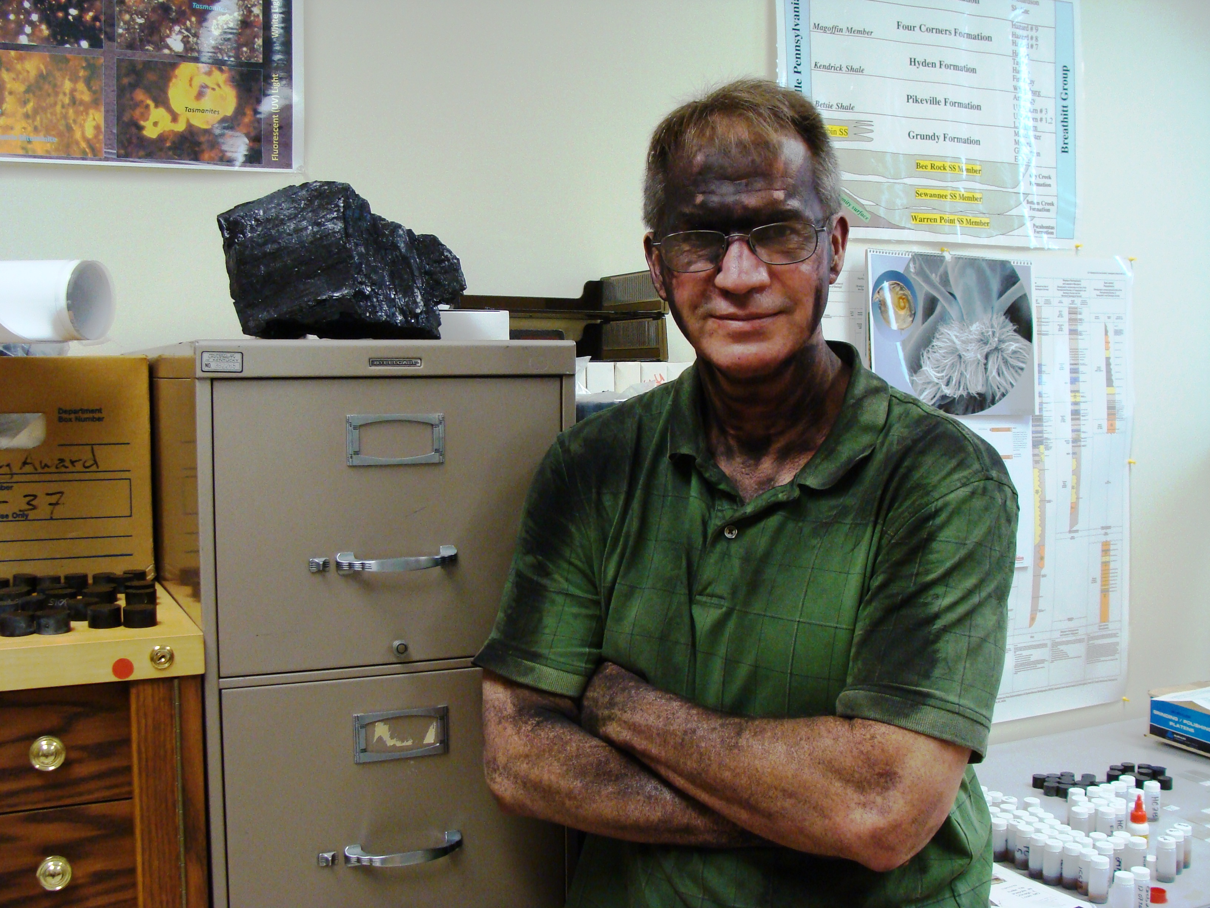
Thank You!

