Slide 1

Monitoring Induced- and Micro-Seismicity in Eastern Kentucky
Seth Carpenter
Seismologist
Geologic Hazards Section
2016 KGS Annual Seminar

Slide 2
Acknowledgements
  KGS
  Zhenming Wang
  Jerry Weisenfluh
  Kati Ellis
  Jifeng Chen
  Scott Waninger
  Max Hammond
  Mike Lynch
  Lifang Zhang
  EES
  Andrew Holcomb
  Paul Rodriguez
  Ed Woolery
  Nanometrics
  Andrew Moores
  Cimarex Energy
  Steve Roche
  Landowners!

Slide 3
Outline
Background and Motivation:
  Induced seismicity
  SWD and Unconventional O&G in E. Ky.
Microseismicity monitoring project
  Partnerships
  Monitoring Network
Project Status and first observations

Slide 4
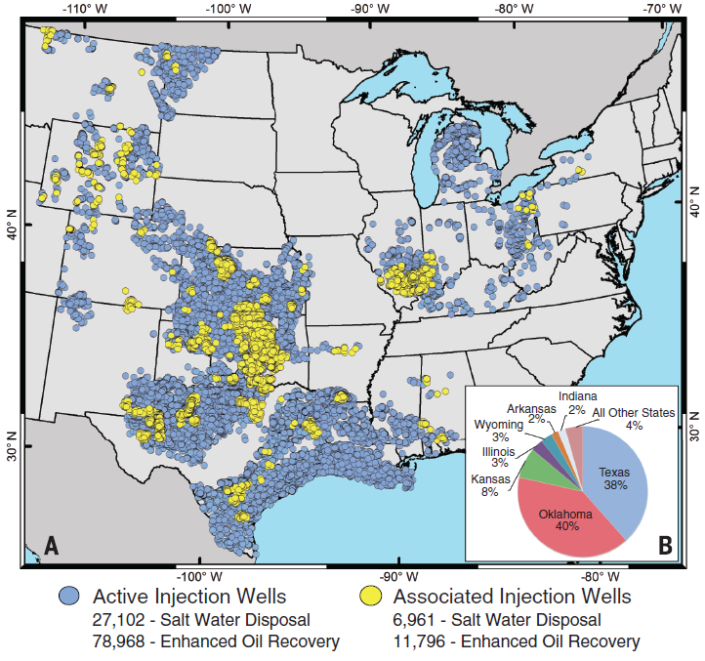
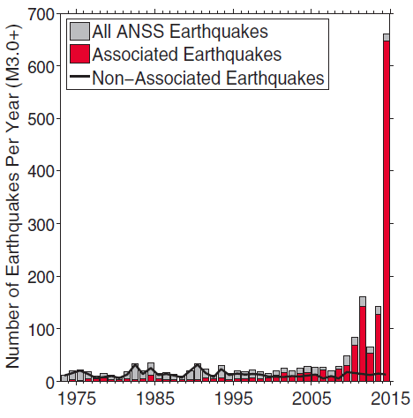
Background: Class II Injection Wells
~125k active wells
~15% SWD
~20% SWD associated
~13% EOR associated
?
10-25 / yr
Weingarten et al., 2015
Notes:
Dense clusters of active waste-water injection wells operate in Kentucky
10-25 M3.0+ eqs in CEUS prior to 2008
~125k active wells
~15% SWD
~20% SWD associated
~13% EOR associated

Slide 5
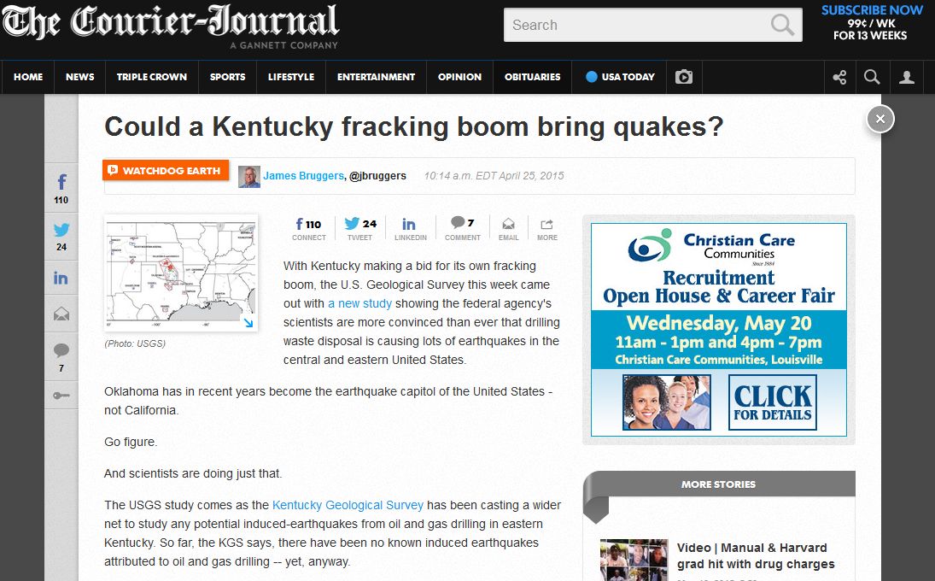
Background and Motivation
?
http://www.courier-journal.com/story/watchdog-earth/2015/04/25/usgs-more-convinced-oil-and-gas-drilling-produces-earthquakes-as-kentucky-makes-fracking-move/26355365/

Slide 6
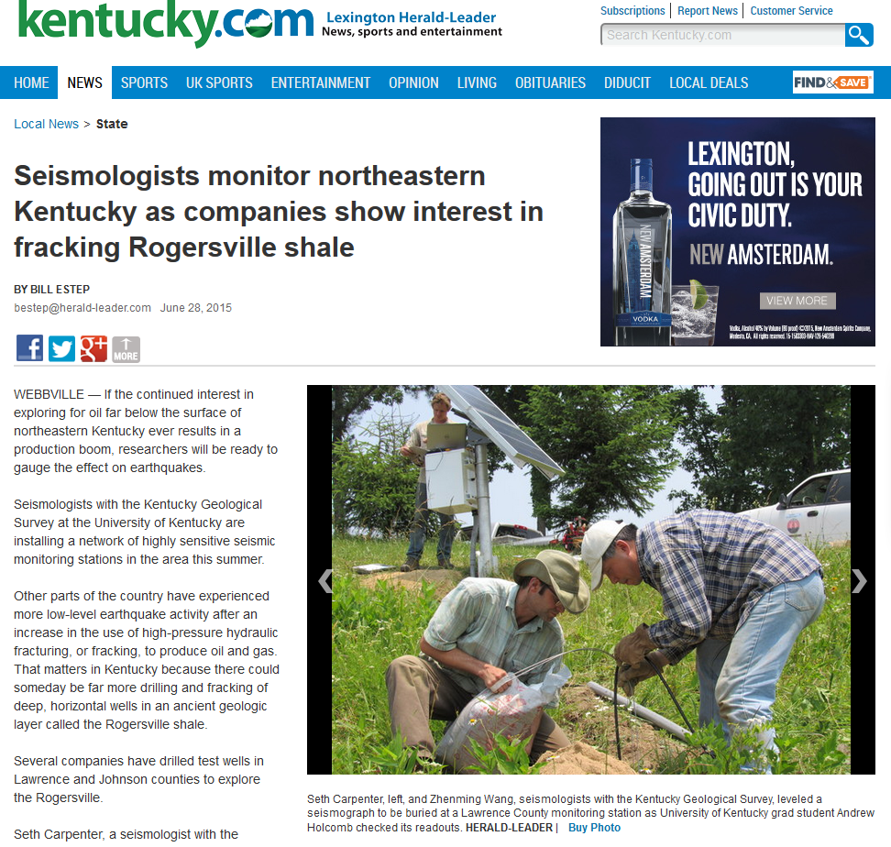
Monitoring Microseismicity in Eastern Kentucky
- KGS has begun a collaborative monitoring project to study this issue
Purpose: collect new data
  Establish background levels of natural earthquakes
  Determine if low-level induced seismicity is occurring
  Discriminate between natural and manmade seismic events.
  Project Partnerships:
  Cimarex Energy – Instrumentation loan, Research
  UK Earth and Env. Sciences Dept. – Graduate Student RA, Instrumentation
  Nanometrics, Inc. – Instrumentation purchase, Tech. support, Research
Notes:
It is important to perform a high-resolution study of microseismicity in eastern Kentucky because of the interest in developing deep shale gas plays, and because the effects of disposal of wastewater in deep injection wells in the heavily faulted Rome Trough of Kentucky are largely unknown. In addition, this part of eastern Kentucky is known to have moderate natural earthquakes, such as the 1980 magnitude-5.2 Sharpsburg earthquake (Fig. 1).

Slide 7
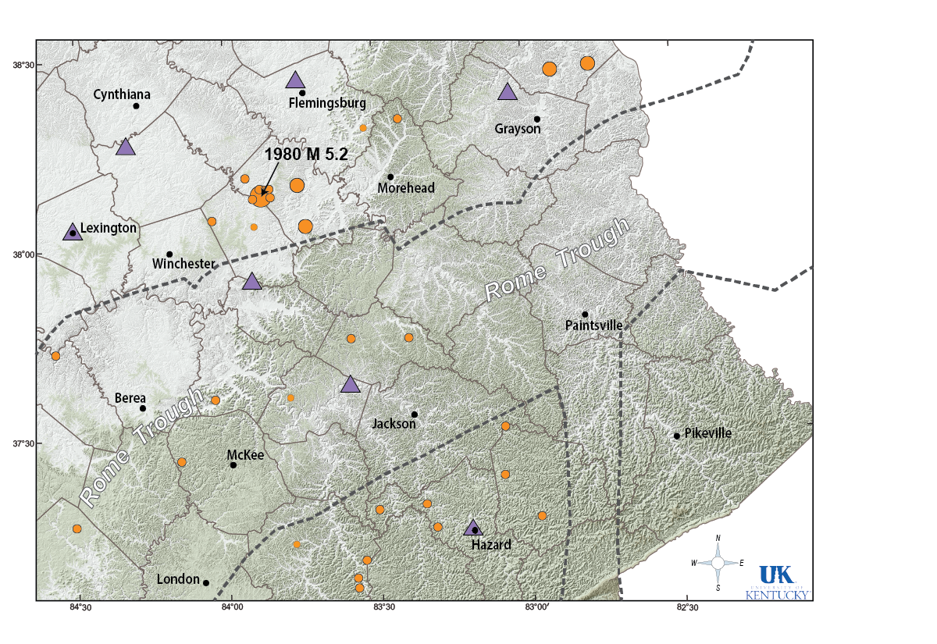
Monitoring Microseismicity in Eastern Kentucky
Notes:
These activities coincide with zones of on-going, natural earthquakes (including the 1980 M 5.2 Sharpsburg event).
Current seismic event detection threshold is modest: M ~2 – 2.5.

Slide 8
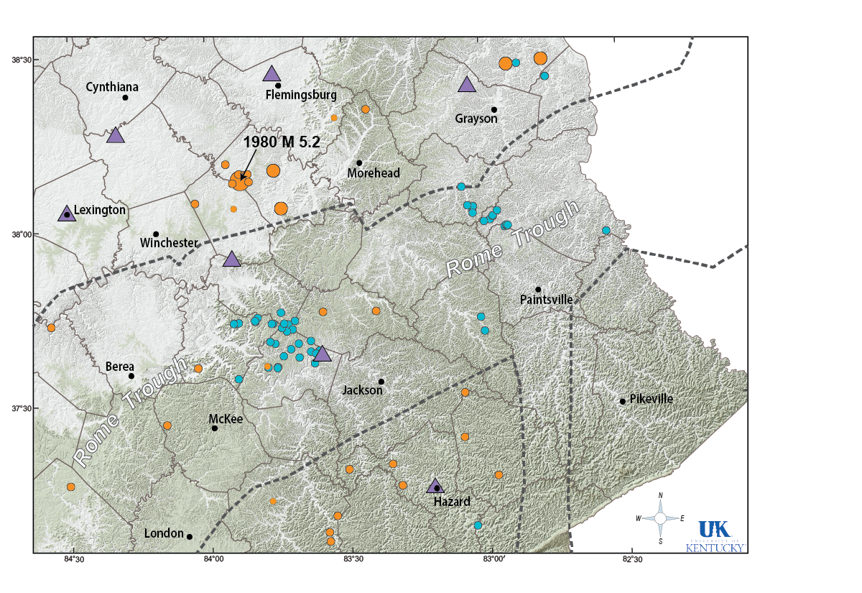
Monitoring Microseismicity in Eastern Kentucky
Notes:
Dense clusters of active waste-water injection wells operate in Kentucky

Slide 9
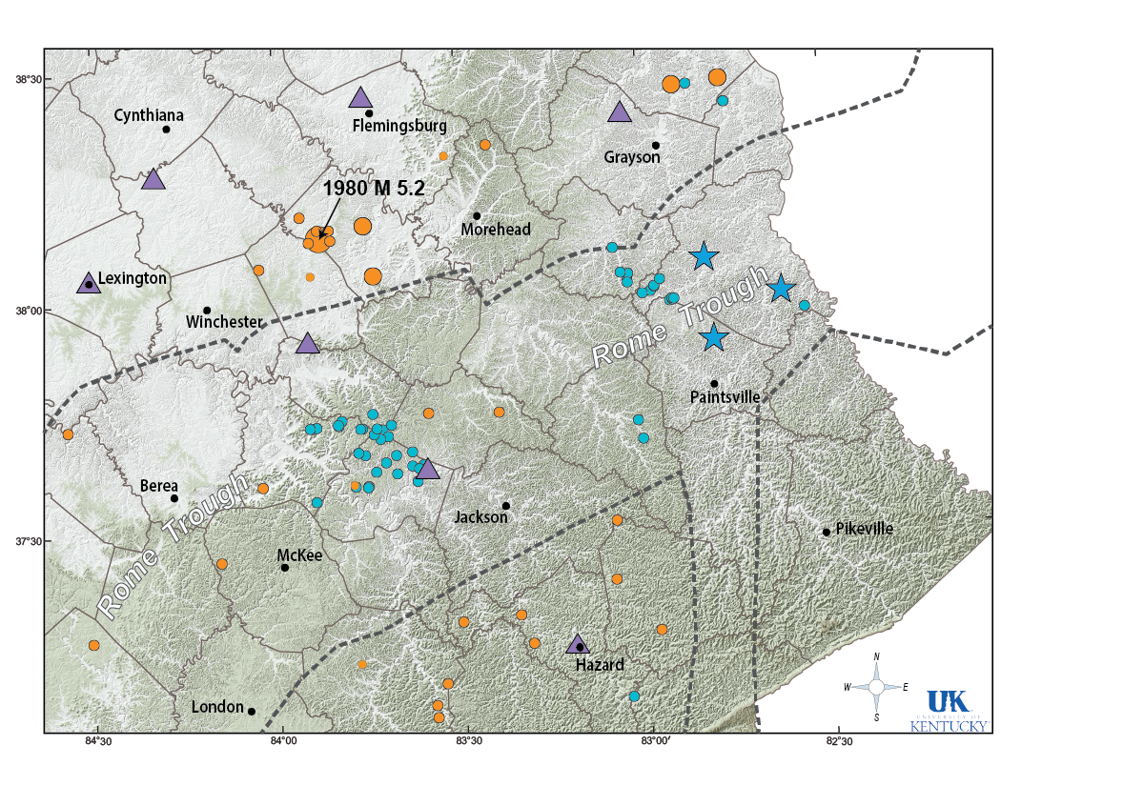
Monitoring Microseismicity in Eastern Kentucky
Notes:
Unconventional oil and gas production activities are increasing → increased likelihood to induce events from
Fracking

Slide 10
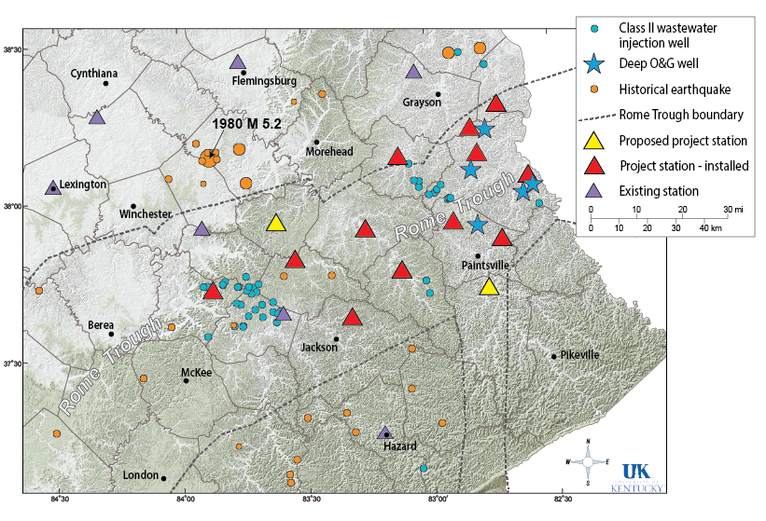
Monitoring Microseismicity in Eastern Kentucky: Network

Slide 11
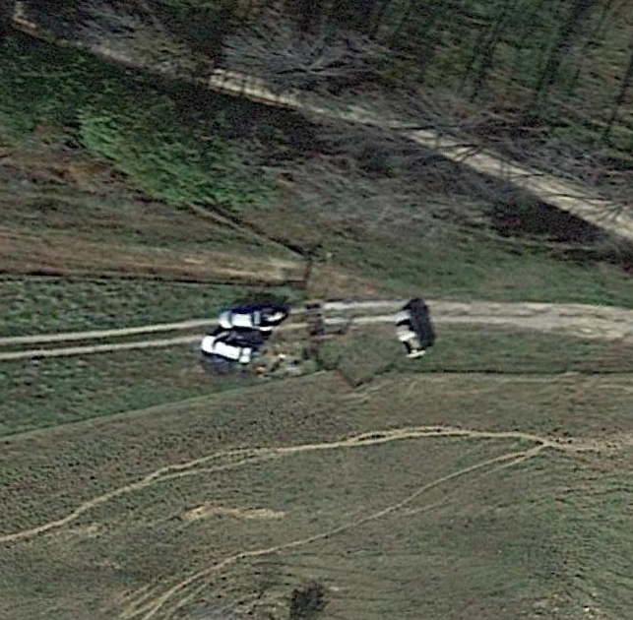
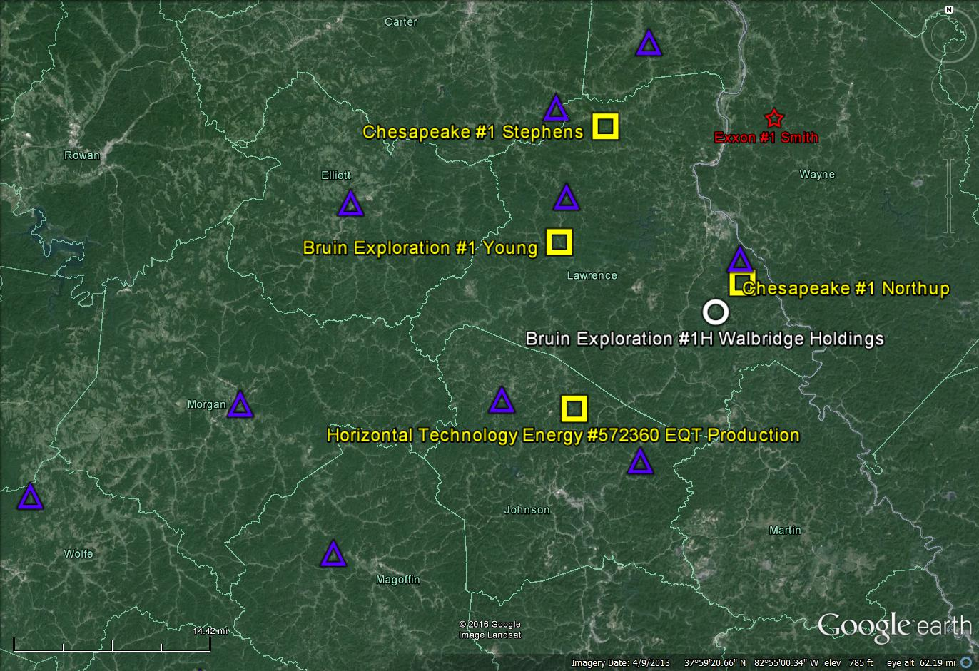
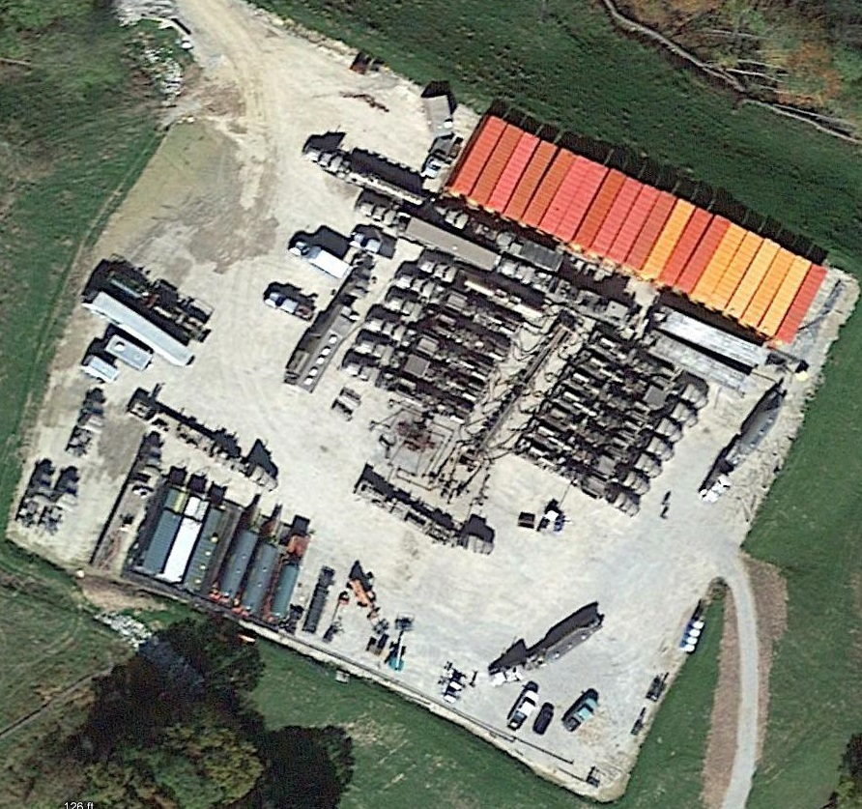
EKMMP: Installation
KGS Microseismic Station
Installation 10/19/2015
Chesapeake #1 Stephens
10/19/2015
Microseismic stations

Slide 12
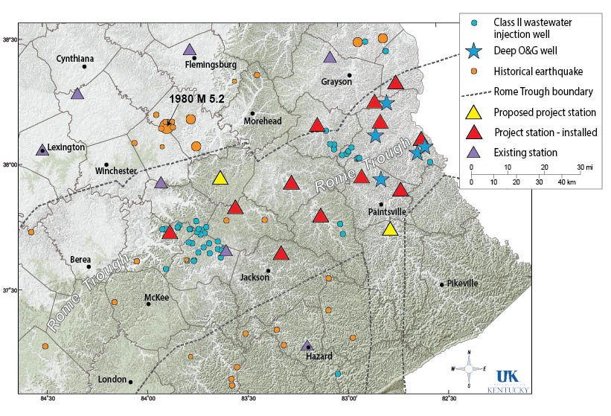
EKMMP: Status & First Findings
  Status:
Network
  12 Stations Installed as of Nov., 2015
  More on the way
  Data & Analysis
  Simultaneous acquisition of other data
  Data in real-time at KGS
  Real-time event location
  First Findings:
  Earthquakes
  7 local earthquakes – none in the Rome Trough
  19 earthquakes within 200 km – one in the WV Rome Trough
Blasts
  > 2100 blasts within ~200 km radius ≈ 18/day

Slide 13
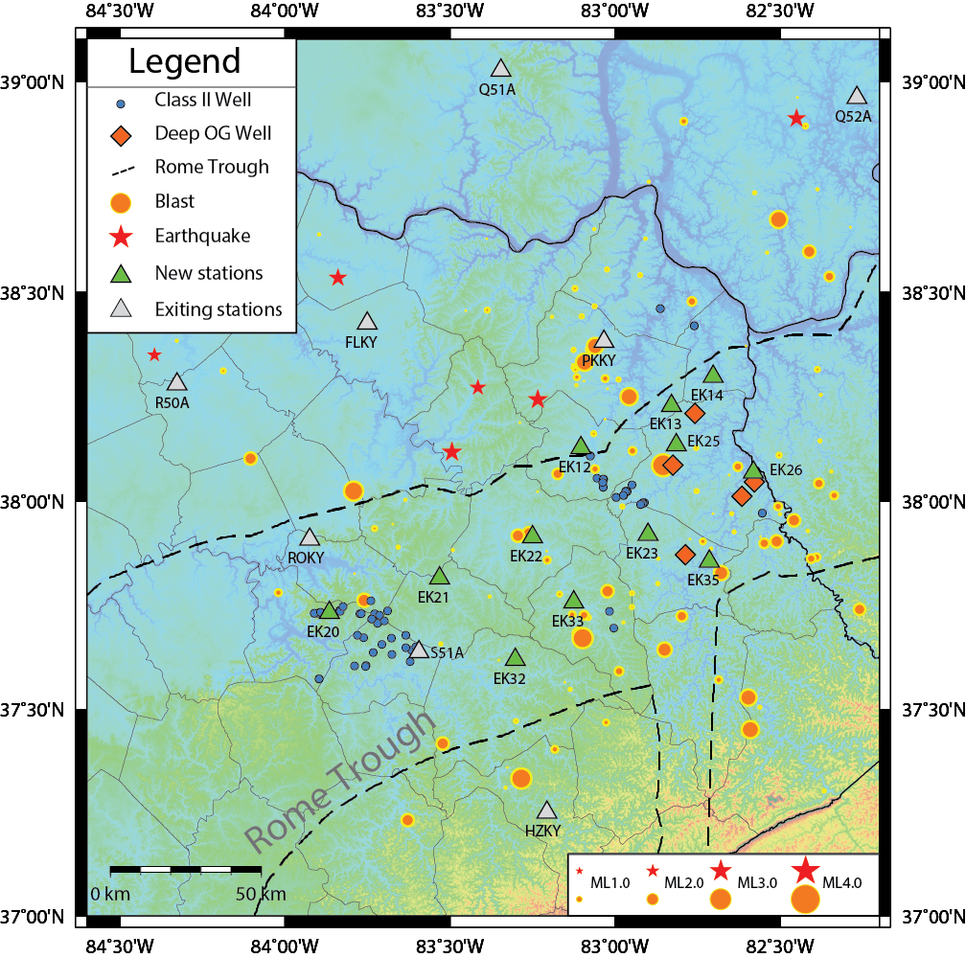
EKMMP: Status & First Findings
  Real-time system

Slide 14
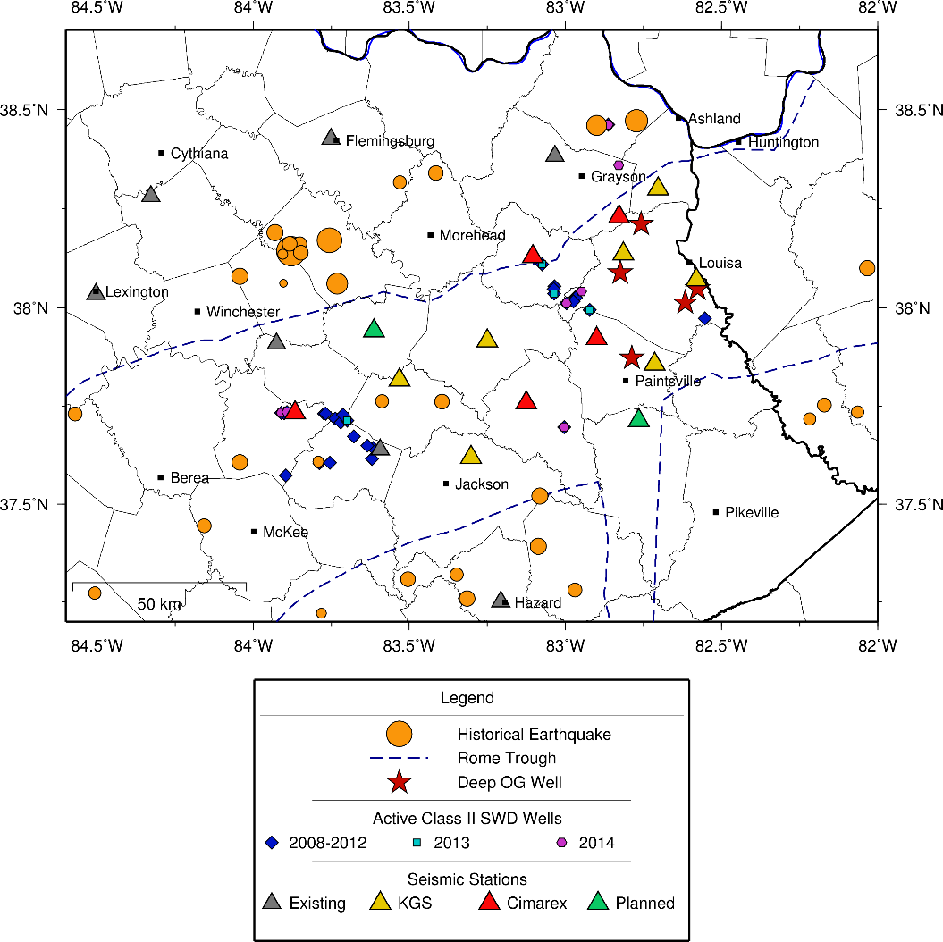
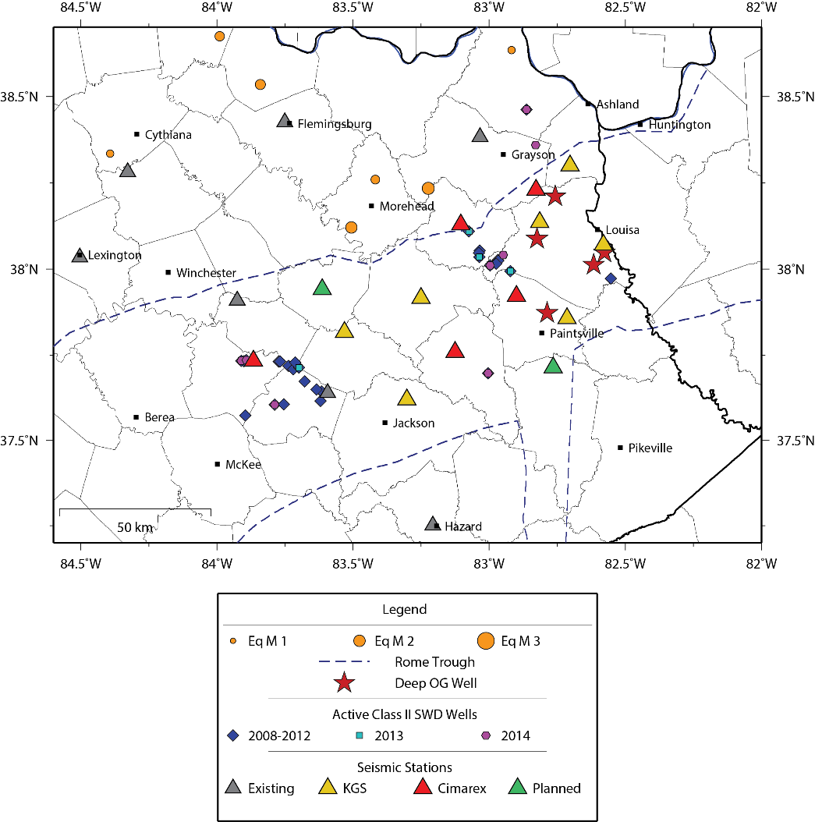
EKMMP: First Findings
Historical earthquakes: Past 40 years
Local earthquakes by EKMMP

Slide 15
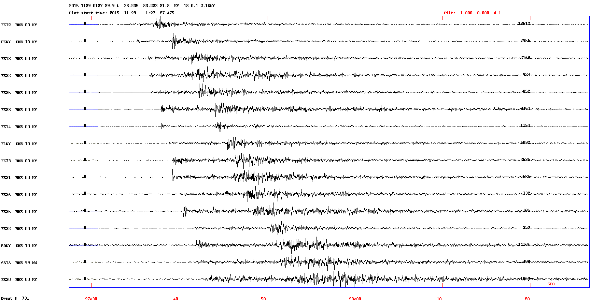
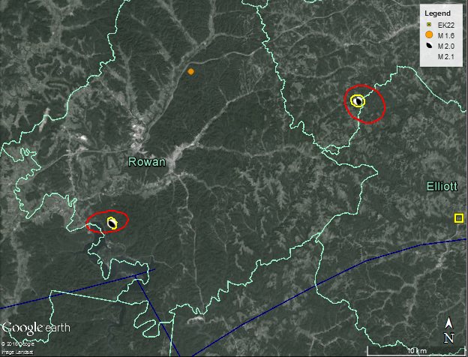

EKMMP: First Findings
  29 Nov 2015 M 2.1: 16 stations within 80 km of the epicenter:
  Uncertainty (km) H Z
  Without EKMMP: 3.1 4.7
  With EKMMP: 1.0 1.2
  Style of Faulting:
  Uncertainty (km) H Z
  Without EKMMP: 2.5 29.8
  With EKMMP: 0.7 7.3
  Style of Faulting:
16 km
23 km
35 km
36 km
37 km
45 km
46km
Regional Stress
51 km
54 km
54 km
59 km
61 km
69 km
72 km
74 km
79 km

Slide 16
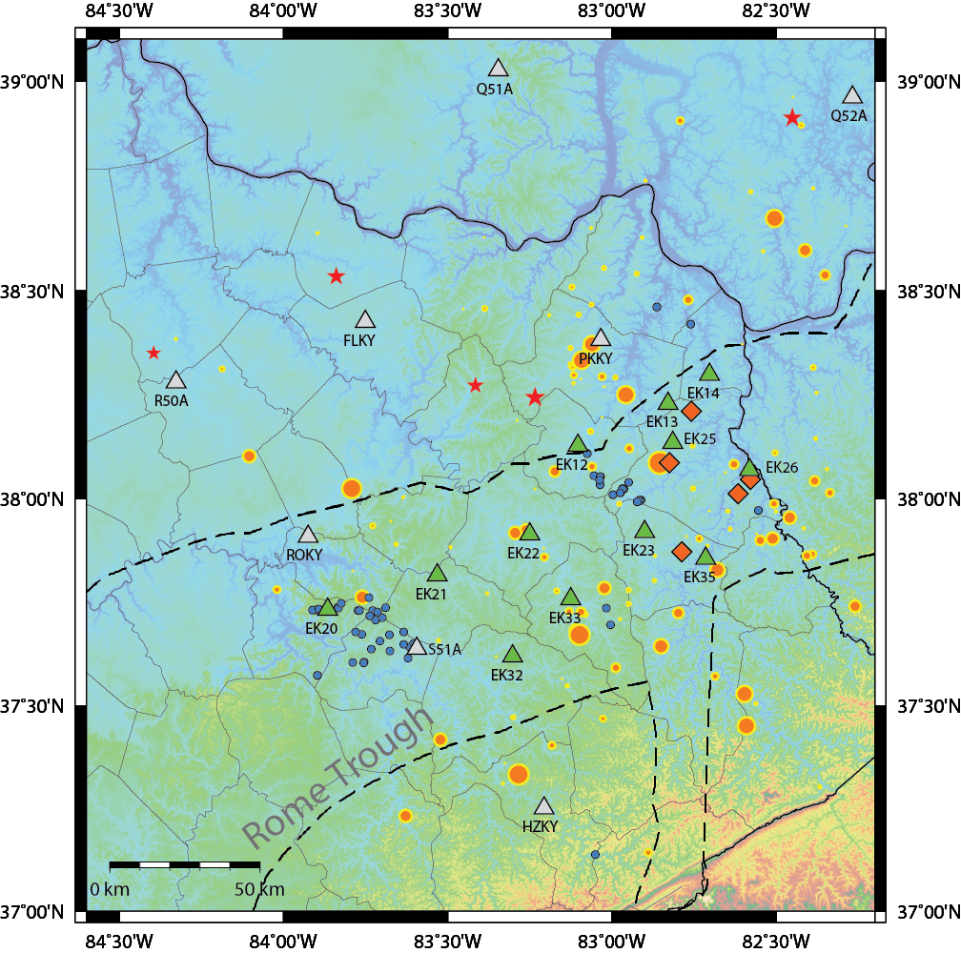
EKMMP: Conclusion
- Thank You -
Increased oil and gas production and wastewater injection could increase the likelihood of felt-events in the Rome Trough, eastern Kentucky. None so far!
KGS, with Cimarex Energy, EES Dept. (UK), and Nanometrics, is conducting this study to:
    Establish background levels of natural micro-earthquakes
    Monitor low-level induced seismicity
    Discriminate between the natural and manmade events.
    Project website:
    http://www.uky.edu/KGS/geologichazards/induced_seismicity.htm
Project contact:
Seth Carpenter (seth.carpenter@uky.edu)
Notes:
Gaining an understanding of the injection-related and geological conditions required for inducing (or not) earthquakes.
Improving the ability to robustly discriminate between natural and induced events.
Establishing background levels prior to the occurrence of any events of significance

Slide 18
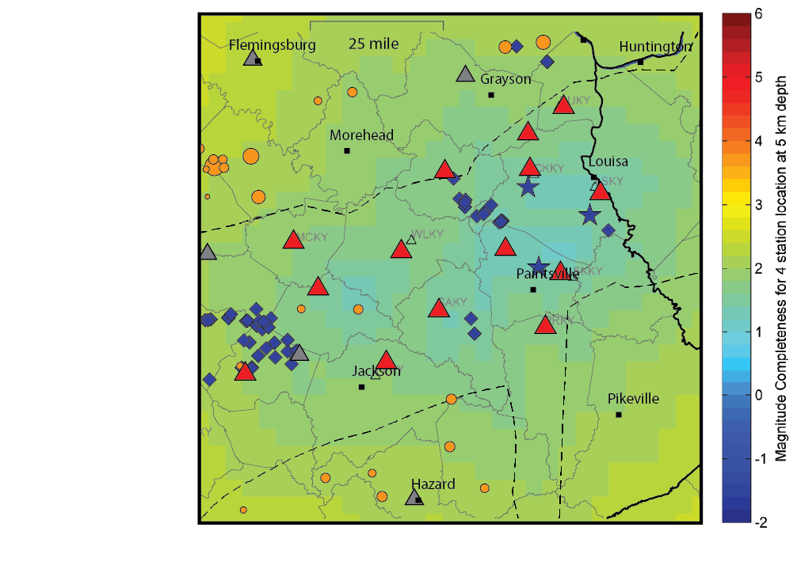
Monitoring Microseismicity in Eastern Kentucky: Magnitude Threshold
M ~ 1 in particular regions
Preliminary result for 9 stations (for illustration purposes only)

Slide 19
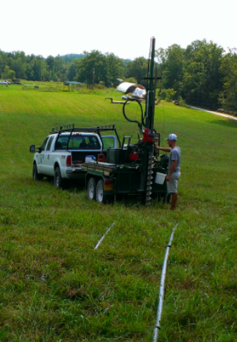
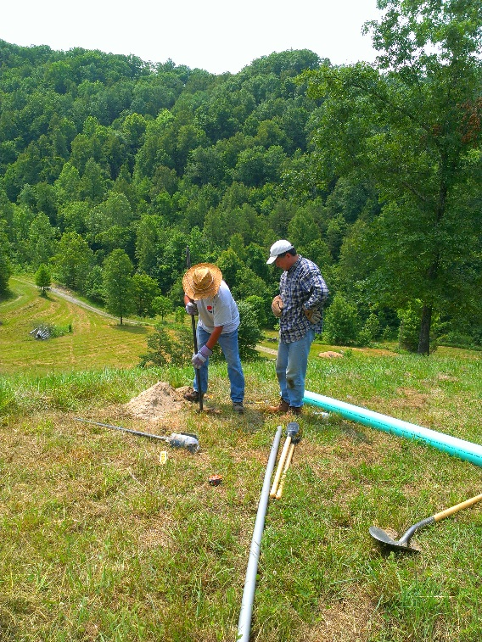
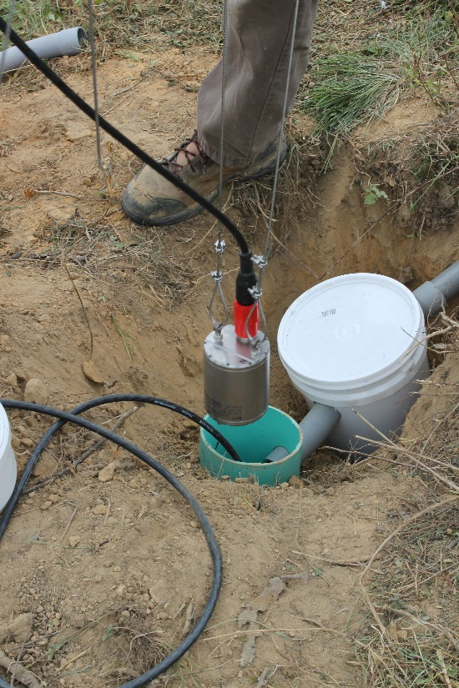
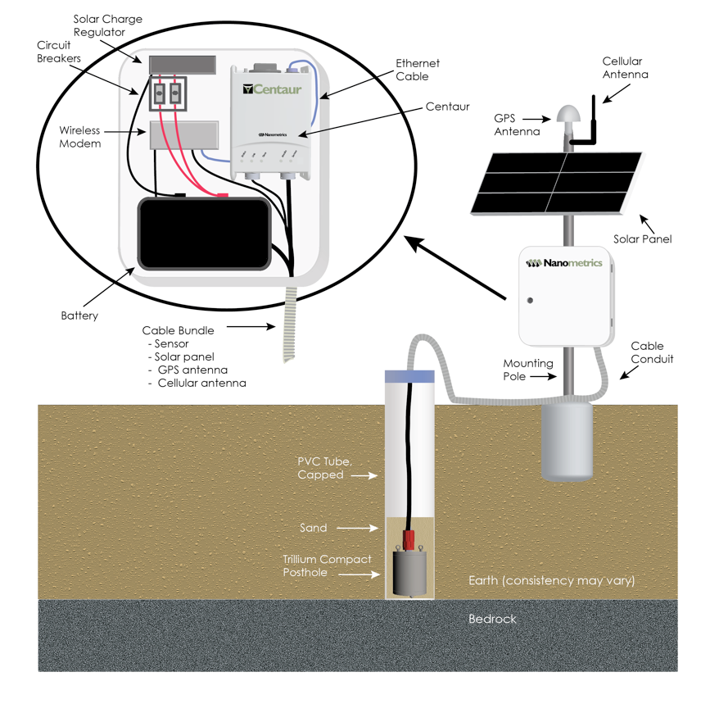
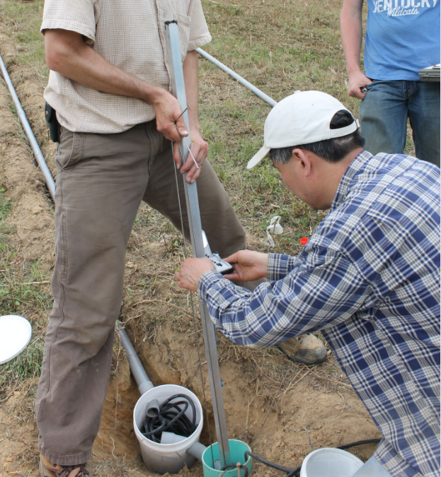
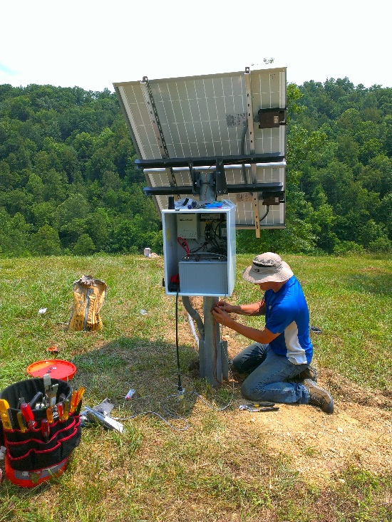
EKMMP: Installation
All KGS stations are borehole installations:

Slide 20
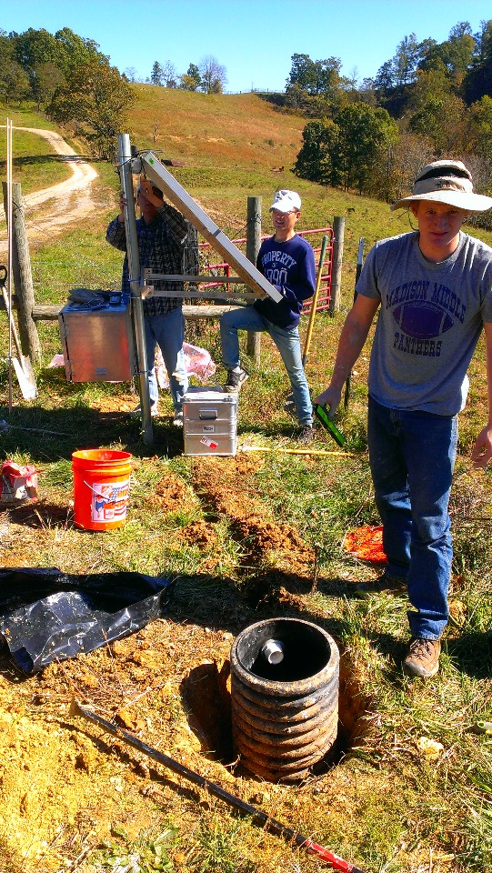
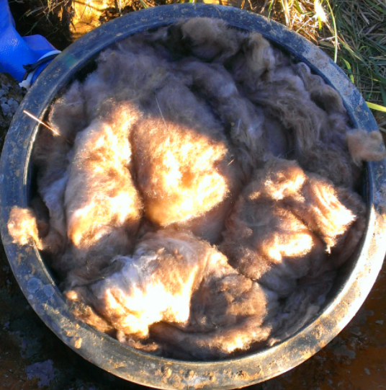
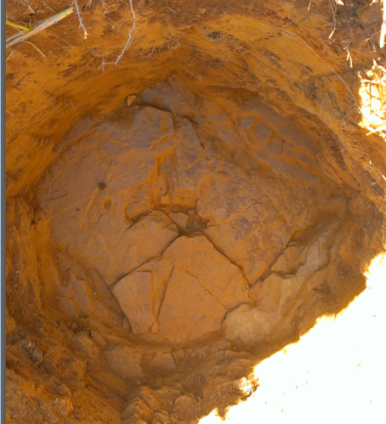
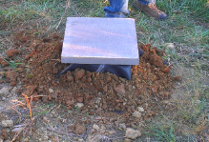
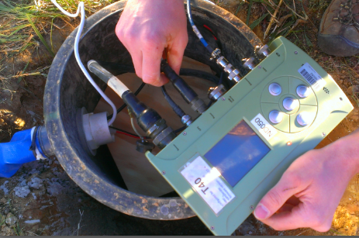
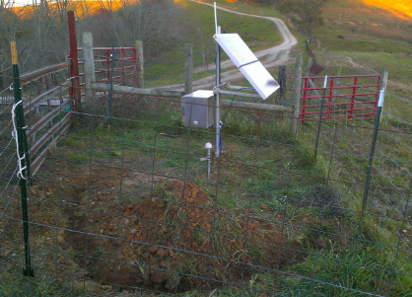
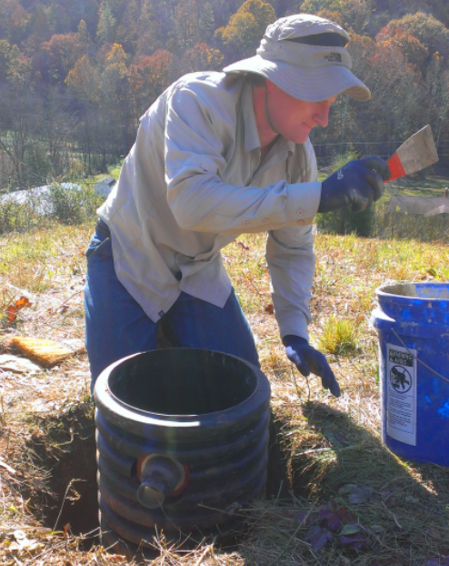
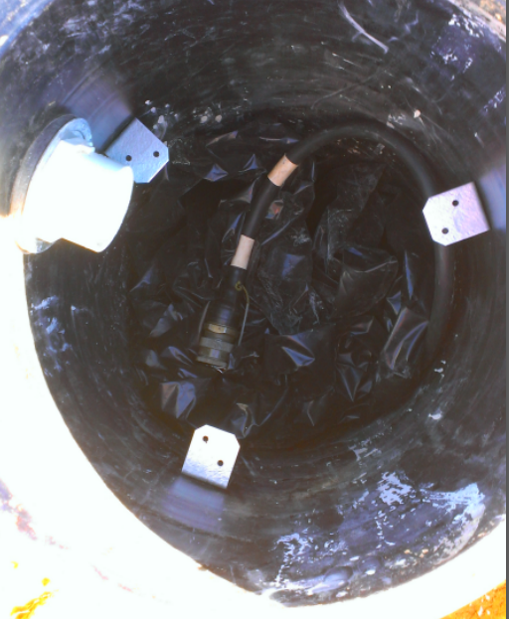
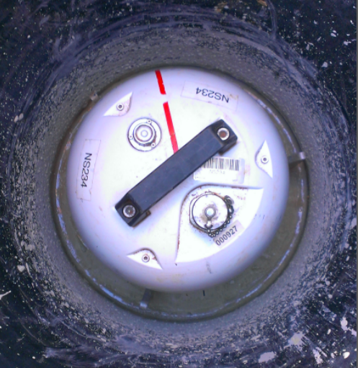
EKMMP: Vault Installation
All Cimarex stations are vault installations:

Slide 21
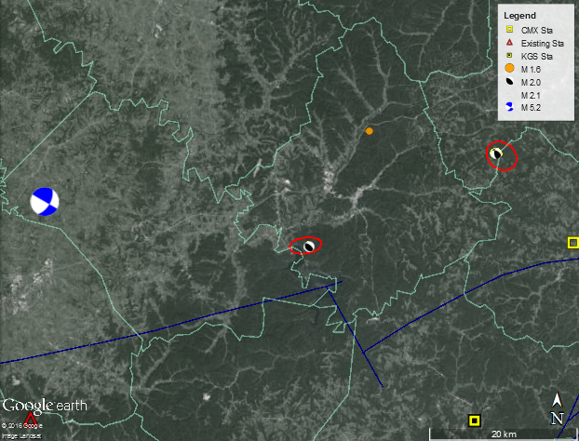
EKMMP: First Findings
  29 Nov 2015 M 2.1: 16 stations within 80 km of the epicenter:
  Uncertainty (km) H Z
  Without EKMMP: 3.1 4.7
  With EKMMP: 1.0 1.2
  Style of Faulting:
  Uncertainty (km) H Z
  Without EKMMP: 2.5 29.8
  With EKMMP: 0.7 7.3
  Style of Faulting:
16 km
23 km
35 km
36 km
37 km
45 km
46km
51 km
54 km
54 km
59 km
61 km
69 km
72 km
74 km
79 km

Slide 22
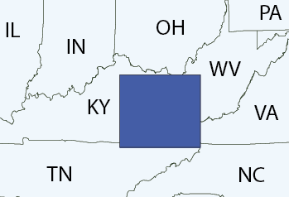
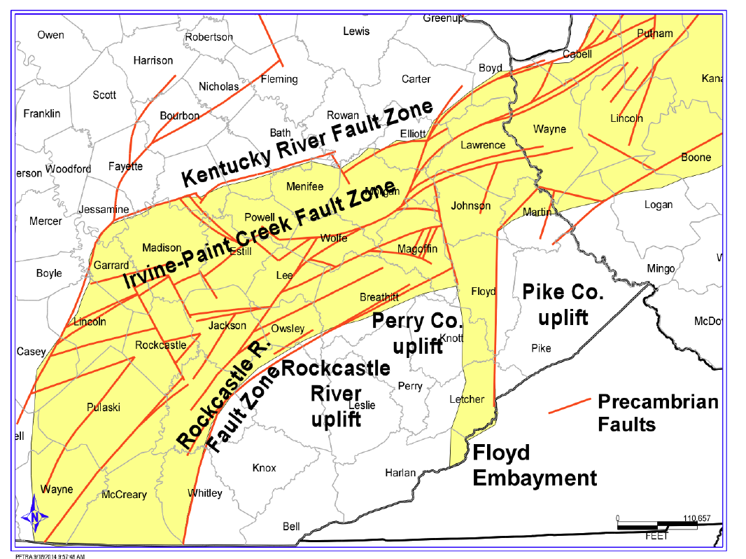
Background: Setting - the Rome Trough
Notes:
Opening of Iapetus Ocean
From 5,000’ – 15,000’ deep

Slide 23
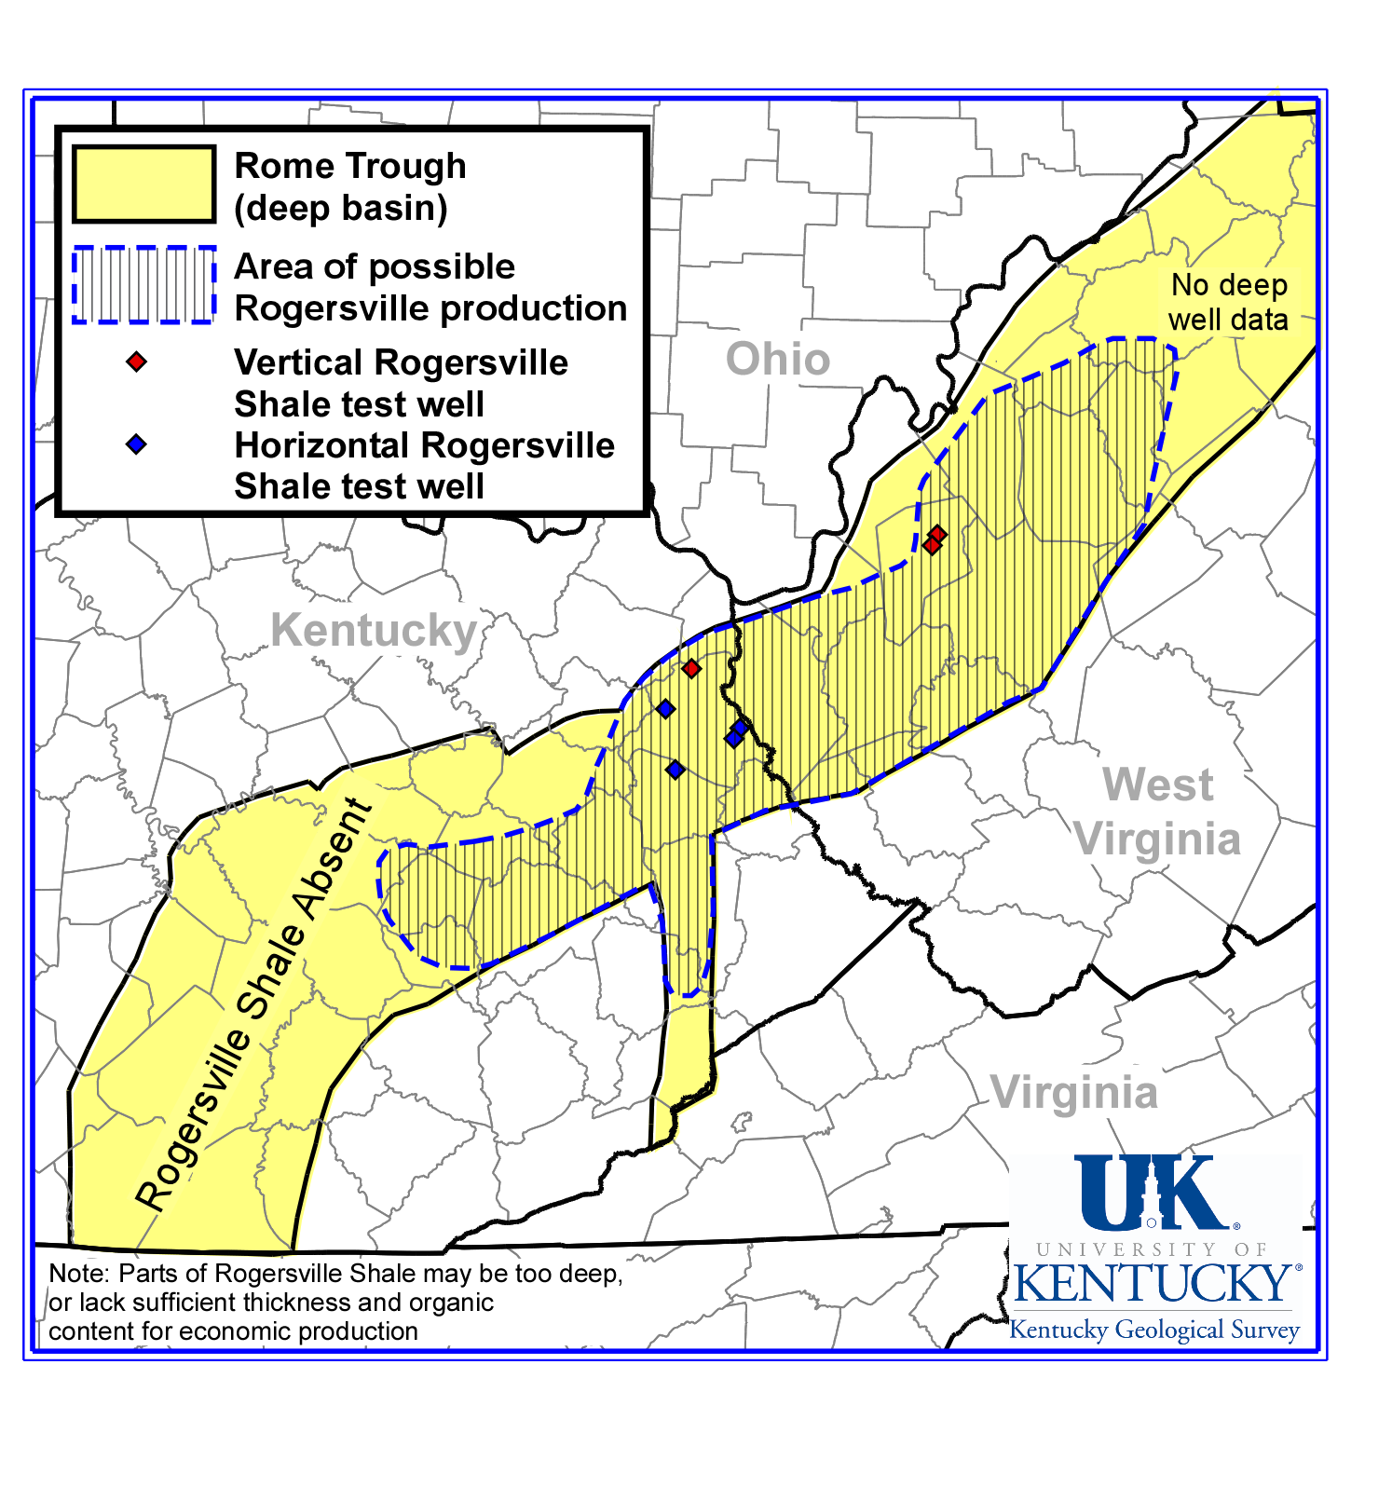
Background: O&G Wells in the Rogersville Shale
2015
2014
2015
Notes:
5,000 to 10,000 feet deep in eastern Kentucky
Extracting oil and gas from this deep formation requires high-volume hydraulic fracturing and horizontal drilling.
- Bruin #1 Young well fracked in 2014 – not currently producing.
- EQT well fracked in 2015 – Current status unknown

Slide 24
EKMMP: Status & First Findings
  Earthquakes within 200 km:
2015-06-15 14:28:04.2 36.511 -83.936 21.2 2.2
2015-06-16 04:37:49.7 37.108 -80.863 1.4 2.6
2015-06-27 07:16:24.9 38.634 -82.917 3.5 1.3
2015-07-03 05:20:52.7 36.867 -83.729 22.5 1.2
2015-07-10 06:09:33.4 38.981 -81.930 29.5 1.5
2015-07-21 03:10:45.1 36.462 -83.748 11.7 2.8
2015-07-27 07:37:45.7 36.039 -83.675 20.7 1.6
2015-08-20 02:45:41.1 37.999 -84.836 34.6 2.8
2015-09-12 04:12:10.7 40.248 -81.203 5.0
2015-10-01 07:25:32.9 40.206 -81.167 1.4 2.1
2015-10-06 02:52:12.8 38.280 -85.272 2.0 3.1
2015-10-18 07:24:11.4 38.725 -82.555 0.1 1.6
2015-11-29 01:27:29.9 38.235 -83.223 21.8 2.1
2015-12-13 00:41:17.7 38.674 -83.990 4.8 1.7
2015-12-13 10:38:25.9 36.692 -83.744 3.1 2.6
2015-12-22 15:20:33.0 38.260 -83.417 0.8 1.6
2016-01-04 11:15:20.4 36.491 -84.015 23.1 2.8
2016-02-02 08:09:02.5 38.335 -84.392 34.0 1.3
2016-02-20 09:24:32.4 36.188 -83.332 0.0 2.5
2016-02-24 03:30:05.0 38.535 -83.840 4.8 1.8
2016-03-01 02:38:34.4 35.981 -82.365 7.7 2.5
2016-03-08 14:25:29.4 38.911 -82.443 18.4 2.0
2016-04-26 19:24:03.8 38.121 -83.506 4.0 2.0
2016-05-08 23:17:25.6 39.029 -81.430 25.0 2.2

Slide 25
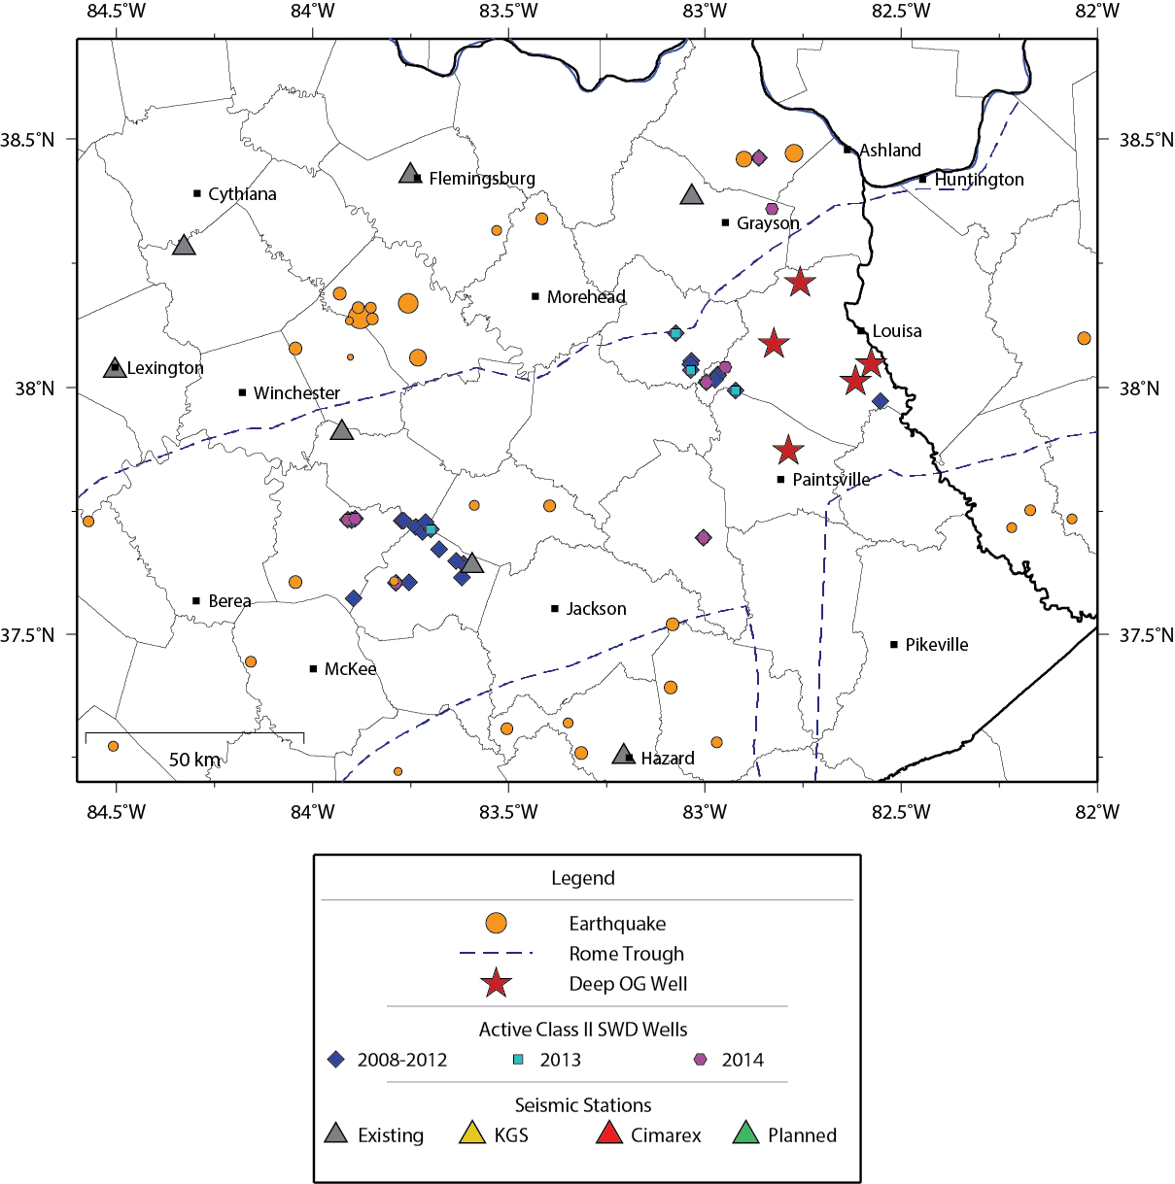
EKMMP: Purpose – I.S. from Waste Water Injection
Reduction in active SWD wells in 2013-2014 (or incomplete data?)

Slide 26
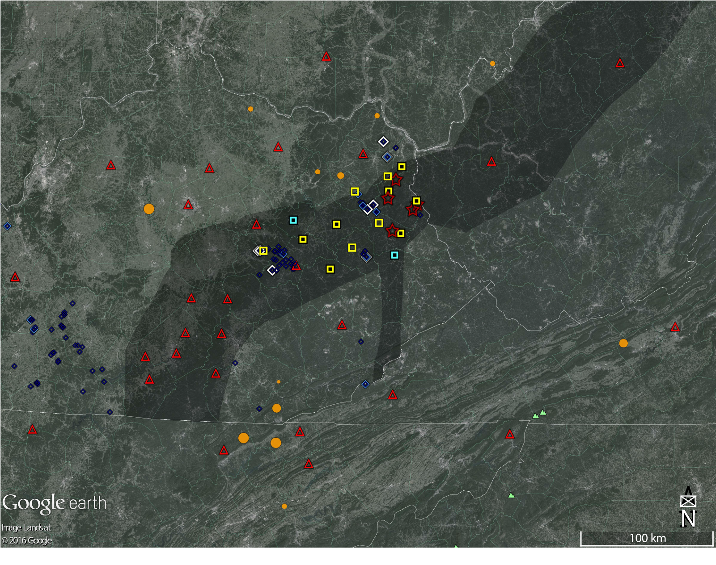
EKMMP: First Findings
Local earthquakes by EKMMP since 27 June 2015

Slide 27

EKMMP: First Findings
Local earthquakes by EKMMP and USGS since 27 June 2015: Complete M 2.5 within 200 km

Slide 28
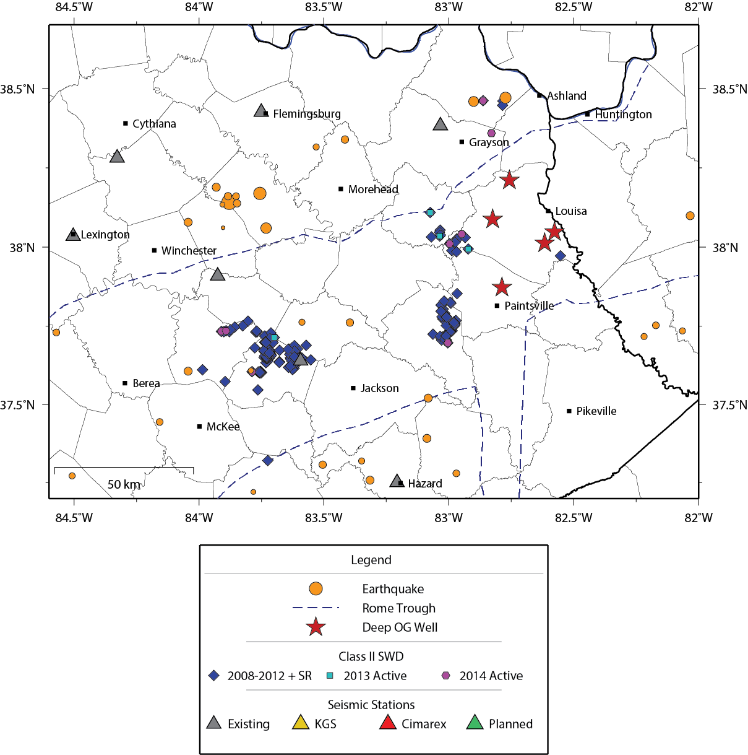
EKMMP: Purpose – I.S. from Waste Water Injection
Interest in the deep Cambrian Rogersville Shale in the Rome Trough is emerging.
Extracting oil and gas from this deep formation will use high-volume hydraulic fracturing and
horizontal drilling.
Disposal of wastewater and fracking have induced felt seismicity in the U.S.
M 5.2

Slide 29
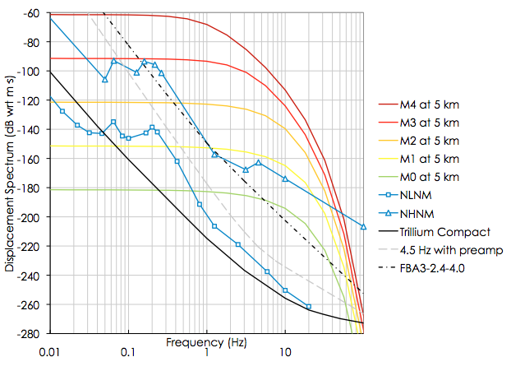
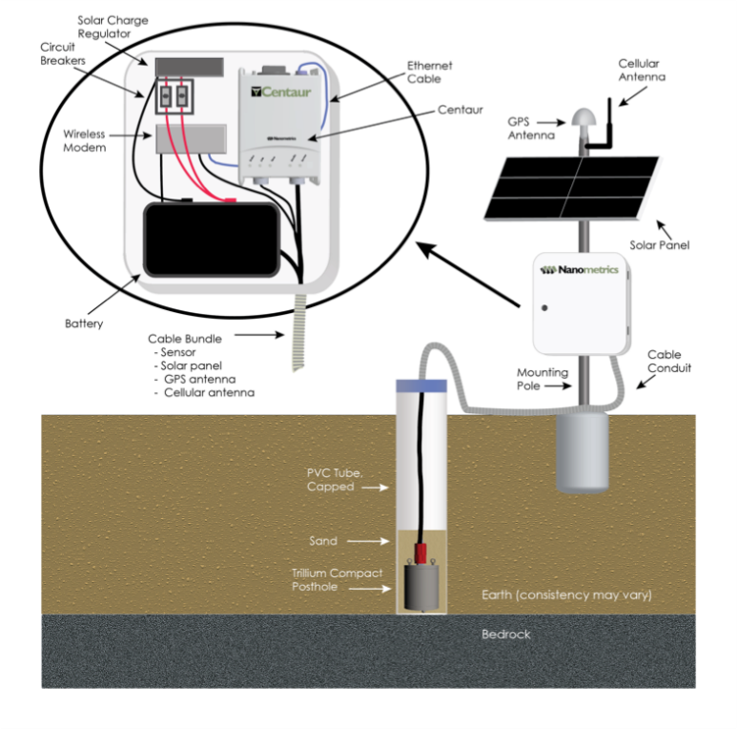
Monitoring Microseismicity in Eastern Kentucky: Instrumentation
Compact Broadband
Surface-vault and posthole installations
Posthole installation benefits:
Thermal stability
Decreased noise
Inexpensive installation
Fast installation
Flooding is not a concern

Slide 30
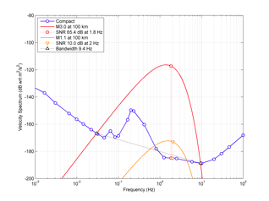
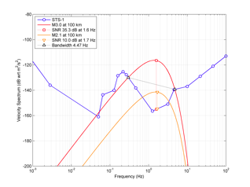
Monitoring Microseismicity in Eastern Kentucky: Instrumentation
Geophone vs. Broadband noise levels:
Greig et al., 2014

Slide 31
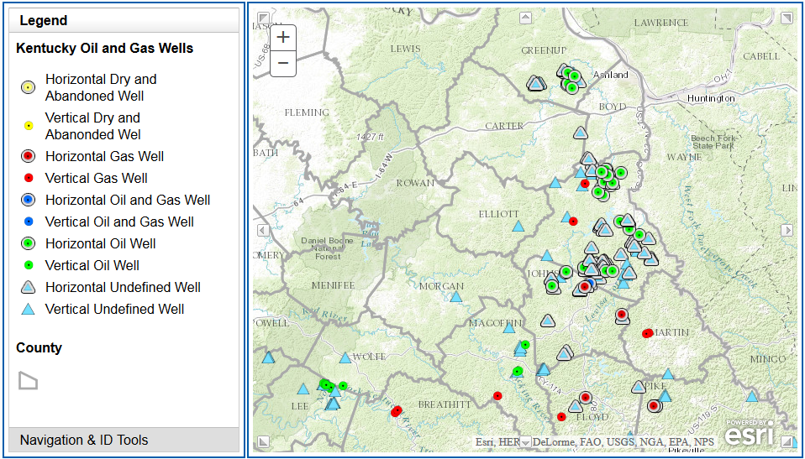
Background: Recent Permitting Activity
Notes:
5,000 to 10,000 feet deep in eastern Kentucky
Extracting oil and gas from this deep formation requires high-volume hydraulic fracturing and horizontal drilling.
- Bruin #1 Young well fracked in 2014 – not currently producing.
- EQT well fracked in 2015 – Current status unknown

Slide 32
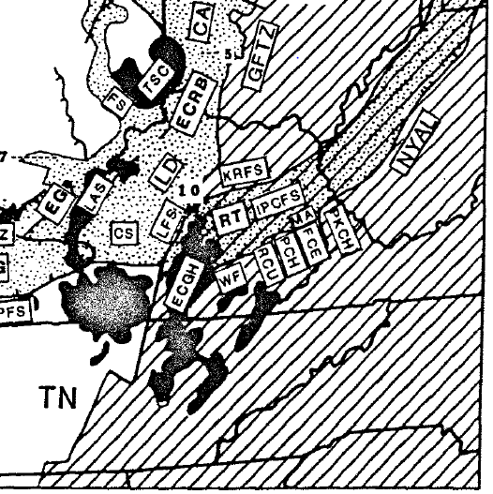
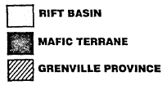
EKMMP: Seismotectonic Setting
Keweenawan (1.05 – 1.3 Ga) extension of the Laurentian Granite-Rhyolite province => rifts that lead to major mafic additions to the crust => ECGH(?)
ECGH = metamorphosed mafic body that extends at least to the mid-crust. Has been linked to the E. Cont’l Rift Complex.
Grenville (880 – 990 Ma) contraction resulted in overthrusting an allochthon of metamorphic strata onto Laurentia => NY-AL suture / cont’l-scale srike-slip fault zone.
Eocambrian (650 – 560 Ma) extension during opening of Iapetus Ocean => half-grabens including formation of Rome Trough.
Eq’s occur in crystalline Laurentian or Grenville crust beneath Phanerozoic sedimentary layers
NY-AL
1980 M 5.2 Sharpsburg
ETSZ
(Stark, 1997)
Notes:
In the crust adjacent to the RT, earthquakes occur in crystalline Laurentian crust beneath Phanerozoic sedimentary layers, including the thrust sheets of the Appalachian orogeny.
Keweenawan (1.05 – 1.3 Ga) extension of the Laurentian Granite-Rhyolite province => rifts that lead to major mafic additions to the crust => possible origin of East Continent Gravity High (cf. Stark p258, top paragraph rh side; Keller et al., 1982; alt. = feature w/in Grenville allochthon).
ECGH = metamorphosed mafic body that probably extends at least to the mid-crust. Has been linked to the E. Cont’l Rift Complex.
Grenville (880 – 990 Ma) contraction resulted in overthrusting an allochthon of metamorphic strata onto Laurentia. Ostensibly responsible for creation of NY-AL suture or cont’l-scale srike-slip fault.
Next major phase was Eocambrian (650 – 560 Ma) extension during opening of Iapetus Ocean => half-grabens from rifting of Laurentia, including formation of Rome Trough,
(the southeast border of which corresponds with the NY-AL - this suture may have been remobilized during this extensional episode (coincidence in maps + RT dips to the south after intersection with NY-AL).
2012 PC Eq is in the northern end of a block of crust extended during the Eocambrian, bounded on the north-northeast by the Rome Trough, and to the northwest by the ECGH => ETSZ.
ETSZ - 450 km long by 120 km wide.

Slide 33
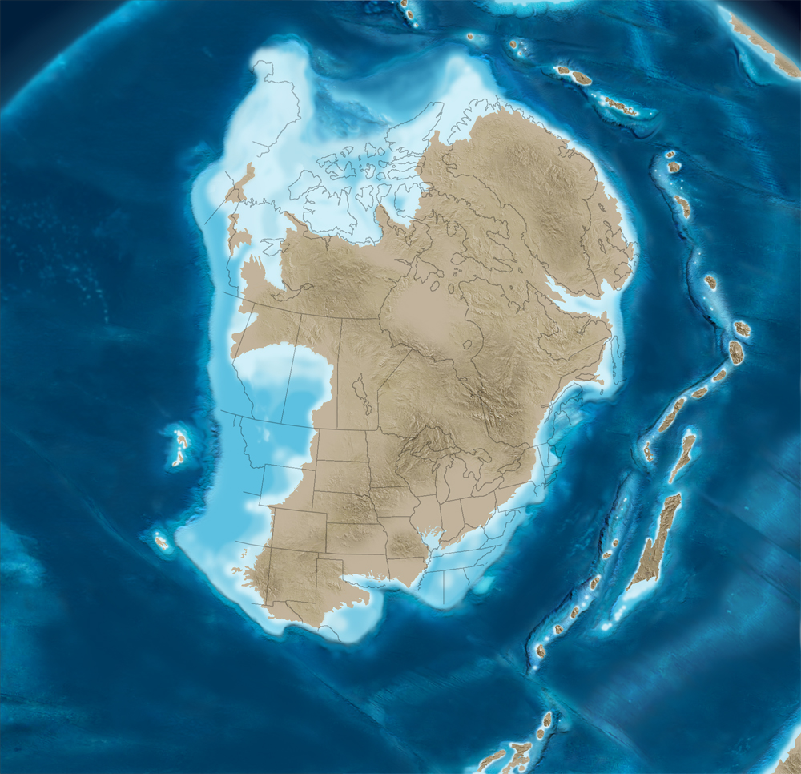
Background: the Rogersville Shale
Middle-Cambrian Paleogeography
Ron Blakey
Colorado Plateau Geosystems, Arizona USA
Notes:
Off-shore basin, roughly parallel to shore, at edge of continent.
Sediment source from northwest over continent.

Slide 34
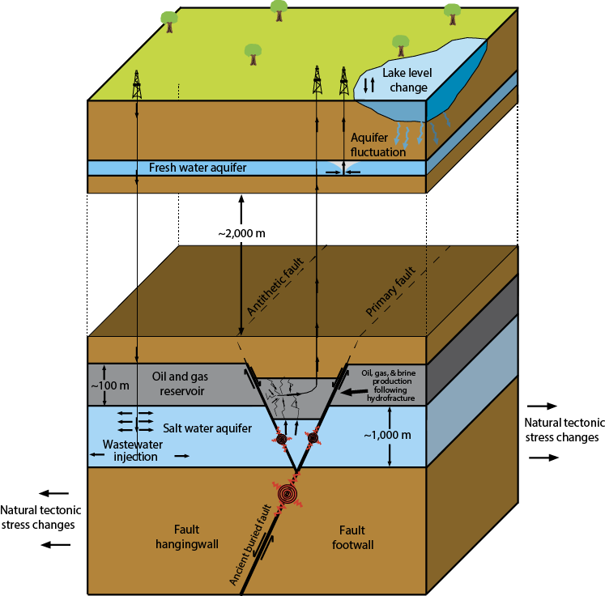
Background: Induced Seismicity
To induce an earthquake with fluid injection, we need the right ingredients:
- Injected fluids: fracking and wastewater
- Pre-existing faults
- Pathway from injection location to faults
- Enough time and volume for pressure
to overcome fault strength
- Favorable tectonic stress conditions
There are 10,000s of wastewater injection wells operating; very few (~20%) have been associated with seismicity; none in Kentucky
(Hornback et al., 2015)
unfavorable condition
Notes:
Wastewater injection
O&G production
Aquifer withdrawal
Lake-level change
Pre-existing fault
Regional Stress

