Slide 1

Kentucky’s Greatest Undeveloped Energy Resource
Kentucky’s Greatest Undeveloped Energy Resource
J. Richard Bowersox
Kentucky Geological Survey Annual Seminar
May 13, 2016
J. Richard Bowersox
Kentucky Geological Survey Annual Seminar
May 13, 2016
Federal Asphalt Company Mine
Grayson County
(Municipal Engineering, 1903)

Slide 2
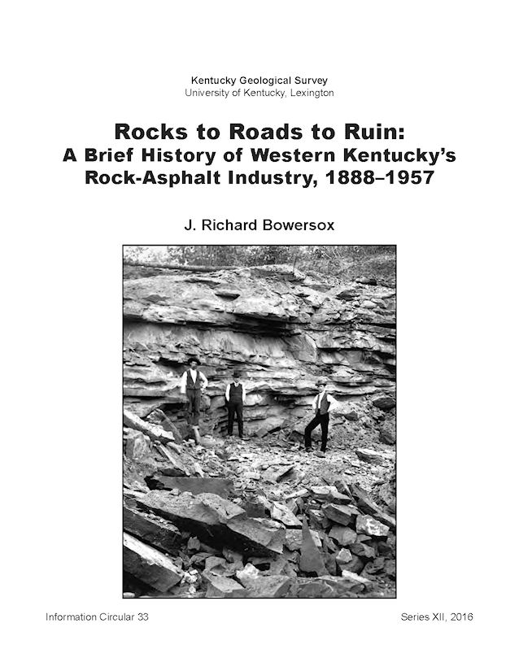
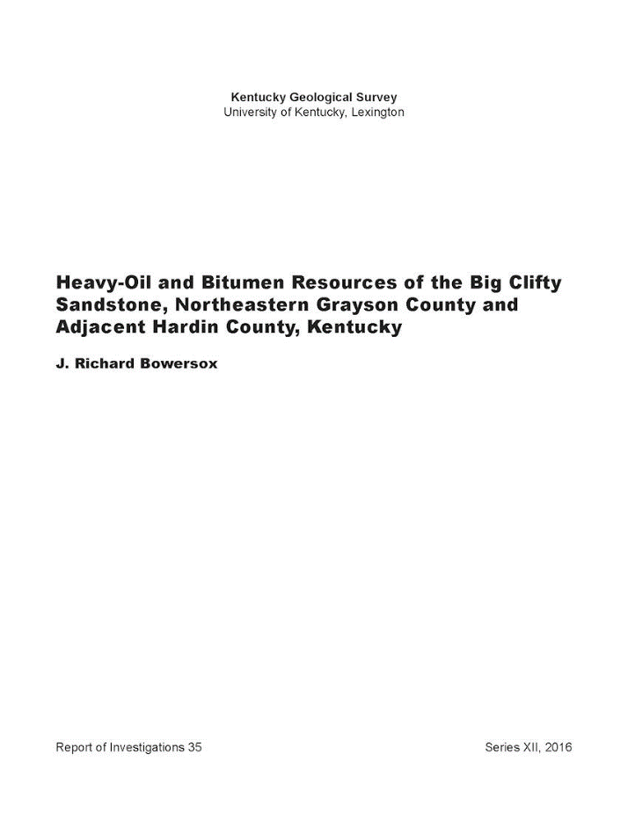
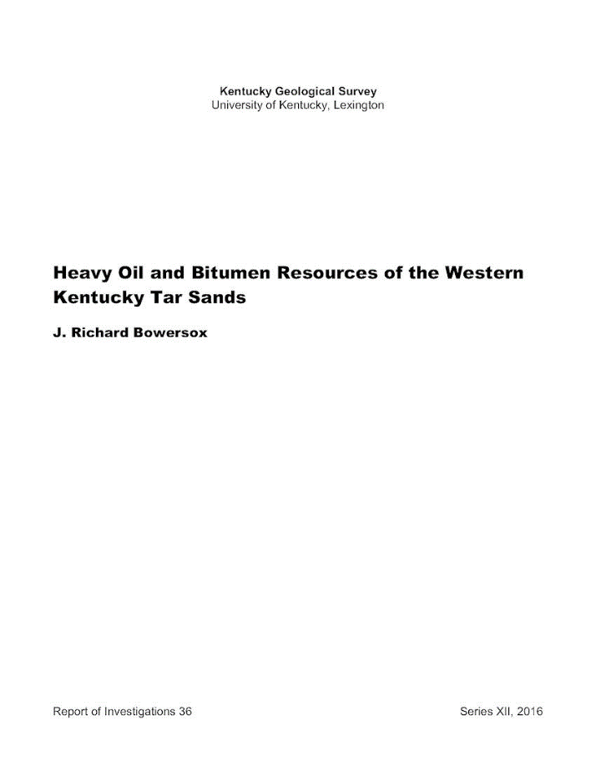
~ Advertisement ~
New KGS Publications
New KGS Publications
Information Circular 33
Available Now
Reports of Investigations 35
Available Now
Reports of Investigations 36
Coming Soon

Slide 3
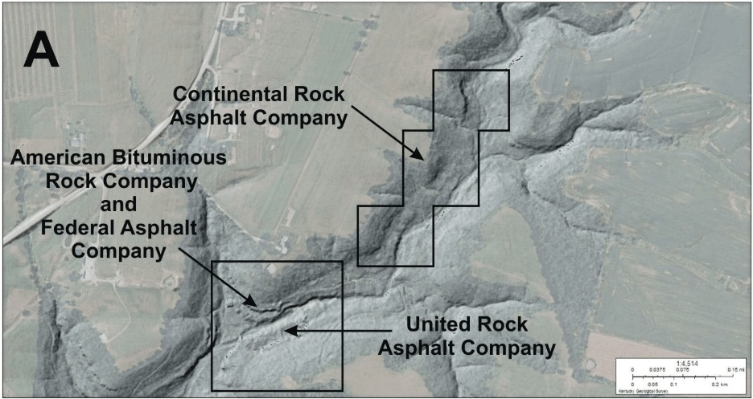
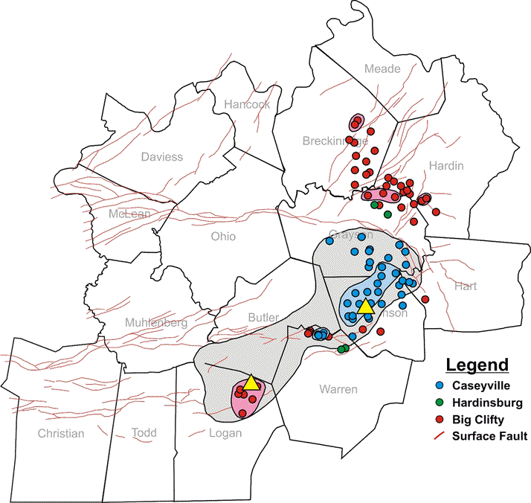
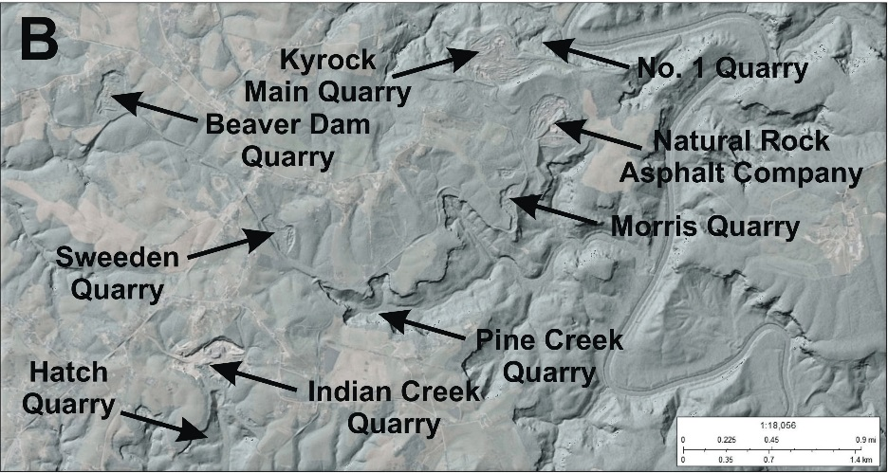
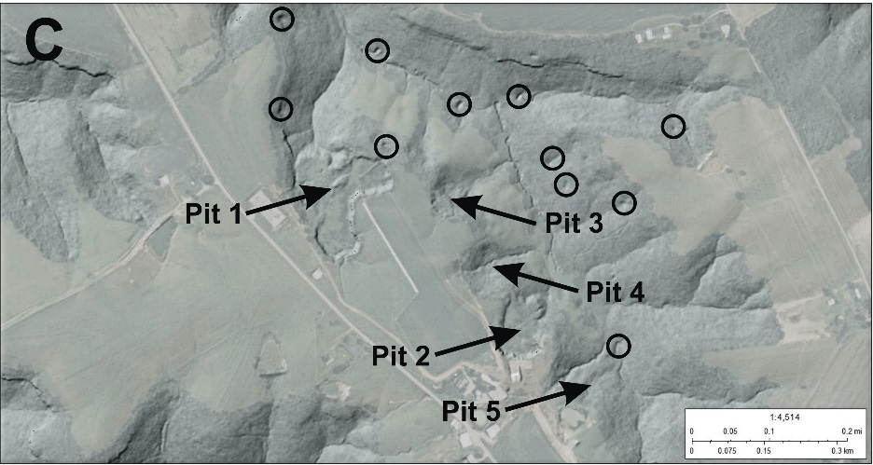
Tar Sands Outcrops and Subsurface Occurrences
A
Tar Sands Outcrops and Subsurface Occurrences
Grayson County
1888 – 1904
1923 – 1930
C
Edmonson County
1904 – 1957
B
Test Pits
Logan County
1897 – 1914
American Standard Asphalt Company

Slide 4
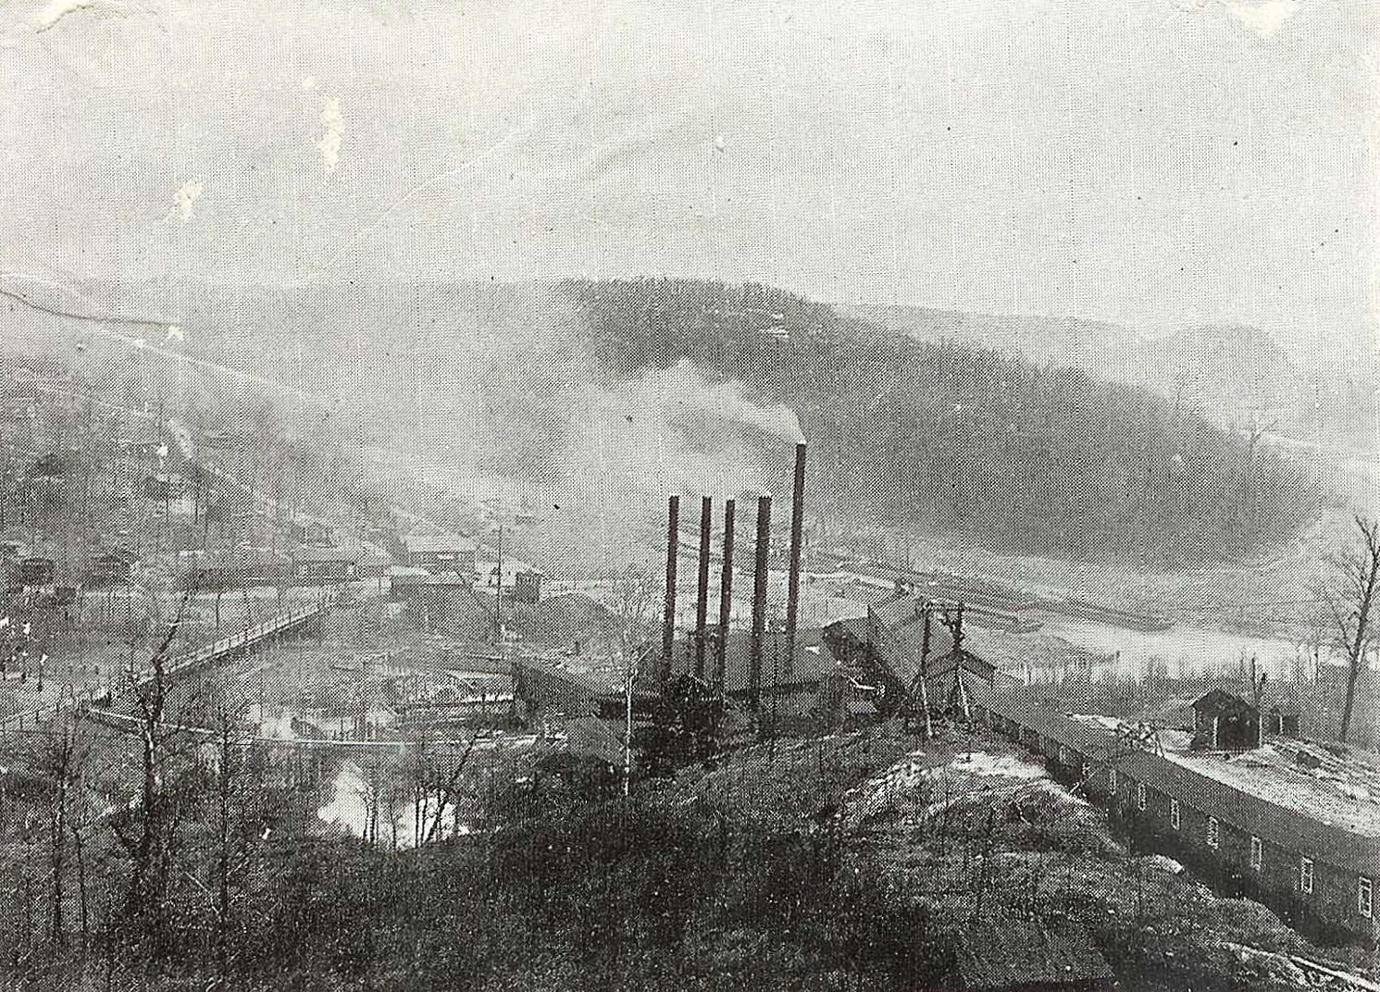
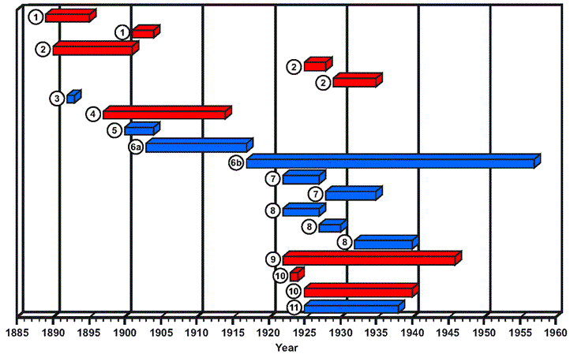

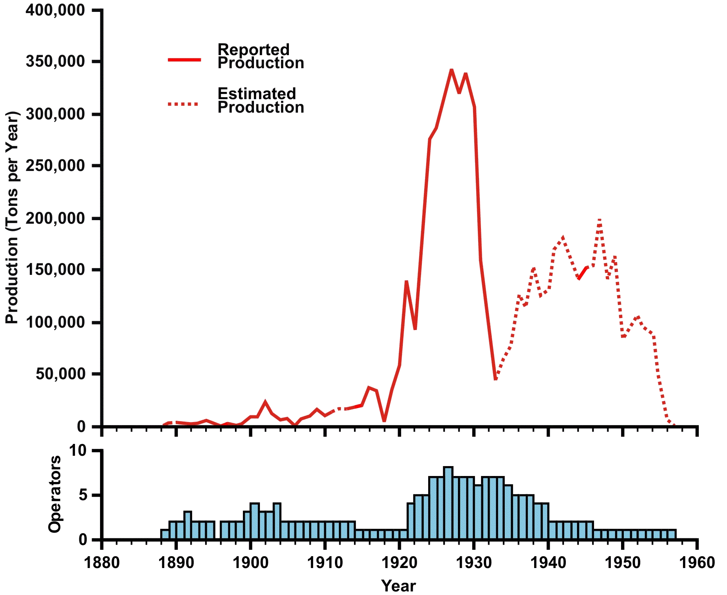
Grayson County
Rocks to Roads to Ruin
Rocks to Roads to Ruin
Grayson County
Logan County
Edmonson County
Grayson County
Grayson County
There are 11 documented rock asphalt producers 1888 – 1957.
Estimated rock asphalt production totaled 6 million tons containing about 2.3 million barrels of bitumen.
Kyrock processing plant c. 1920
Kentucky Historical Society

Slide 5
What did we learn about the tar sands during this evaluation that is new?
Geochemical evidence demonstrates that oil in the tar sands was sourced from the New Albany Shale.
Diagenetic partitioning of the tar sands reservoirs was in a geochemically-reducing environment associated the migration of the oil.
Oil in the tar sands reservoirs was microbially biodegraded to heavy oil and bitumen before Middle Cretaceous exposure at the surface.
Tar sands reservoirs are oil-wet, a consequence of the microbial biodegradation of the oil depositing bitumen on the reservoir pore walls.
Tar sands reservoirs are undersaturated in water, and underpressured, because of rapid tectonic uplift and the lack of connection to an active aquifer.

Slide 6
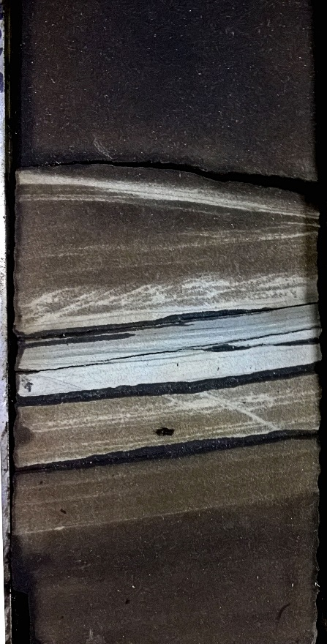
Megawest CH 102 Clark
Warren County
Big Clifty Sandstone
520.0 – 520.7 ft
Model of oil migration from the New Albany Shale into the tar sands along fault planes (modified after Rowe and Burley, 1997) . Reservoir diagenetic partitioning (white bands in the core photo) is characteristically associated with oil migration where the oil is the geochemically-reducing diagenetic fluid (Schumacher, 1996).

Slide 7
Isopach of net Big Clifty
oil and bitumen saturated sandstone. Oil reservoirs are primarily found in down-thrown fault blocks.

Slide 8
Water-Wet versus Oil-Wet Reservoirs
11º Gravity Oil
Methane
Water
5° Gravity
Bitumen
Biodegradation of the oil during migration and trapping formed an immobile bitumen lining of the pore space.
Core analysis from the Big Clifty shows the effect of pore-lining bitumen on reservoir porosity.

Slide 9
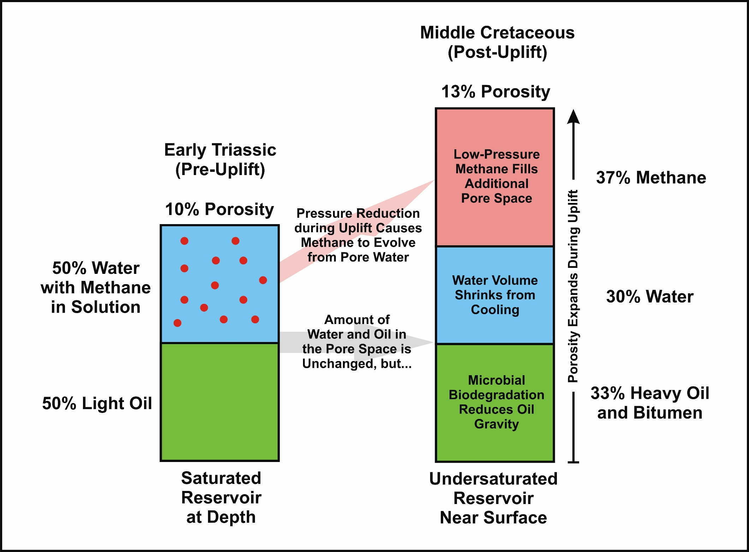
Making an Undersaturated Tar Sand Reservoir
C

Slide 10
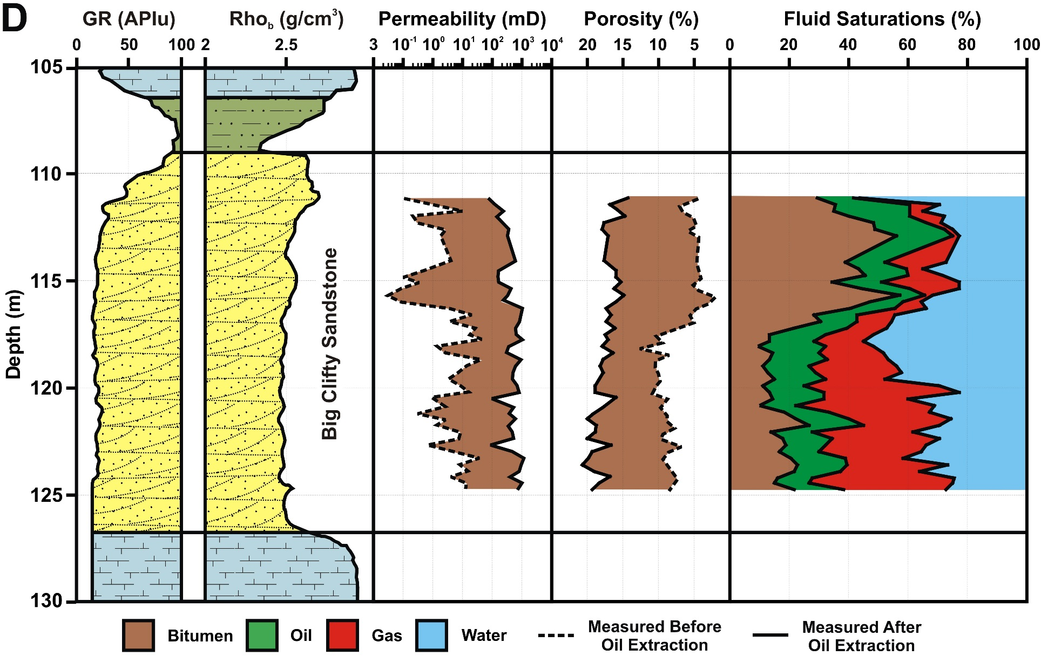
Interpretation of core analysis from the Westken 18 Vincent well showing the effects of microbial degradation of the oil and reservoir undersaturation. Only about 40% of the total oil in place is mobile and potentially producible.

Slide 11
Western Kentucky Tar Sands Resources
Estimated Oil in Place is 3.36 Billion Barrels
  Caseyville Formation: 117,200 acres, 740 MMBO
    Contingent: 111,000 acres, 700 MMBO = 6,300 BO/acre
    Prospective: 6,200 acres, 40 MMBO
  Hardinsburg Sandstone : 125,500 acres, 357 MMBO
    Contingent : 121,100 acres, 345 MMBO = 2,850 BO/acre
    Prospective : 4,400 acres, 12 MMBO
  Big Clifty Sandstone: 364,000 acres, 2,260 MMBO
    Contingent : 333,600 acres, 2,100 MMBO = 6,300 BO/acre
    Prospective : 30,400 acres, 160 MMBO
Total Oil in Place is about 9% more than the previous evaluation of Noger (1984)

Slide 12


Earth Resources – Our Common Wealth
Earth Resources – Our Common Wealth

