Slide 1
Kentucky Coal
Past, Present, and Future
Presentation to the
Kentucky Geological Survey
Aron Patrick
Assistant Director
Aron.Patrick@ky.gov
Adam Blandford
Energy Analyst
Kentucky Energy and Environment Cabinet
Department for Energy Development and Independence
502-564-7192
Twitter: @KentuckyEEC
Website: energy.ky.gov

Slide 2
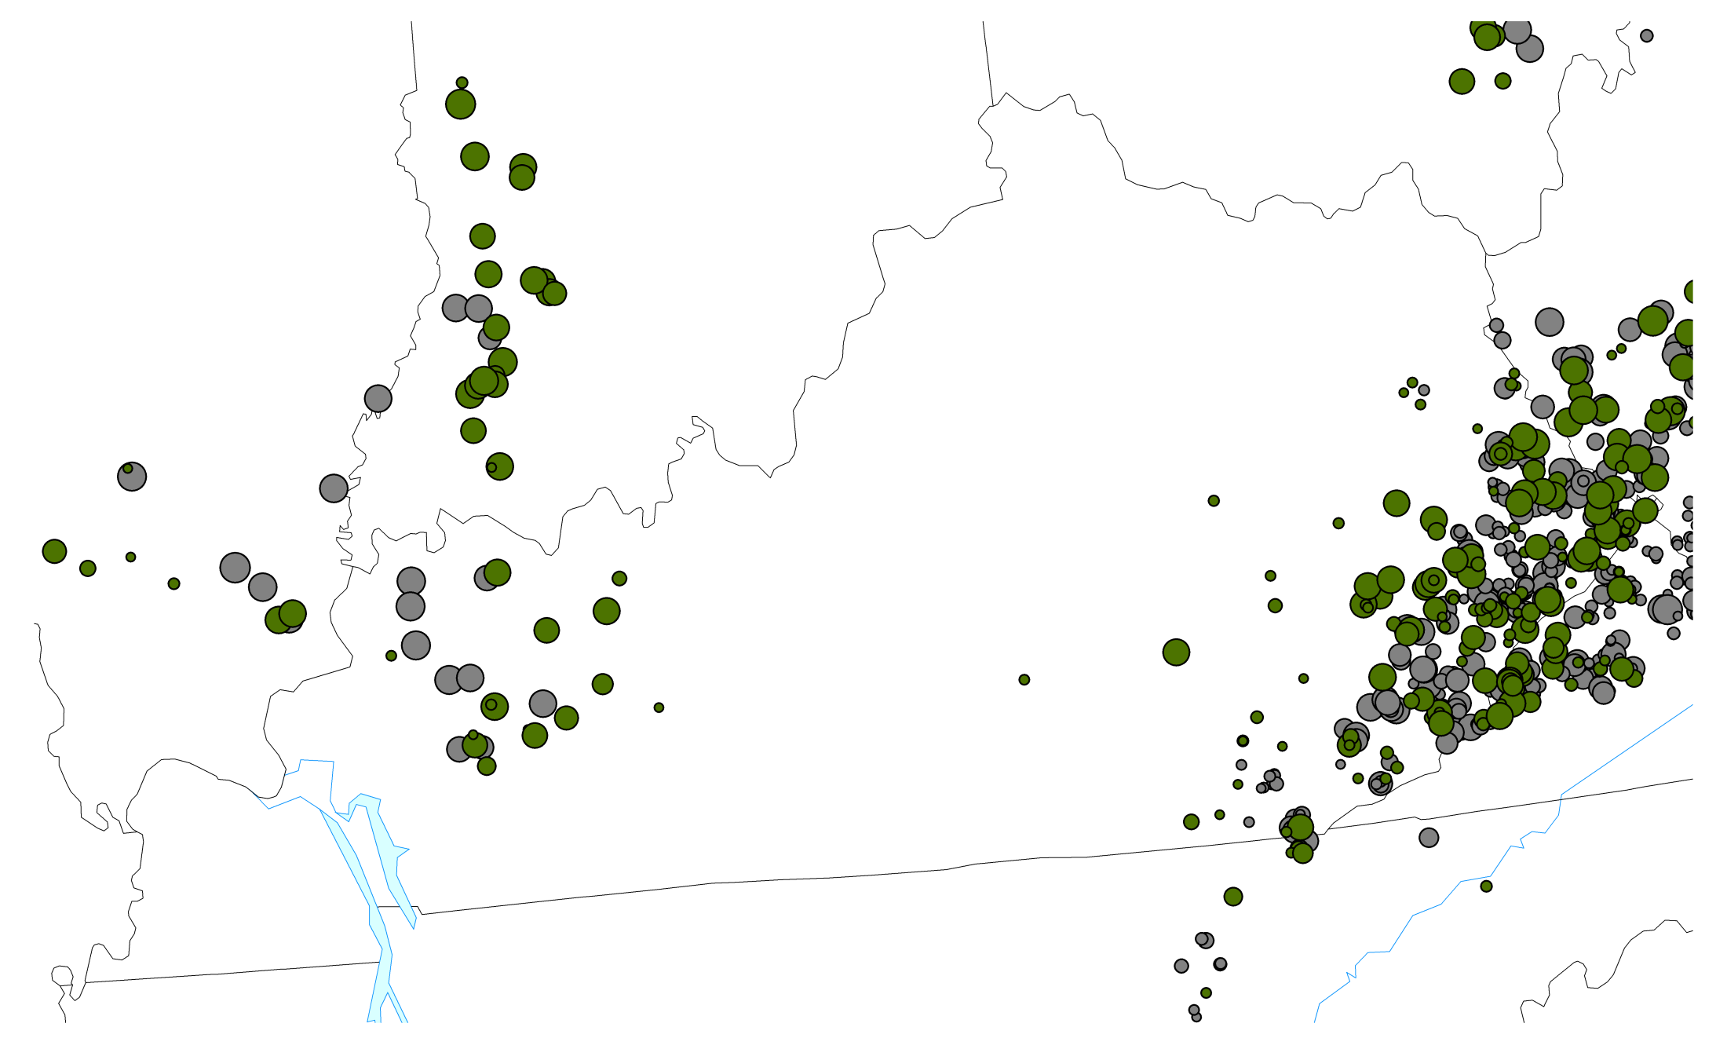
Kentucky Coal Production, Q1-2000
21.1 MT
Underground
14.2 MT
Surface
Kentucky Energy Database, EEC-DEDI, 2014 energy.ky.gov

Slide 3
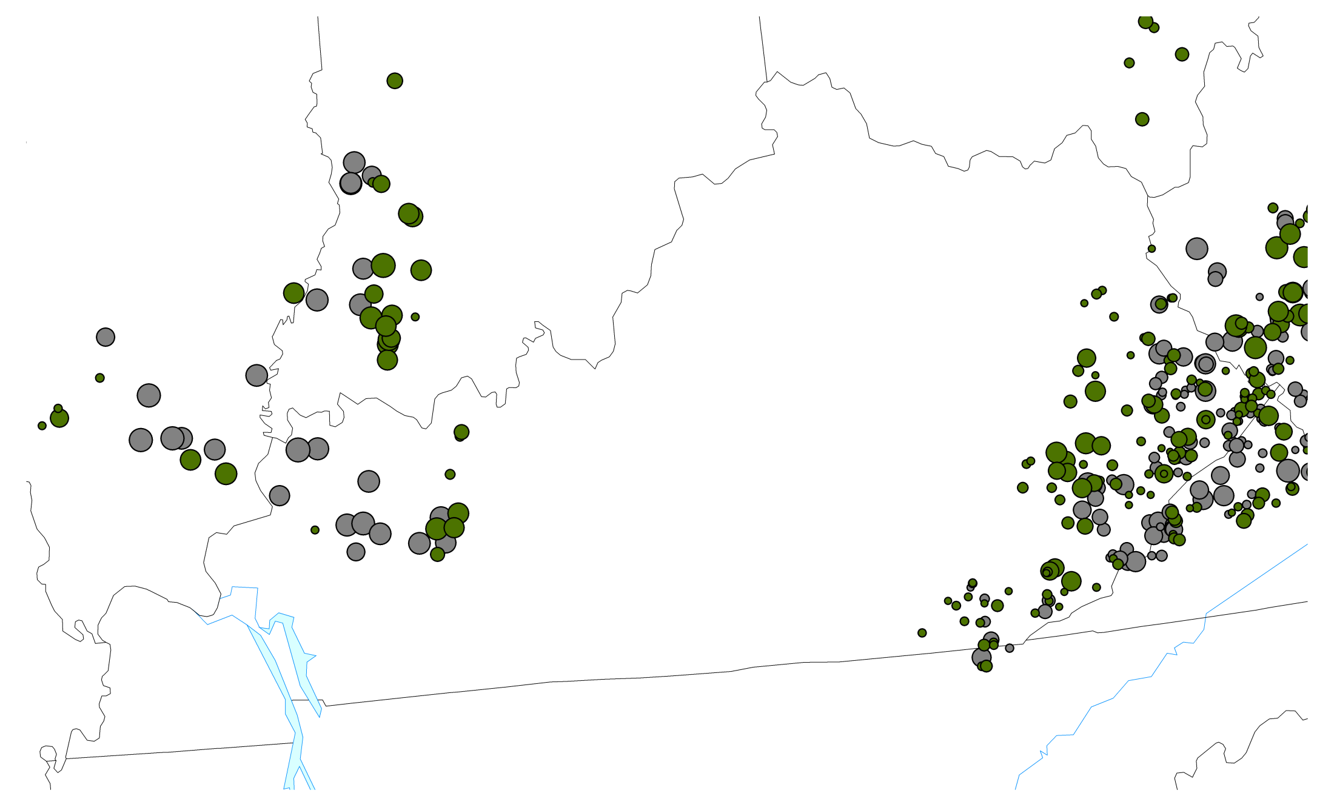
Kentucky Coal Production, Q4-2013
13.0 MT
Underground
6.1 MT
Surface
Kentucky Energy Database, EEC-DEDI, 2014 energy.ky.gov

Slide 4
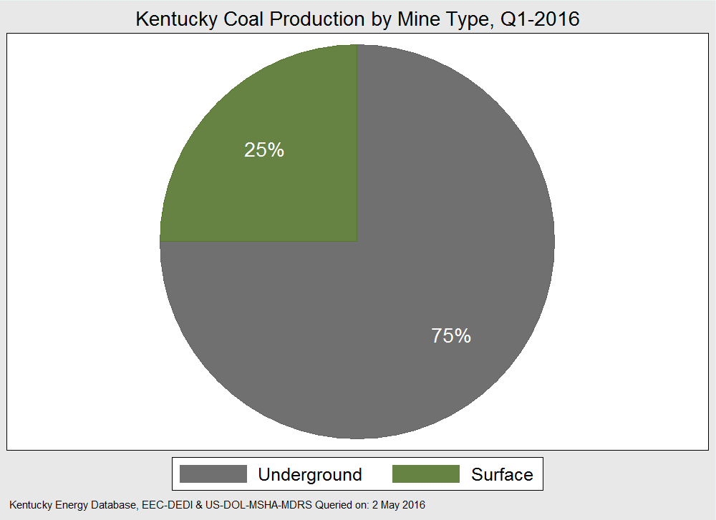

Slide 5
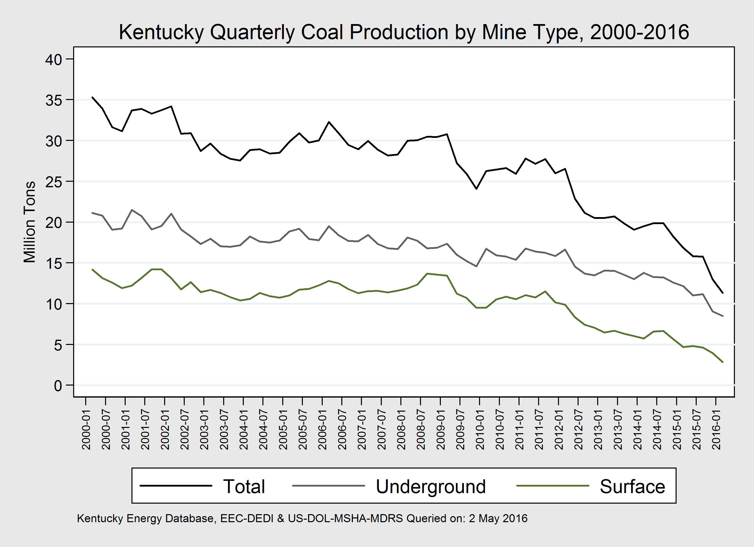

Slide 6
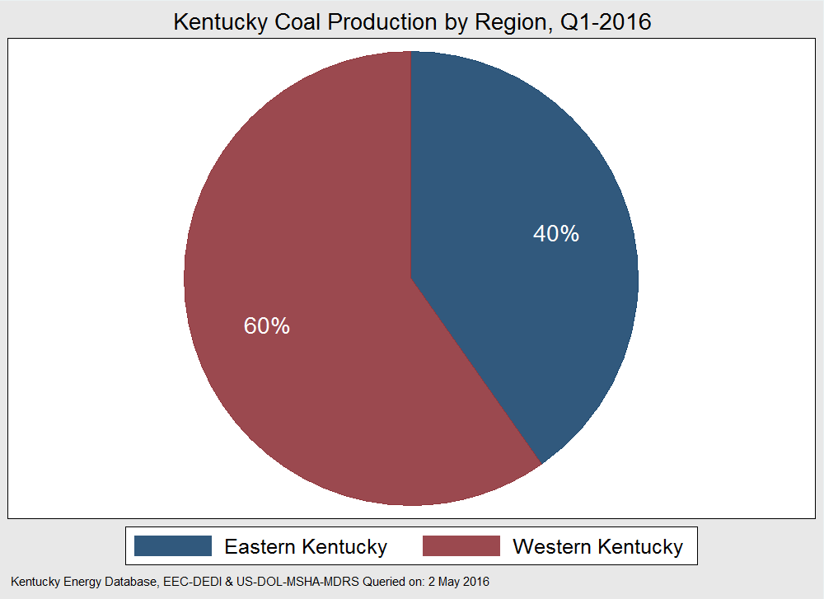

Slide 7
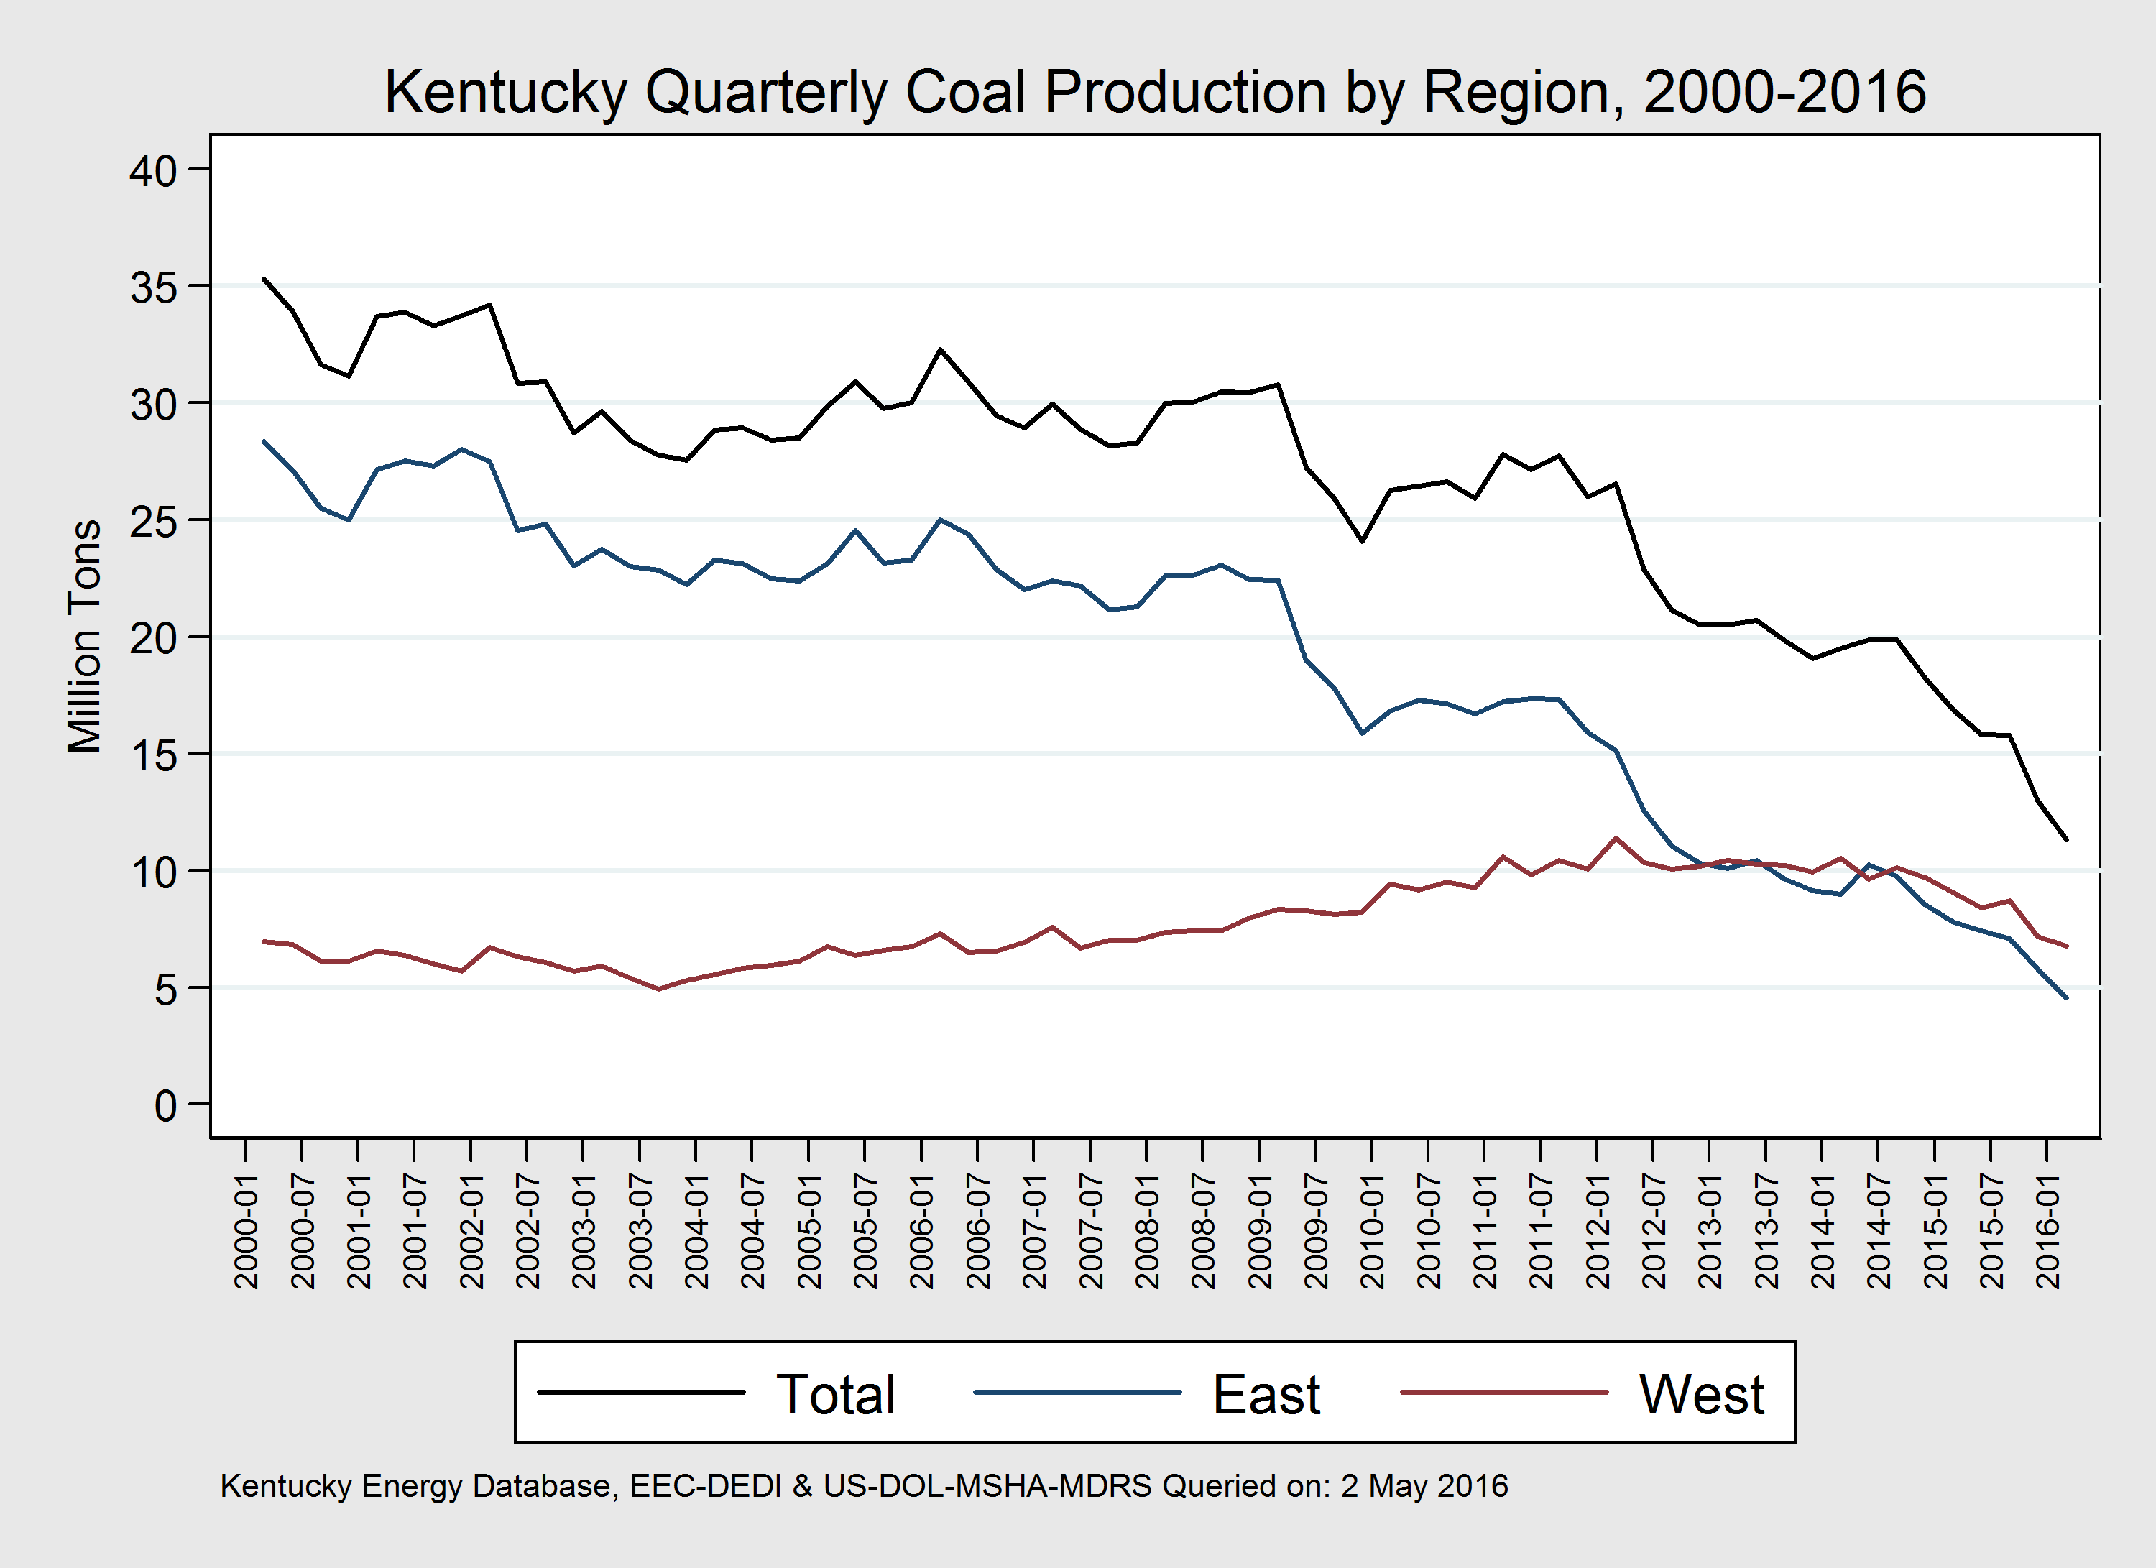

Slide 9
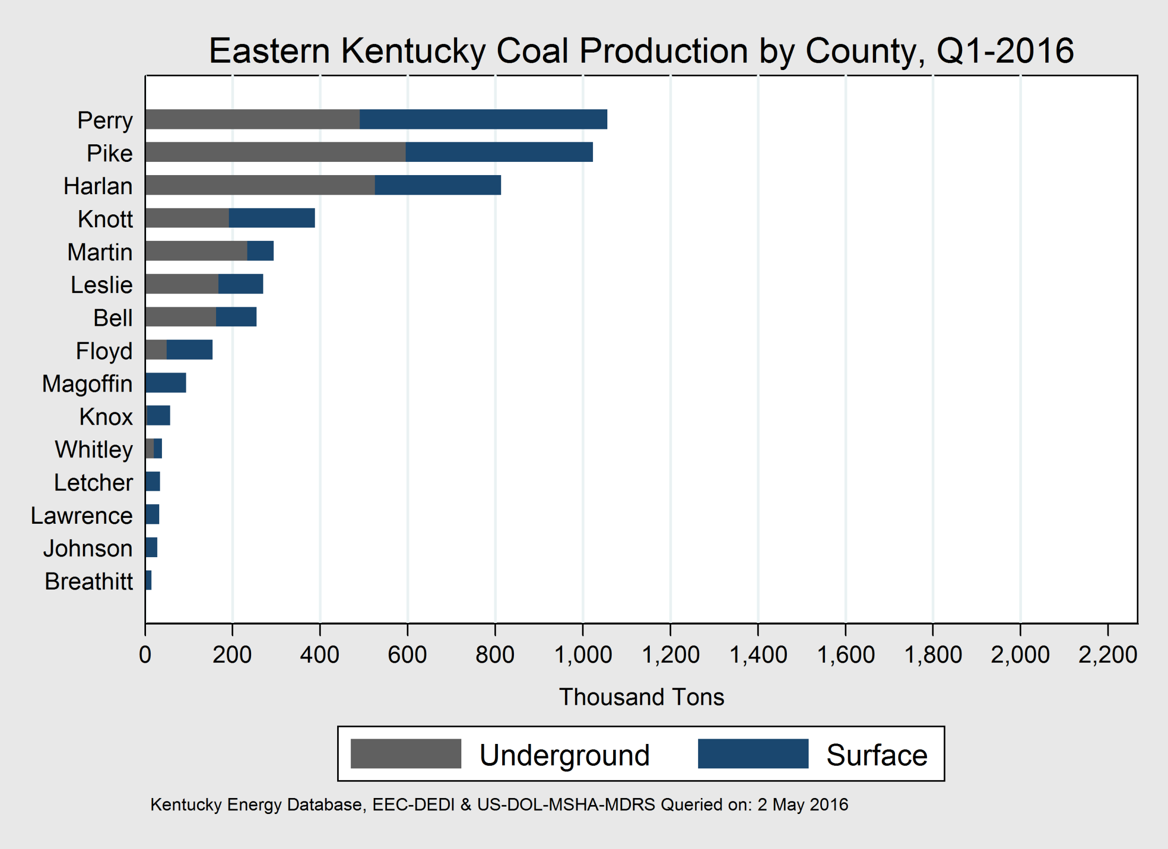

Slide 10
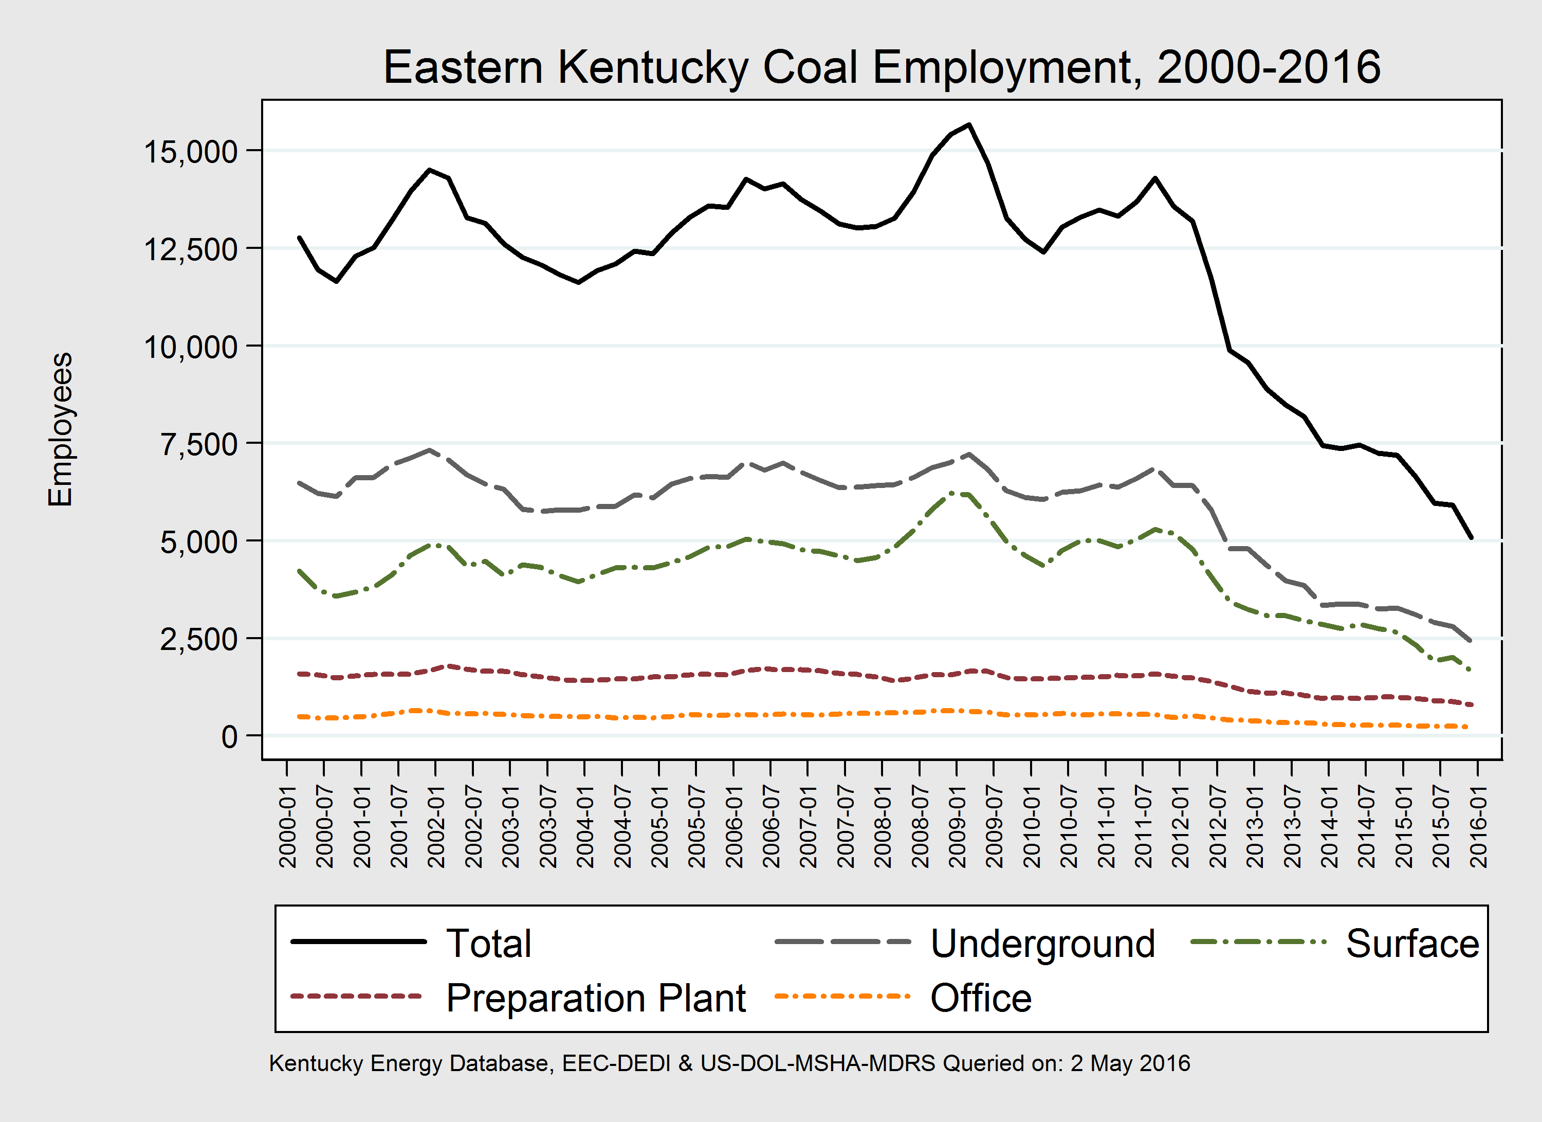

Slide 11
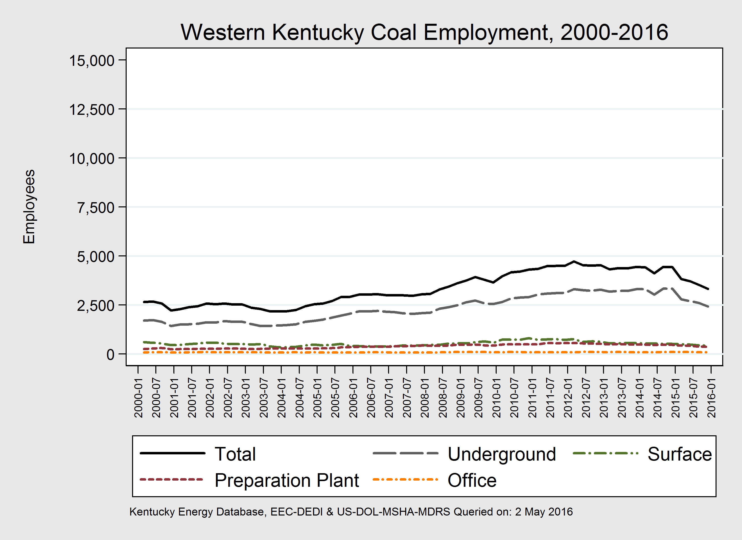

Slide 12
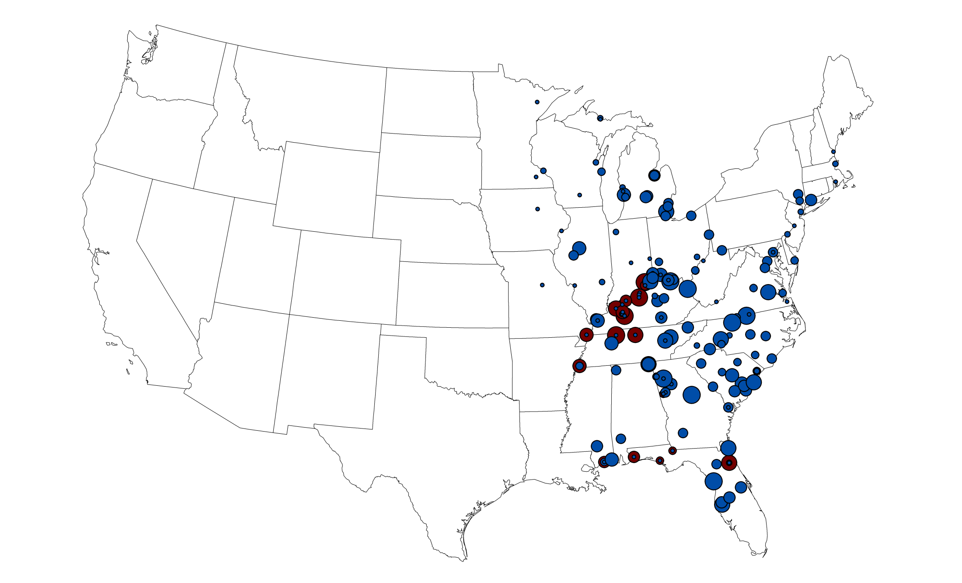
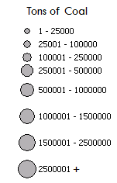
Kentucky Coal Deliveries, 1990
85.2 MT
43.6 MT
Kentucky Energy Database, EEC-DEDI, 2015 energy.ky.gov

Slide 13
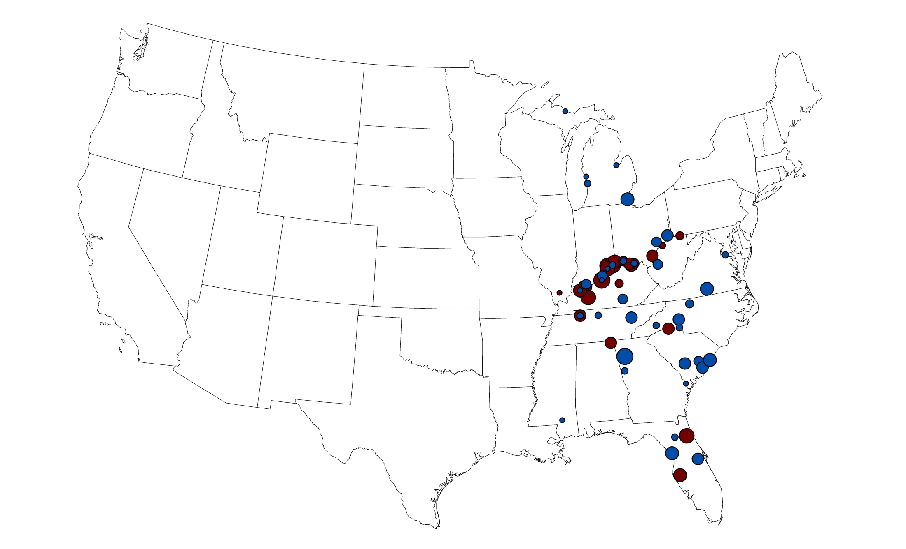
Kentucky Coal Deliveries, 2020
2015 Forecast
17.8 MT
28.6 MT
Kentucky Energy Database, EEC-DEDI, 2015 energy.ky.gov

Slide 14
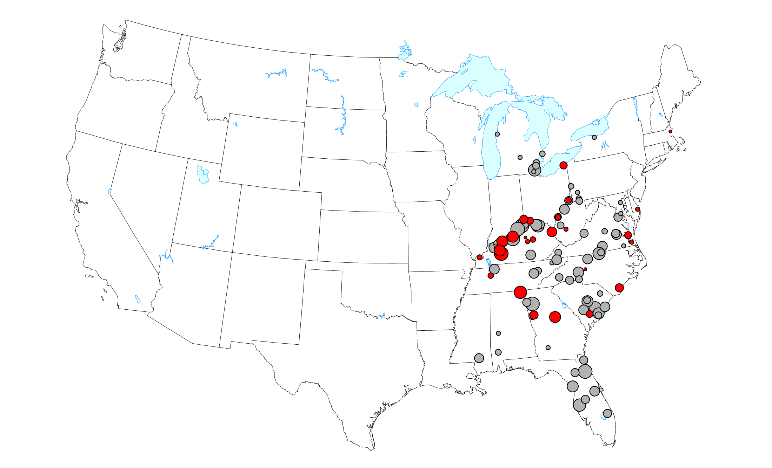
Kentucky Coal Deliveries & Future Retirements, 2012
15.4 MT
Retirement 2013-2018
53+ MT
Unknown Future Retirement
Kentucky Energy Database, EEC-DEDI, 2014 energy.ky.gov

Slide 15
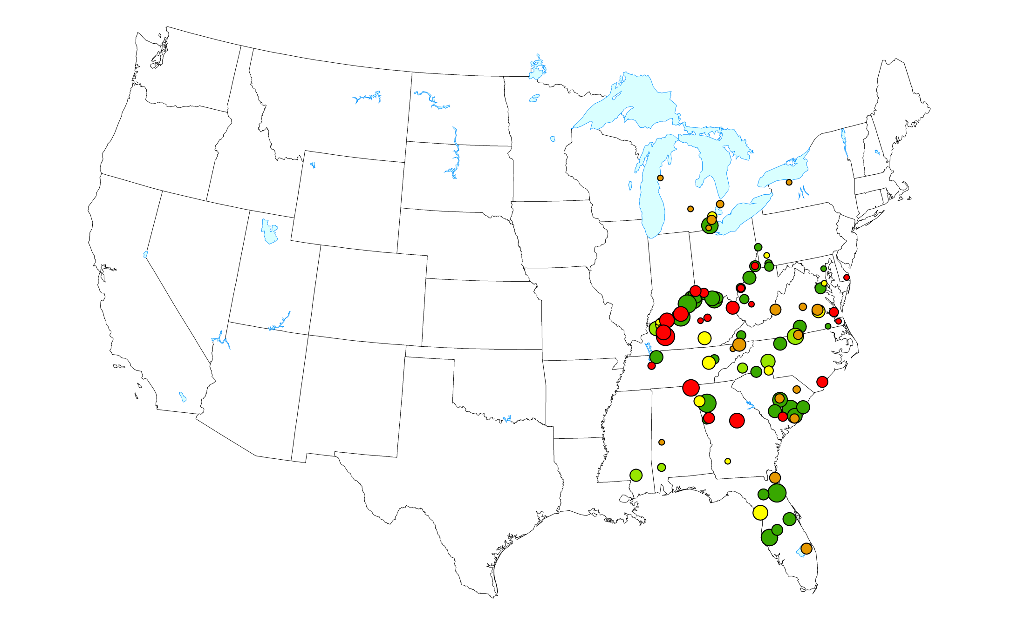
Kentucky Coal Deliveries & Future Retirements, 2012
15.4 MT
Retirement 2013-2018
3.3 MT
High Probability of Retirement
5.2 MT
Moderate Probability of Retirement
3.5 MT
Retirement Unlikely
40+ MT
Retirement Highly Unlikely
Kentucky Energy Database, EEC-DEDI, 2014 energy.ky.gov

Slide 16
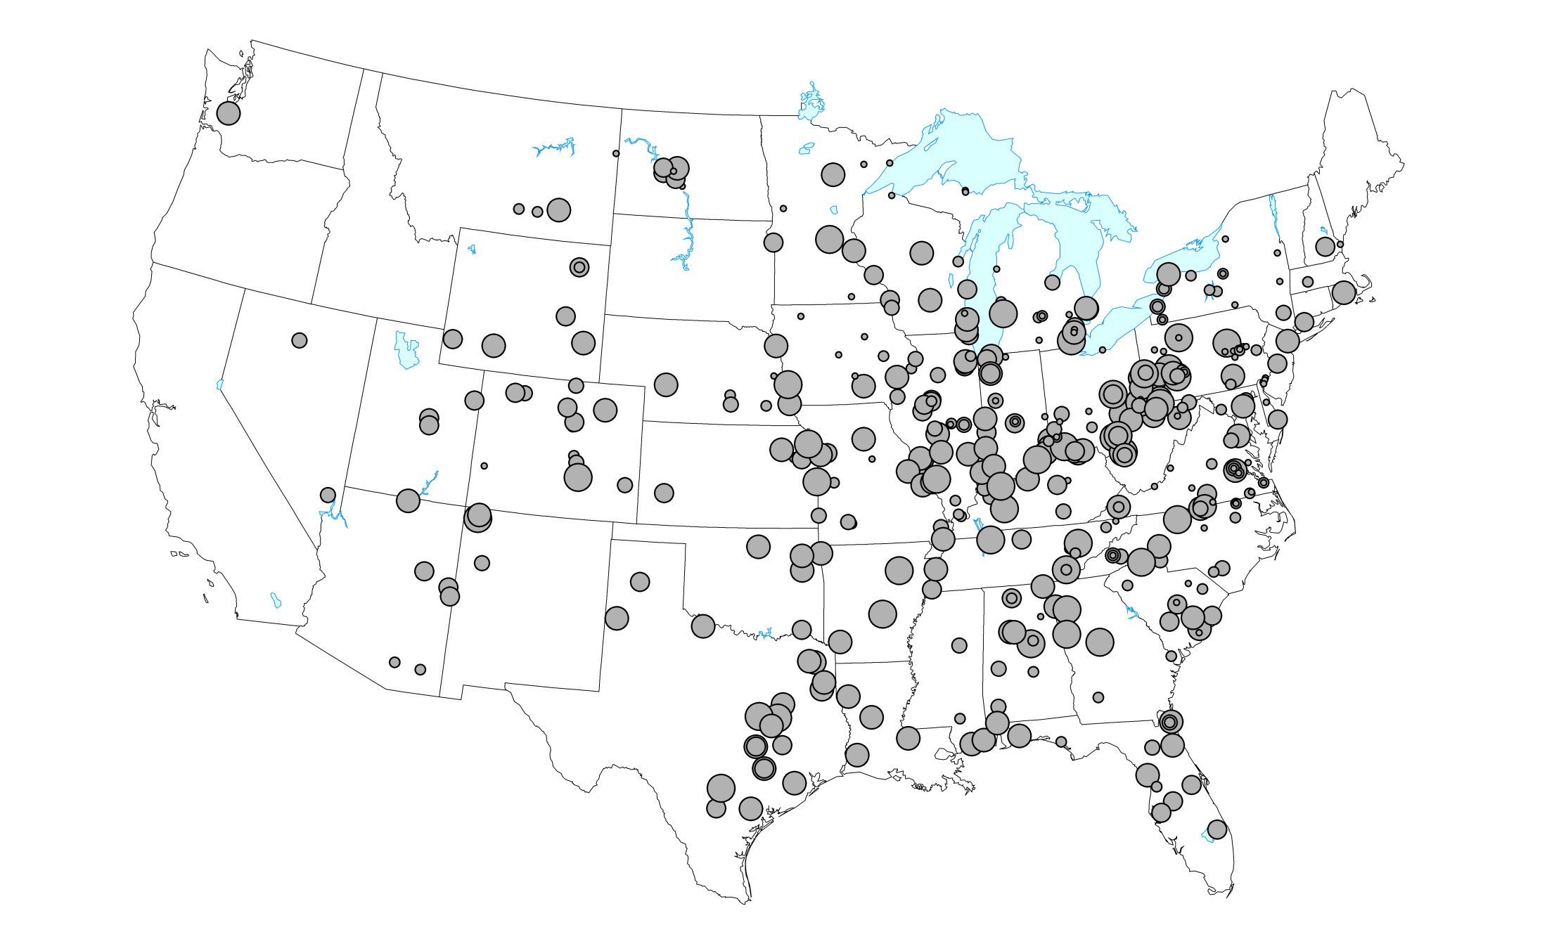
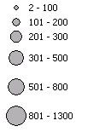
United States Coal-Fired Power Plants, 2012
Nameplate Capacity
Kentucky Energy Database, EEC-DEDI, 2014 energy.ky.gov

Slide 17
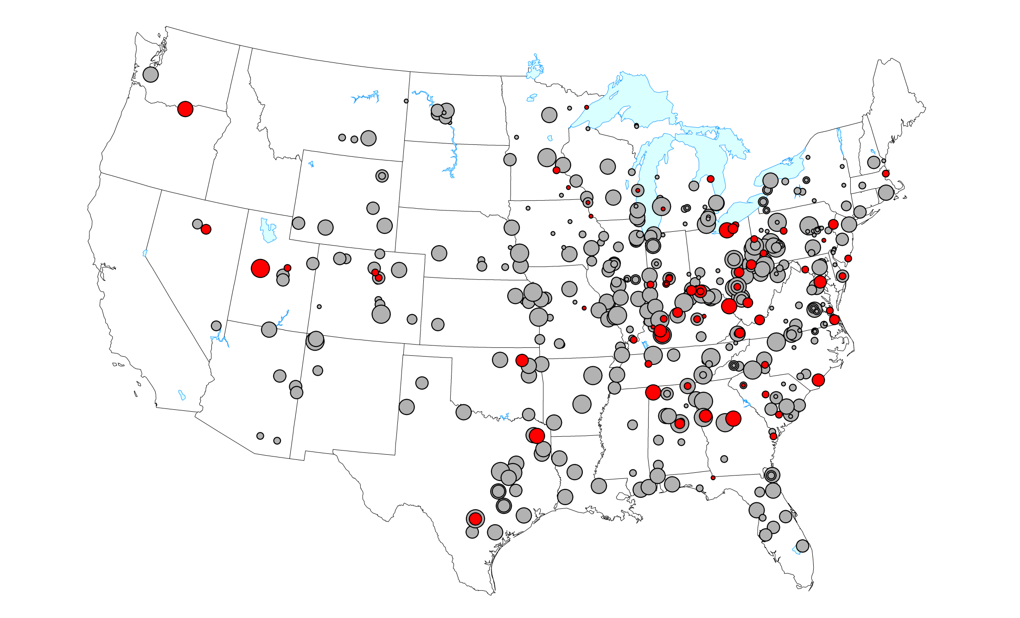
United States Coal-Fired Power Plants, 2012
Nameplate Capacity
33 GW
Retirement 2013-2018
312 GW
Unknown Future Retirement
Kentucky Energy Database, EEC-DEDI, 2014 energy.ky.gov

Slide 18
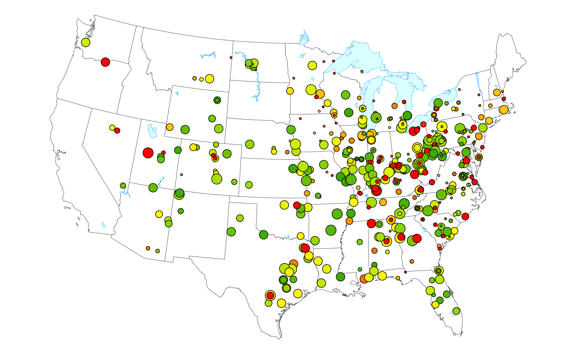
United States Coal-Fired Power Plants, 2012
33 GW
Retirement 2013-2018
18 GW
High Probability of Retirement
Nameplate Capacity
30 GW
Moderate Probability of Retirement
25 GW
Retirement Unlikely
237 GW
Retirement Highly Unlikely
Kentucky Energy Database, EEC-DEDI, 2014 energy.ky.gov

Slide 19
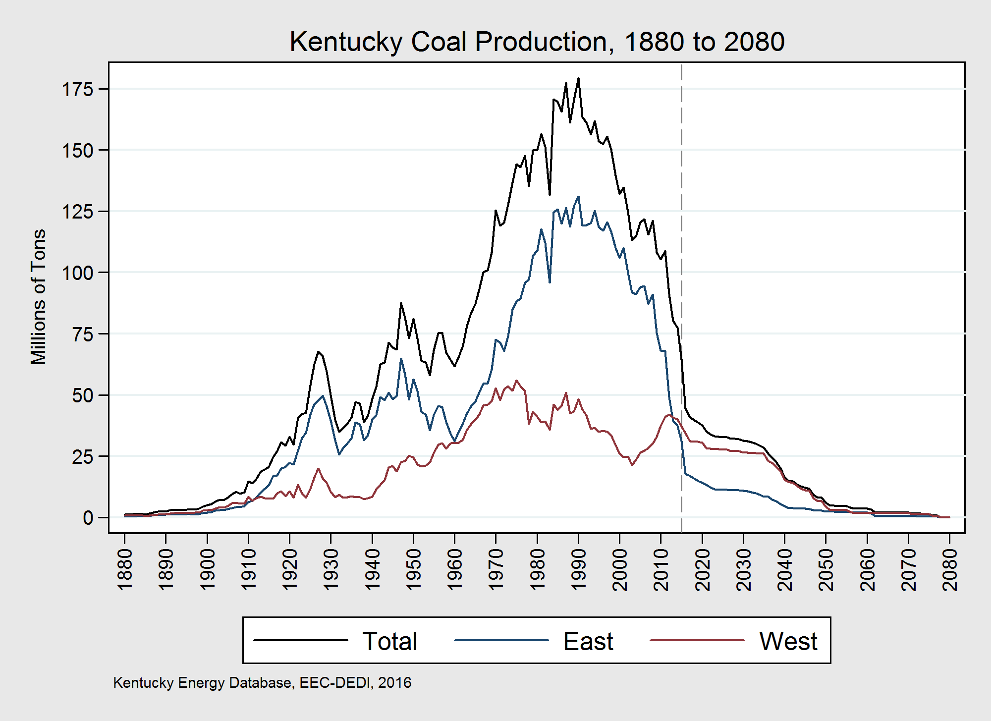

Slide 20
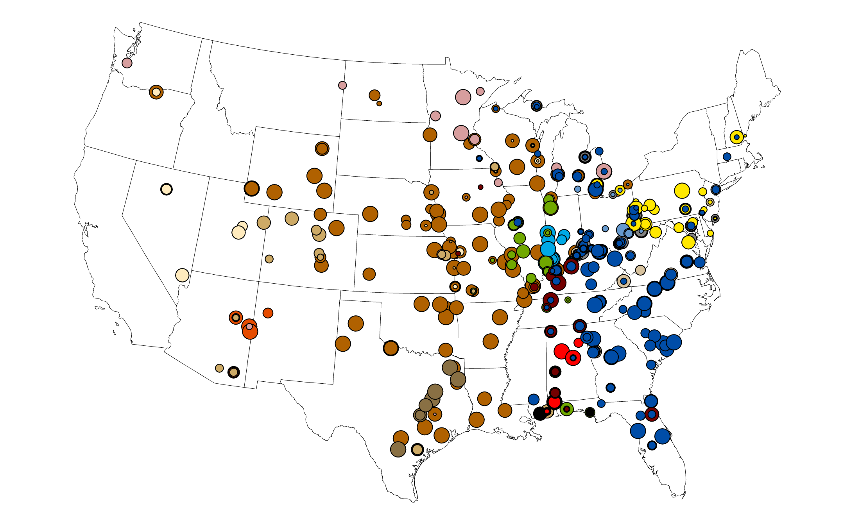
United States Coal Deliveries, 2000
Kentucky Energy Database, EEC-DEDI, 2015 energy.ky.gov

Slide 21
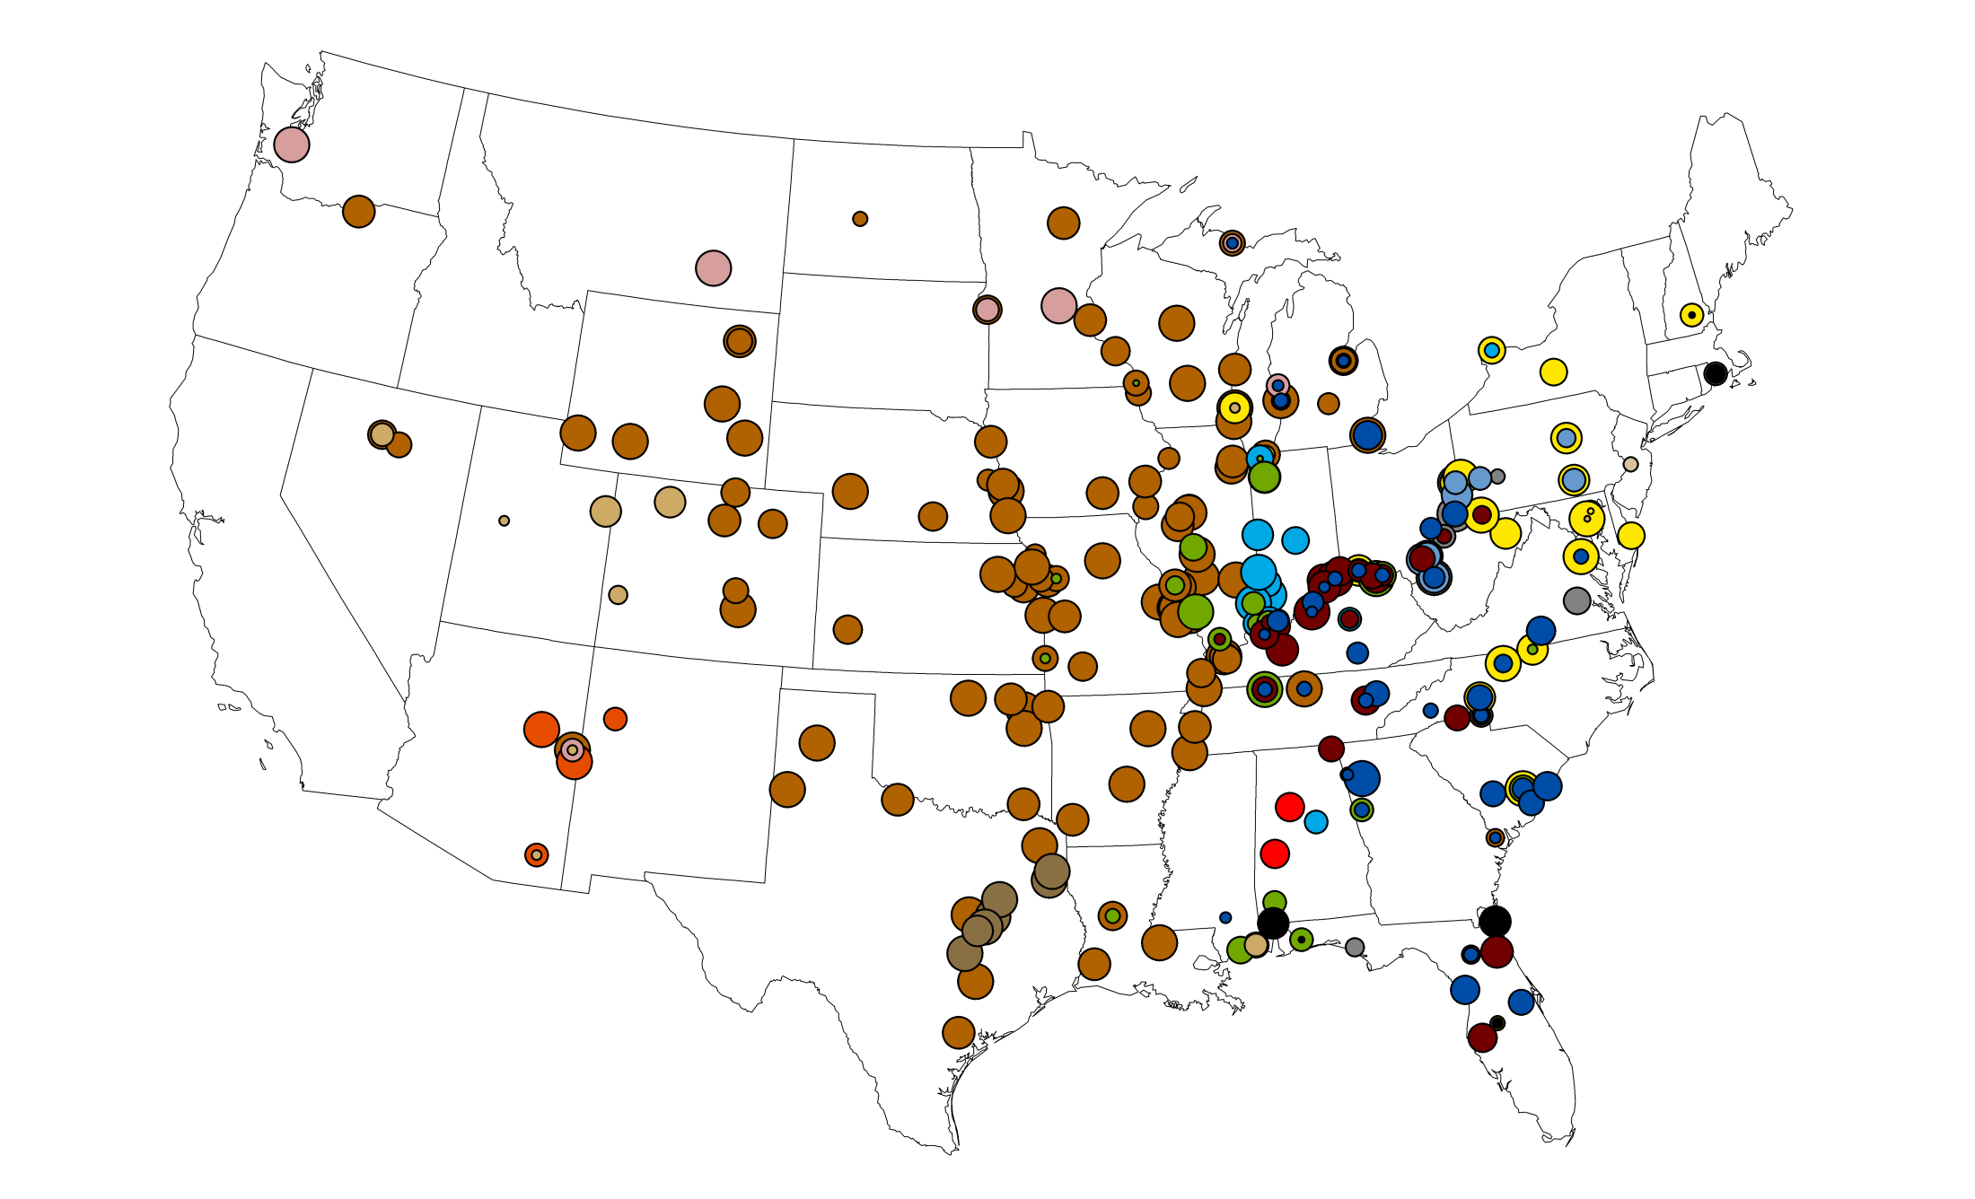
United States Coal Deliveries, 2020
2015 Forecast
Kentucky Energy Database, EEC-DEDI, 2015 energy.ky.gov

Slide 22
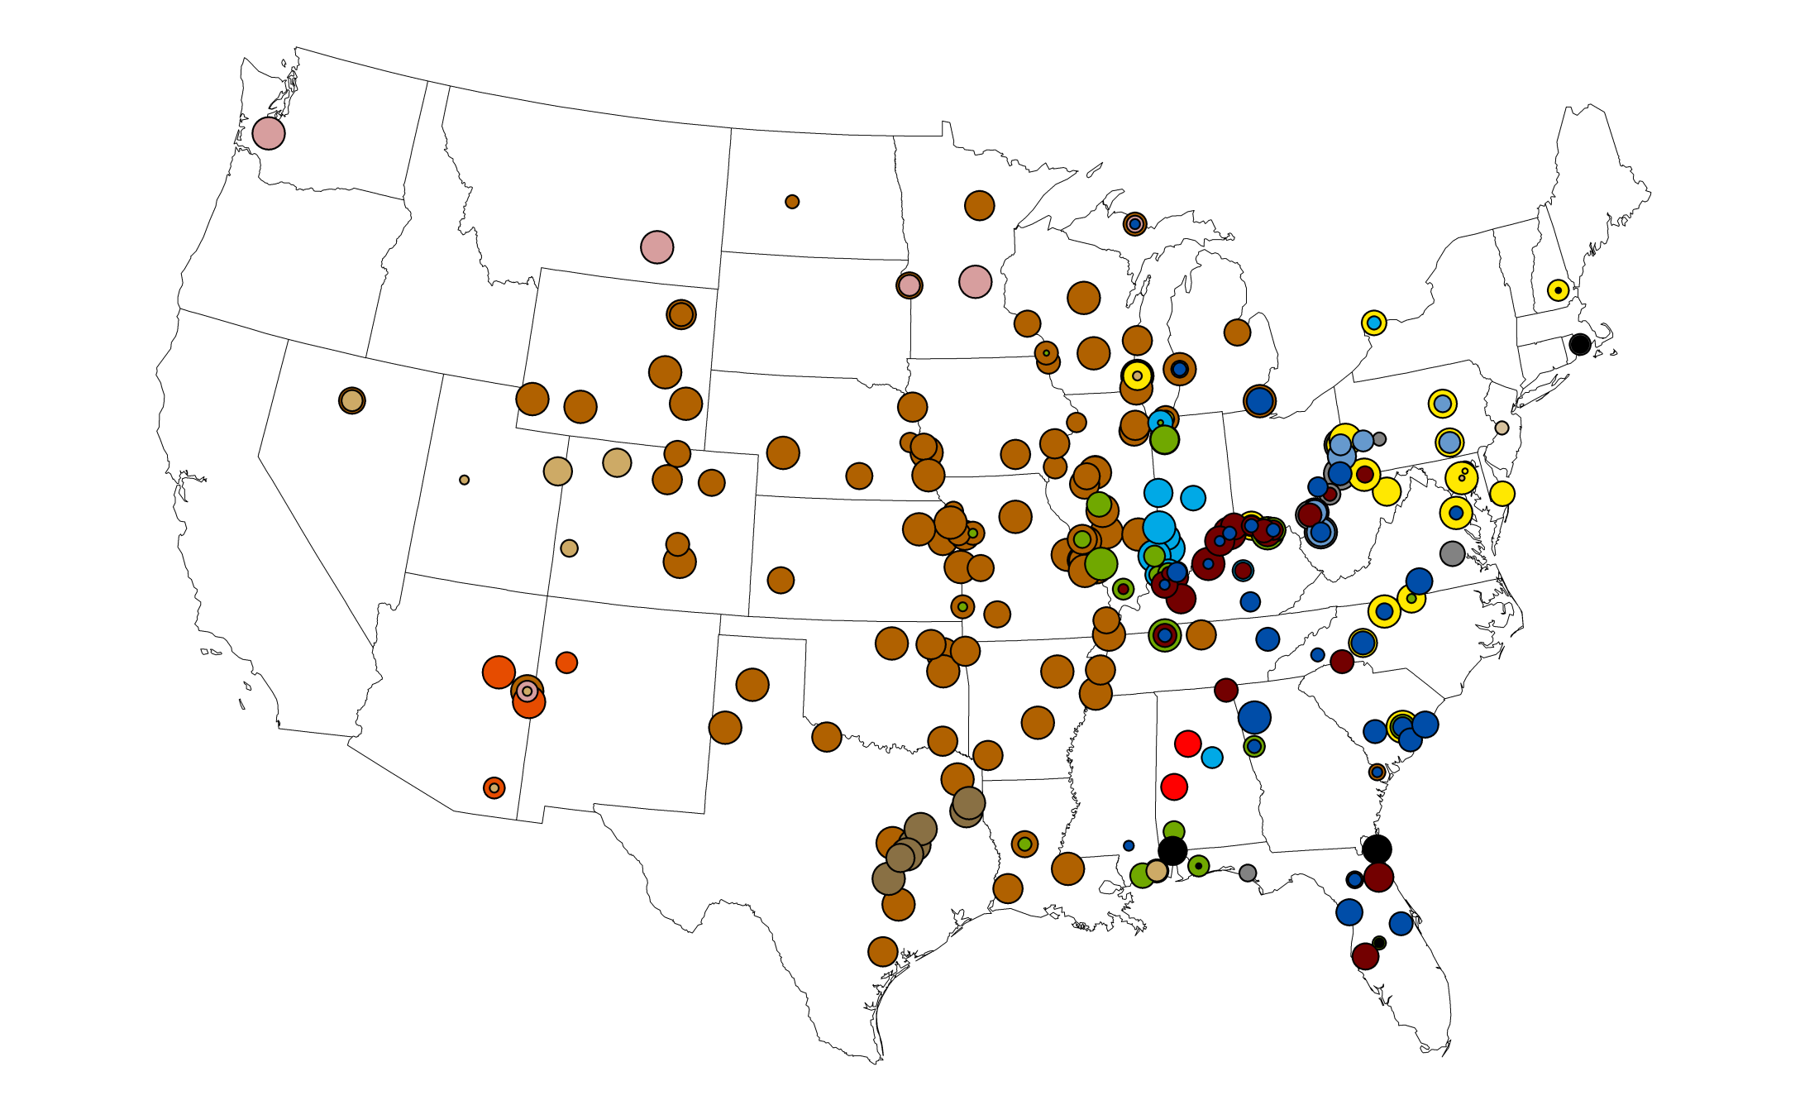
United States Coal Deliveries, 2025
2015 Forecast
Kentucky Energy Database, EEC-DEDI, 2015 energy.ky.gov

Slide 23
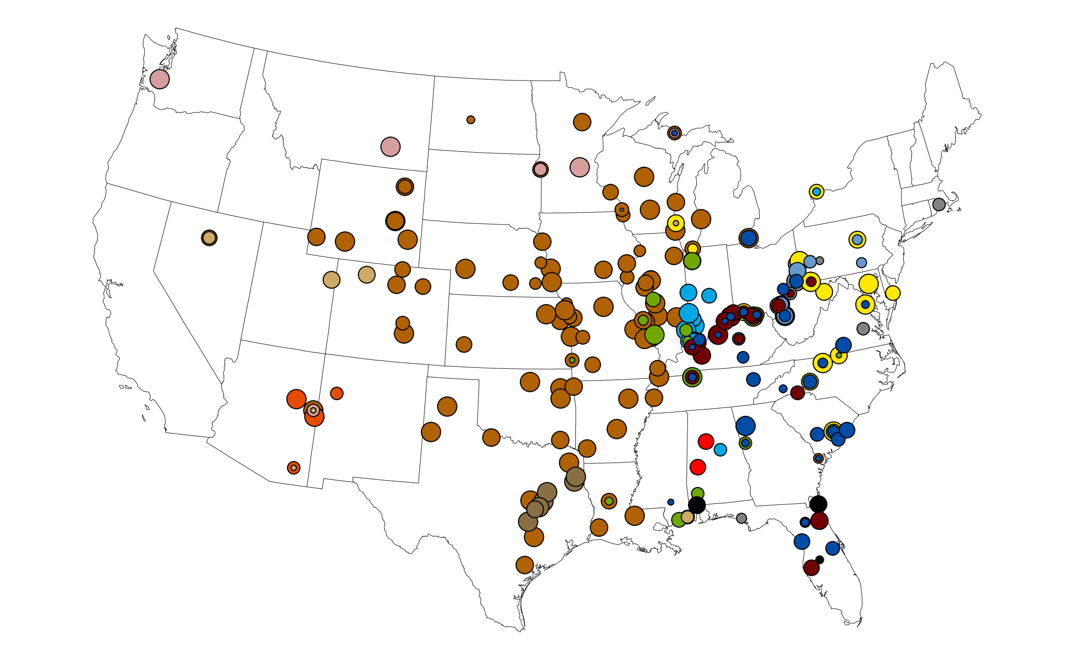
United States Coal Deliveries, 2030
2015 Forecast
Kentucky Energy Database, EEC-DEDI, 2015 energy.ky.gov

Slide 24
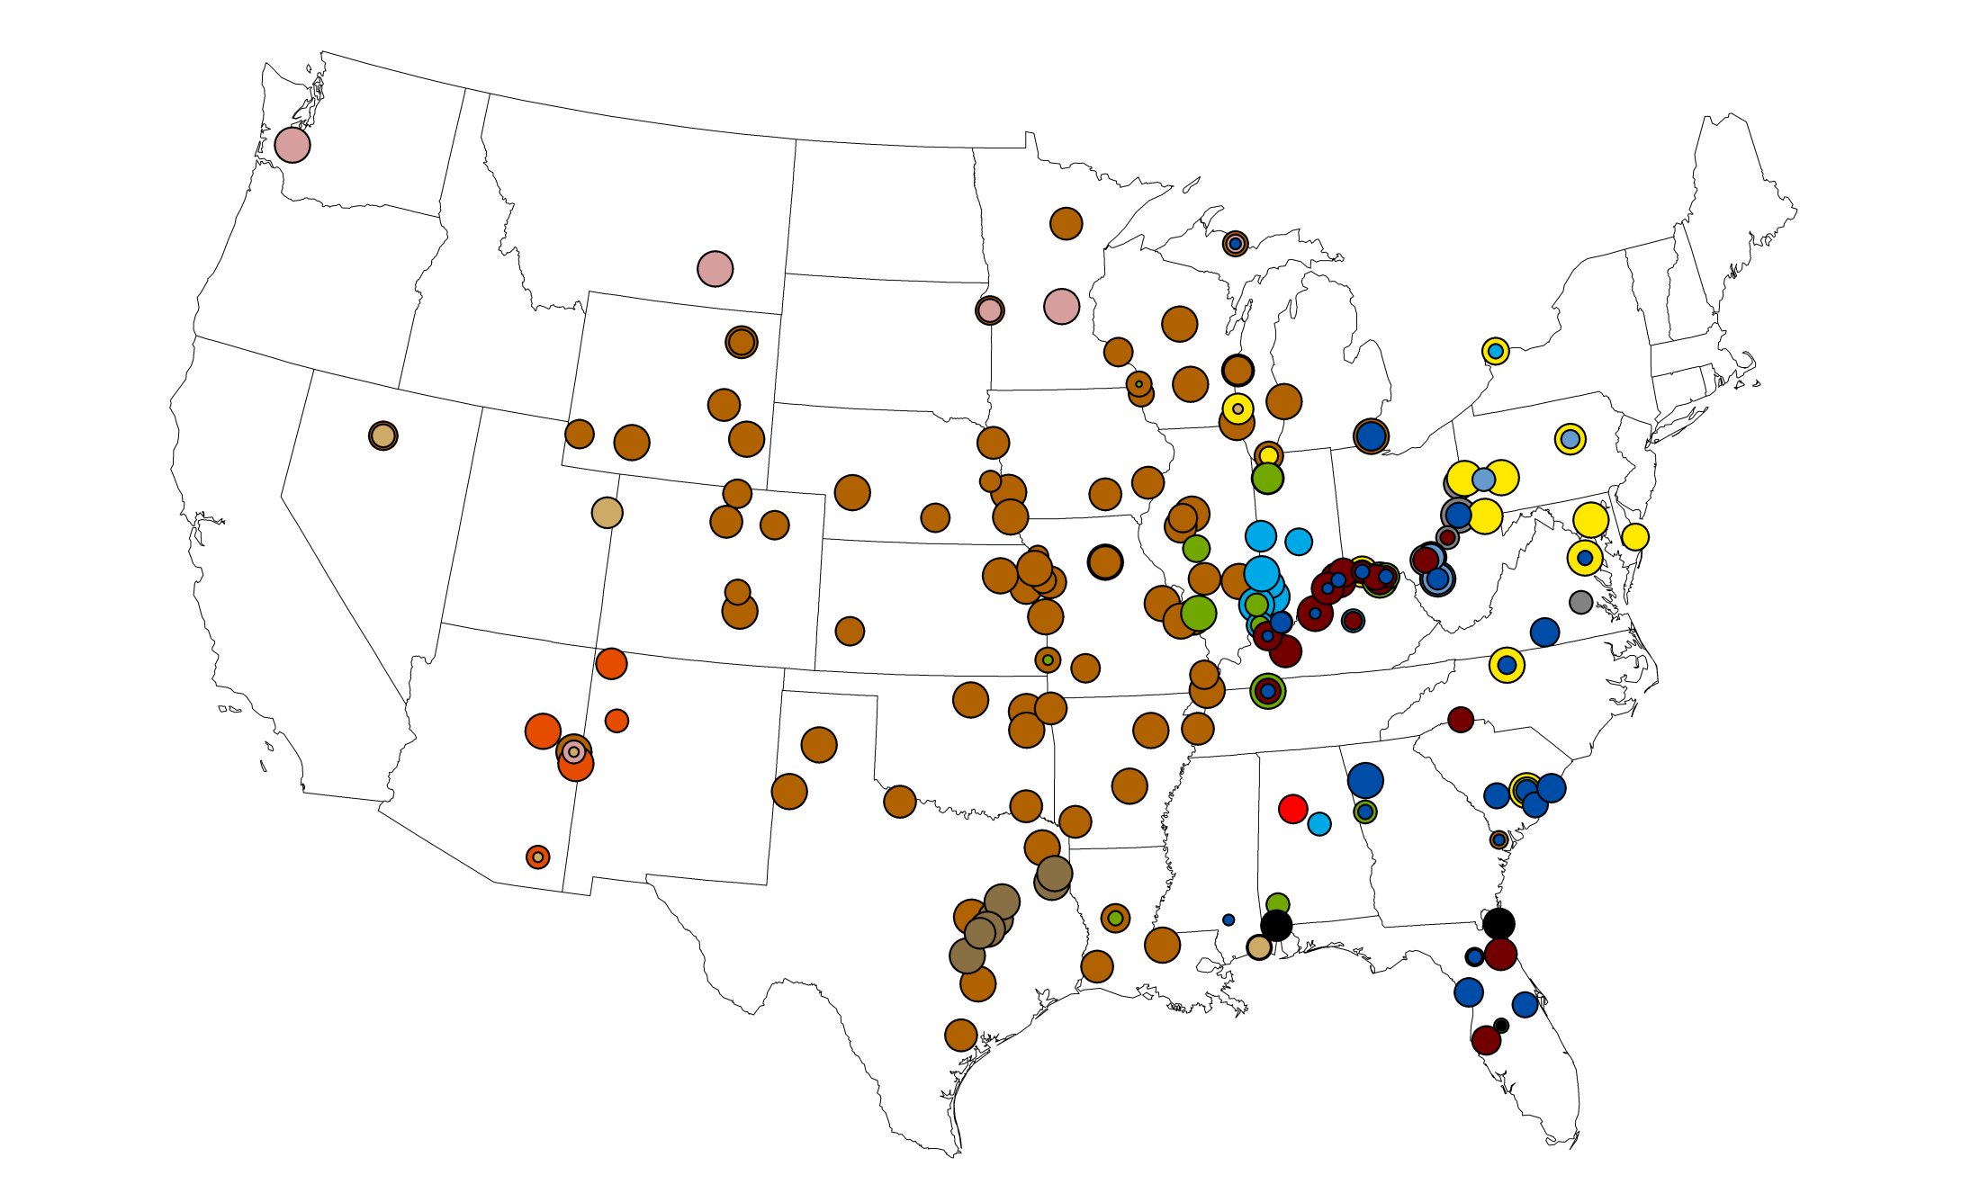
United States Coal Deliveries, 2035
2015 Forecast
Kentucky Energy Database, EEC-DEDI, 2015 energy.ky.gov

Slide 25
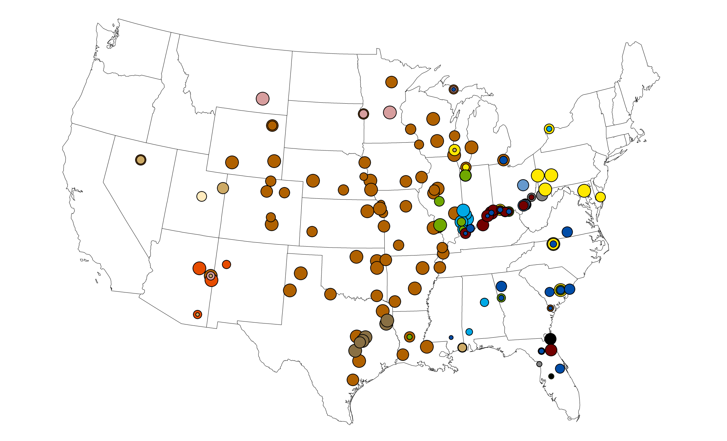
United States Coal Deliveries, 2040
2015 Forecast
Kentucky Energy Database, EEC-DEDI, 2015 energy.ky.gov

Slide 26
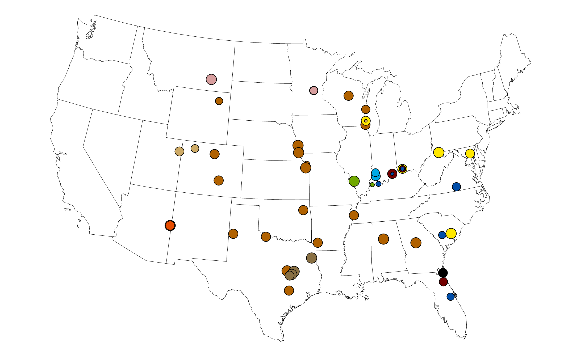
United States Coal Deliveries, 2050
2015 Forecast
Kentucky Energy Database, EEC-DEDI, 2015 energy.ky.gov

Slide 27
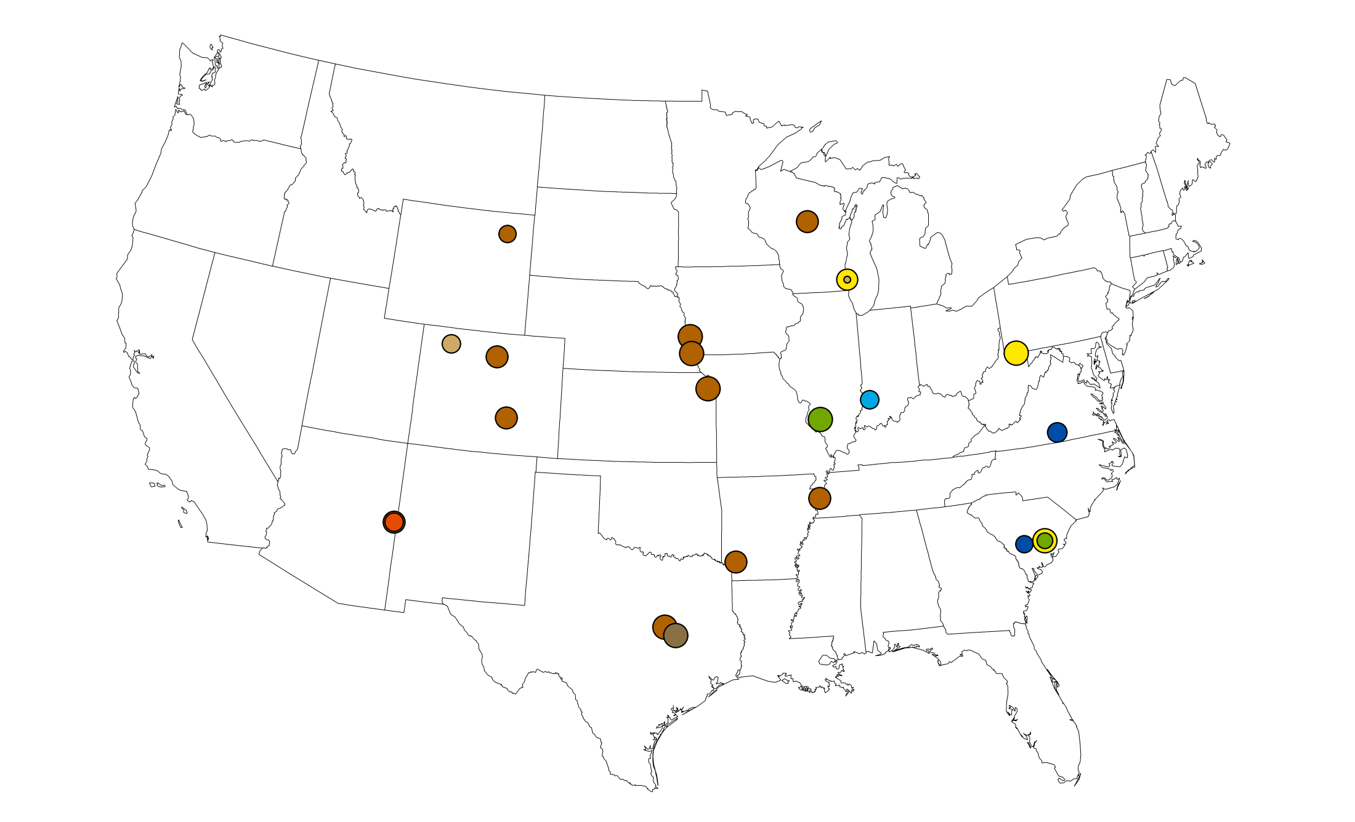
United States Coal Deliveries, 2060
2015 Forecast
Kentucky Energy Database, EEC-DEDI, 2015 energy.ky.gov

Slide 28
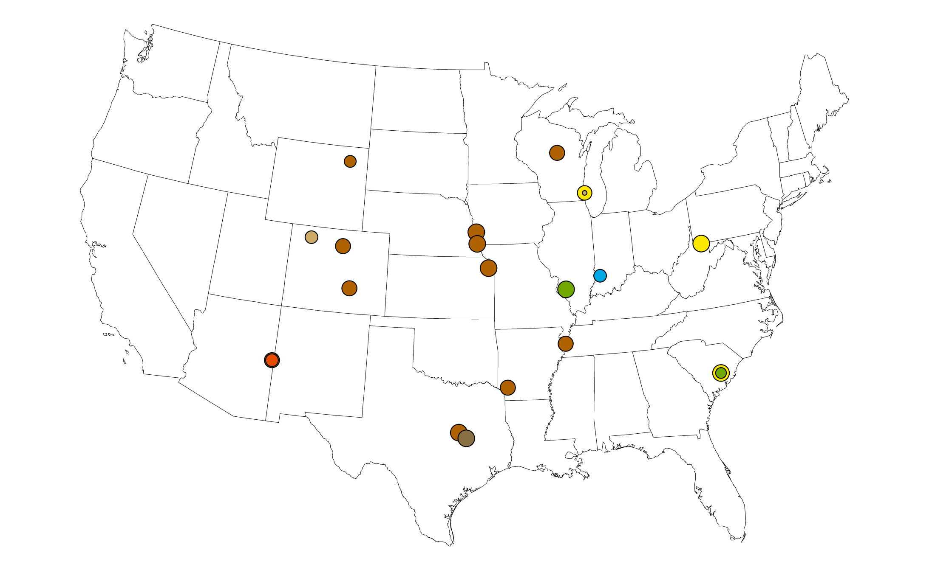
United States Coal Deliveries, 2070
2015 Forecast
Kentucky Energy Database, EEC-DEDI, 2015 energy.ky.gov

Slide 29
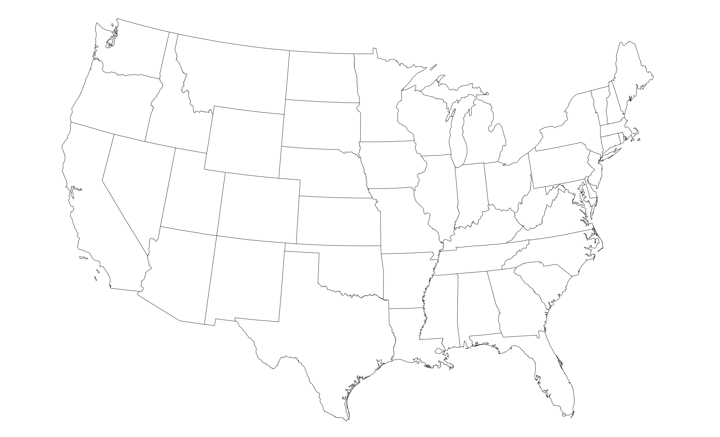
United States Coal Deliveries, 2080
2015 Forecast
Kentucky Energy Database, EEC-DEDI, 2015 energy.ky.gov

Slide 30
Contact Information
Aron Patrick
Assistant Director
Aron.Patrick@ky.gov
Adam Blandford
Energy Analyst
Kentucky Energy and Environment Cabinet
Department for Energy Development & Independence
502-564-7192
Twitter: @KentuckyEEC
Facebook: facebook.com/KentuckyEEC
Website: energy.ky.gov
30

